Slide 1
Week Date | Module / Topic | Writing | Key language
WEEK 7 11/12/23 | Holidays | Q1 photo description: using 'hay' + definite article (or number in digit) + noun, practising 3rd person singular and plural with 'estar' + adjectives (contento/triste) | En la foto hay un hombre / padre una mujer / madre un chico / niño una chica / niña unos padres unos chicos / niños unos abuelos Está + ADJ Están + ADJ contento / triste
 | Holidays | Q3 translation: focus on accuracy of key verbs in the preterite tense | fui jugué hice fue preterite tense -IR/ER/yo

Slide 2
Target 5 Writing
Session objectives: Question
knowing how to describe a photo for the writing paper Q1 Photo
being able to translate key verbs in the past tense Q3 Translation
Do Now:
Translate the sentences into English.
exemple: En la foto hay un hombre. = In the photo there is 1 man.
En la foto hay tres niños. =
En la foto hay unos abuelos. =
Hay un padre. =
Está contento. =
Escuché música. =
Fui al cine. =
Extra:
¿Cómo se dice …?
I played
I watched
I visited
I lived
I spoke
I thought

Slide 3
Target 5 Writing
Session objectives: Question
knowing how to describe a photo for the writing paper Q1 Photo
being able to translate key verbs in the past tense Q3 Translation
Do Now:
Translate the sentences into English.
exemple: En la foto hay un hombre. = In the photo there is 1 man.
En la foto hay tres niños. =
En la foto hay unos abuelos. =
Hay un padre. =
Está contento. =
Escuché música. =
Fui al cine. =
Extra:
¿Cómo se dice …?
I played
I watched
I visited
I lived
I spoke
I thought
jugué
In the photo there are 3 children.
vi
In the photo there are grandparents.
visité
There is a father.
viví
He is happy.
hablé
I listened to music.
pensé
I went to the cinema.

Slide 4
Target 5 Writing
Vocabulary – Photo task
People
Hay… There is/are…
1/2/3/4 personas 1/2/3 person/people
1/2/3 mujer(es) 1/2/3 woman/women
1/2/3 hombre(s) 1/2/3 man/men
1/2/3 niña(s) 1/2/3 girl(s)
1/2/3 niño(s) 1/2/3 boy(s)
2/3 niños 2/3 child(ren)
1/2/3 amigo/a(s) 1/2/3 friend(s)
Mood/Description
Está … she/he is
Están … they are
contento/a(s) happy
triste(s) sad
Es … she/he is
Son … they are
alto/a(s) tall
bajo/a(s) short
Weather
Hace…
buen tiempo good weather
mal tiempo bad weather
calor hot
frío cold

Slide 5
Target 5 Writing
Vocabulary
People
Hay… There is/are…
1/2/3/4 personas 1/2/3 person/people
1/2/3 mujer(es) 1/2/3 woman/women
1/2/3 hombre(s) 1/2/3 man/men
1/2/3 niña(s) 1/2/3 girl(s)
1/2/3 niño(s) 1/2/3 boy(s)
2/3 niños 2/3 child(ren)
1/2/3 amigo/a(s) 1/2/3 friend(s)
Mood/Description
Está … she/he is
Están … they are
contento/a(s) happy
triste(s) sad
Es … she/he is
Son … they are
alto/a(s) tall
bajo/a(s) short
Weather
Hace…
buen tiempo good weather
mal tiempo bad weather
calor hot
frío cold

Slide 6
Target 5 Writing
Listen to the teacher and write down the sentences in Spanish, using the sentence builder below:
example: En la foto hay un hombre.
_________________________ 5. ____________________________
_________________________ 6. ____________________________
_________________________ 7. ____________________________
_________________________ 8. ____________________________
Notes:
Keep sentences VERY simple: students can use ‘il y a’ 4 times and write numbers in digit. They will get full marks by doing so.

Slide 7
Target 5 Writing
Complete gaps in the sentences in Spanish, using the sentence builder below:
example: Hay 4 personas.
H__ 3 m________. 5. E___ t______.
H__ 2 a___________. 6. H____ b___ t_____.
H__ 5 h___________. 7. E___ a____.
H__ 3 n______. 8. H___ f____ .

Slide 8
Target 5 Writing
LAS RESPUESTAS – THE ANSWERS
example: Hay 4 personas.
H__ 3 m________. 5. E___ t______.
H__ 2 a___________. 6. H____ b___ t_____.
H__ 5 h___________. 7. E___ a____.
H__ 3 n______. 8. H___ f____ .
Hay 3 mujeres.
Está(n) triste(s).
Hay 2 amigos.
Hace buen tiempo.
Hay 5 hombres.
Es alto(s)/alta(s).
Hay 3 niños/niñas.
Hace frío.

Slide 9
Target 5 Writing
Without using the sentence builder, rewrite the words in the correct order to make a sentence:
example: personas / hay / 4
→ Hay 4 personas.
5 / hay / mujeres / _____________________________
hay / 2 / niñas _____________________________
están / contentos / muy _____________________________
bajos / son / bastante _____________________________
frío / hace / mucho _____________________________
Extra:
Translate the sentences 1-5 into English from memory.
Notes:
Il y a 5 femmes.
Il y a 2 garçons.
Elle est contente.
Ils sont petits.
Il fait froid.

Slide 10
Target 5 Writing
LAS RESPUESTAS – THE ANSWERS
5 / hay / mujeres / _____________________________
hay / 2 / niñas _____________________________
están / contentos / muy _____________________________
bajos / son / bastante _____________________________
frío / hace / mucho _____________________________
Hay 5 mujeres.
There are 5 women.
Hay 2 niñas.
There are 2 girls.
Están muy contentos.
They are very happy.
Son bastante bajos.
They are quite short.
Hace mucho frío.
It is very cold.
Extra:
Translate the sentences 1-5 into English from memory.
Notes:
Il y a 5 femmes.
Il y a 2 garçons.
Elle est contente.
Ils sont petits.
Il fait froid.

Slide 11
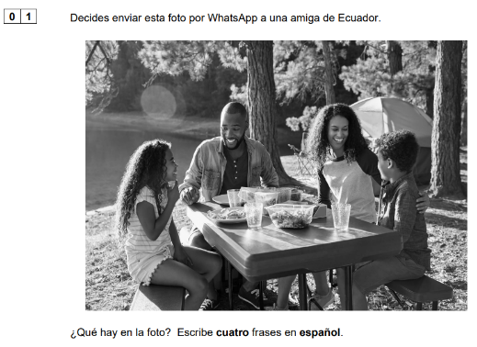
Target 5 Writing
The question 1 of the writing paper always asks:
¿Qué hay en la foto? Escribe cuatro frases en español.

Slide 12
Target 5 Writing
Let’s have a look at the mark scheme for question 1:
For 2 marks
• The response must be in the form of a sentence, using an appropriate conjugated verb.
• The same verb/grammatical structure may be repeated in more than one sentence, e.g. ‘hay’ plus different nouns.
Notes:
For 2 marks
• The response must be in the form of a sentence, using an appropriate conjugated verb. The only exception to this is in French, where voici/voilà may be used in place of a verb. The same verb/grammatical structure may be repeated in more than one sentence, eg il y a/es gibt/hay plus different nouns.
• Any sentence that is broadly relevant to the photo is given 2 marks. For example, imagine that the photo is of a man in a café. The student writes, in the target language: It’s a man. He’s old (even if to your eyes he may not be – ‘old’ to a 16-year old may be different from your perception of ‘old’). He’s a father (even if this is not apparent from the photo, it would potentially be true). He’s a teacher (he could be, for all we know).
• The first person of the verb is acceptable, for example: ‘I am/we are playing tennis’.
• There may be linguistic errors, but the message must be communicated without ambiguity.

Slide 13
Target 5 Writing
What do you think about this student’s answers?
How many marks will they get?
2
Hay una madre y 2 niños.
2
Hay 4 personas y están contentos.
1 – no verb
Mucha comida.
0 – (incorrect) single word
Comer.
Notes:
For 0 marks
• The message makes no sense.
• A second person of the verb is used, for example: ‘You are wearing a t-shirt’.
• A single word, unless it is a conjugated verb in Spanish or Italian (comen/mangiano).

Slide 14
Target 5 Writing
What could they have done to get full marks?
2
Hay una madre.
Hay una madre y 2 niños.
2
8 out of 8
FULL MARKS!
Hay 4 personas y están contentos.
Hay 2 niños.
2
Hay 4 personas.
Mucha comida.
2
Están contentos.
Comer.
Notes:
For 0 marks
• The message makes no sense.
• A second person of the verb is used, for example: ‘You are wearing a t-shirt’.
• A single word, unless it is a conjugated verb in Spanish or Italian (comen/mangiano).

Slide 15
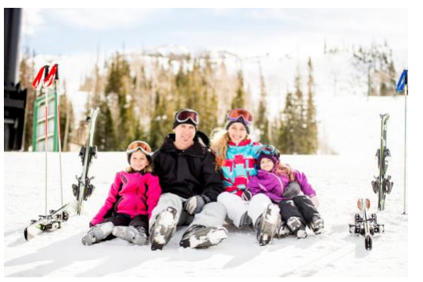
Target 5 Writing
Write 4 sentences in Spanish to describe the photo. Do so within the time!
End
3 minutes

Slide 16
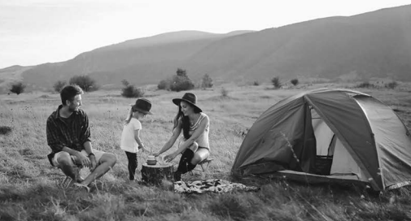
Target 5 Writing
Write 4 sentences in Spanish to describe the photo. Do so within the time!
End
3 minutes

Slide 17
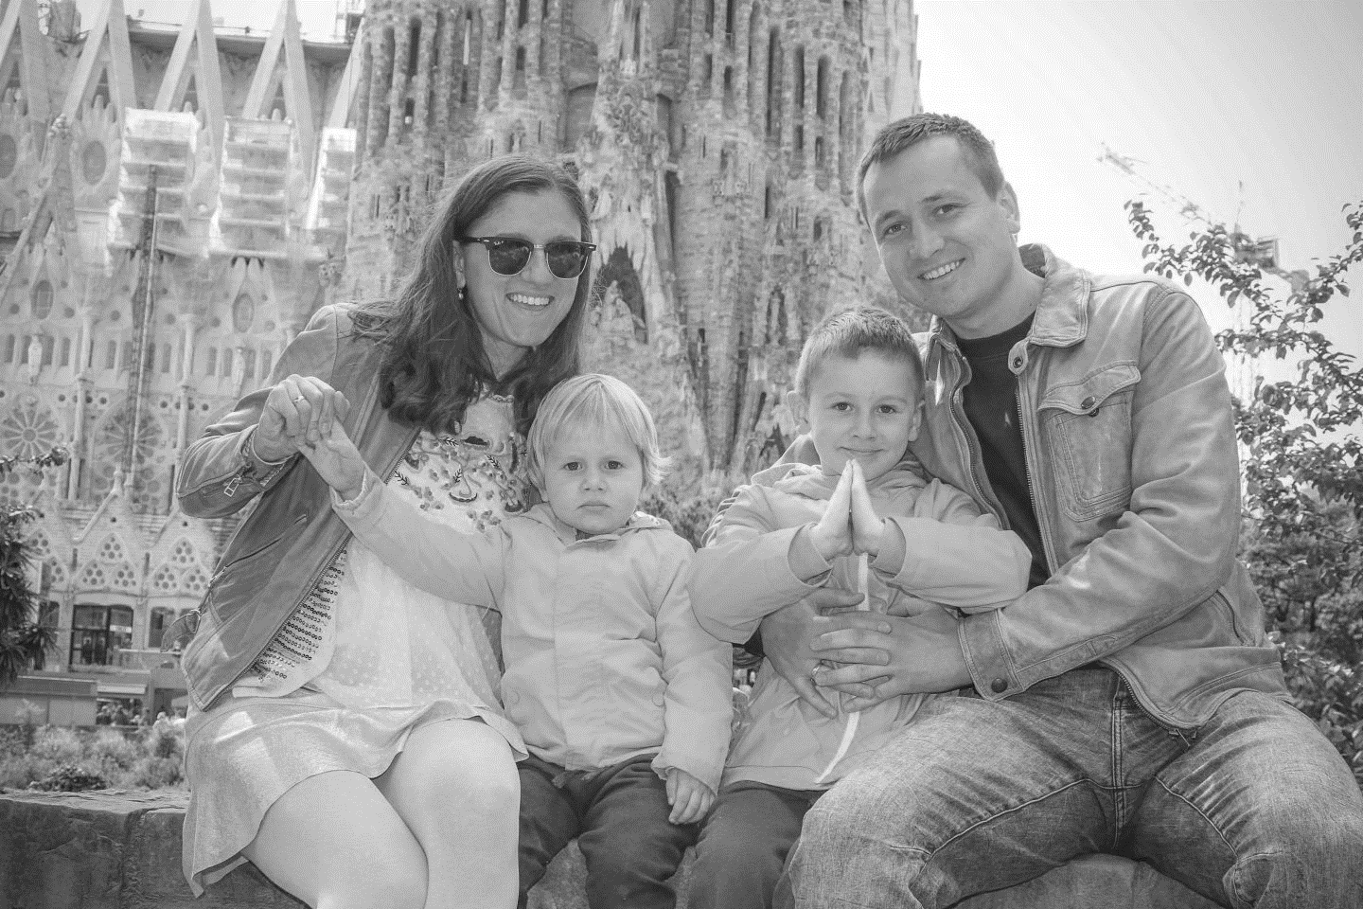
Target 5 Writing
Write 4 sentences in Spanish to describe the photo. Do so within the time!
End
3 minutes

Slide 18
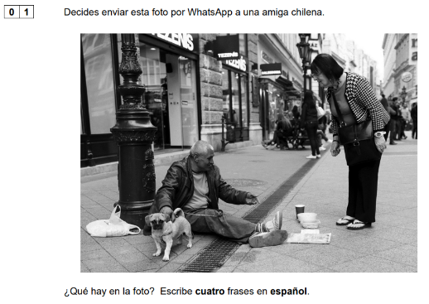
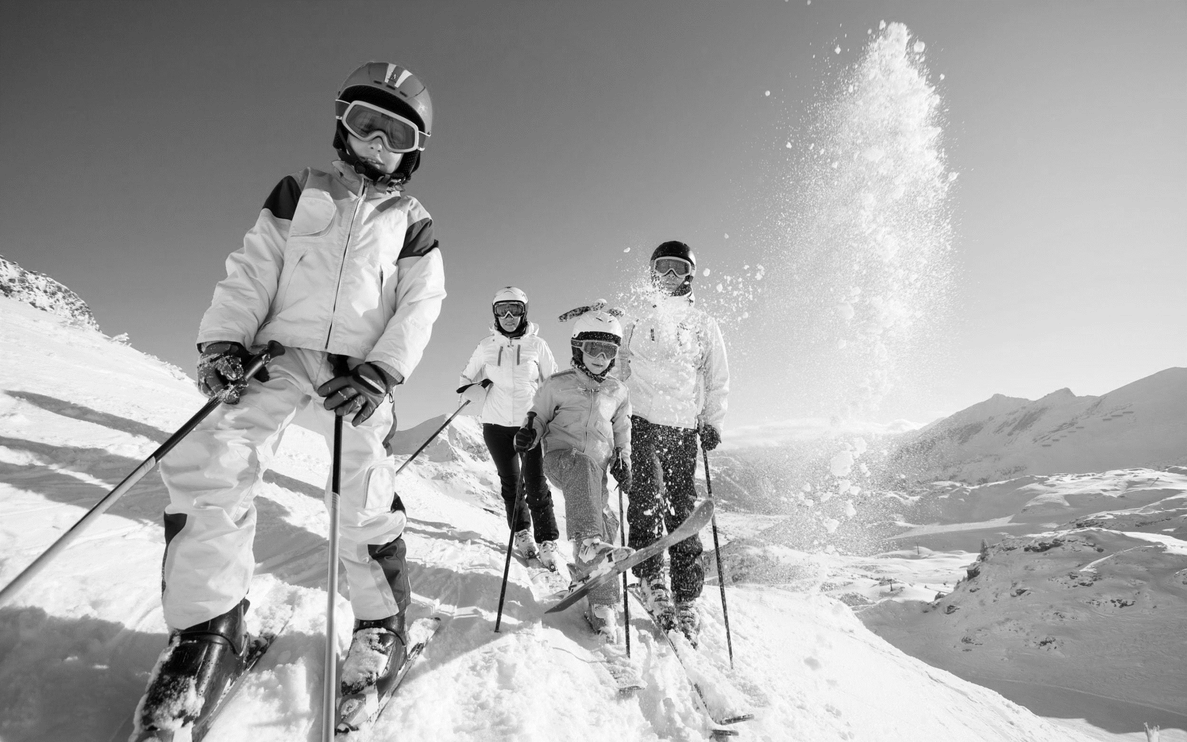
Exam question
Target 5 Writing
Now on your own!
End
3 minutes
Notes:
From June 2021

Slide 19
Target 5 Writing
Session objectives: Question
knowing how to describe a photo for the writing paper Q1 Photo
being able to translate key verbs in the past tense Q3 Translation

Slide 20
Target 5 Writing
This is how you will be assessed for the translation:
Conveying key messages (5 marks)
5: All key messages are conveyed.
4: Nearly all key messages are conveyed.
3: Most key messages are conveyed.
2: Some key messages are conveyed.
1: Few key messages are conveyed.
Application of grammatical knowledge of language and structures (5 marks)
5: Very good knowledge of vocabulary and structures; highly accurate.
4: Good knowledge of vocabulary and structures; generally accurate.
3: Reasonable knowledge of vocabulary and structures; more accurate than inaccurate.
2: Limited knowledge of vocabulary and structures; generally inaccurate.
1: Very limited knowledge of vocabulary and structures; highly inaccurate.
Today we will focus on this.
Notes:
Perfection is not required for full marks. For example, occasional missing accents and minor spelling errors do not preclude a top band mark. However, if there are numerous minor errors and incorrect use of accents which change the meaning of a word, this is likely to have an impact on the mark for Application of grammatical knowledge of language and structures.

Slide 21
Target 5 Writing
Grammar
Grammar
To describe actions in the past, we use the preterite tense. There are 3 steps.
What are they?
Choose a verb in the infinitive example: escuchar OR comer
Drop the last 2 letters of the infinitive example: escuchar OR comer
Add:
-é for AR verbs example: escuché
OR -í for ER/IR verbs example: comí
Now spot the errors and correct:
example: (yo) montar → Monté.
(yo) escuche _______________ 5. (yo) escribo ______________
(yo) trabajo _______________ 6. (yo) bebi ______________
(yo) nadaré _______________ 7. (yo) irí ______________
(yo) vivé _______________ 8. (yo) hacé ____________

Slide 22
Target 5 Writing
Grammar
LAS RESPUESTAS – THE ANSWERS
To describe actions in the past, we use the preterite tense. There are 3 steps.
What are they?
Choose a verb in the infinitive example: escuchar OR comer
Drop the last 2 letters of the infinitive example: escuchar OR comer
Add:
-é for AR verbs example: escuché
OR -í for ER/IR verbs example: comí
Now spot the errors and correct:
example: (yo) montar → Monté.
(yo) escuche _______________ 5. (yo) escribo ______________
(yo) trabajo _______________ 6. (yo) bebi ______________
(yo) nadaré _______________ 7. (yo) irí ______________
(yo) vivé _______________ 8. (yo) hacé ____________
escuché
trabajé
nadé
viví
escribí
bebí
fui
hice

Slide 23
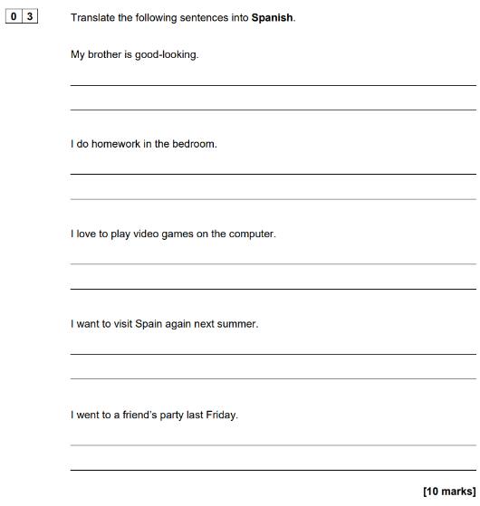
Target 5 Writing
This is what the translation question looks like.
Where is the sentence in the past tense?
The last sentence you need to translate is often in the past tense.
Ensure you read all the sentences first and identify where the sentence in the past tense is.
My brother is good-looking.
I do homework in the bedroom.
I love to play video games on the computer.
I want to visit Spain against next summer.
I went to a friend’s party last Friday.
Notes:
Nov 2021

Slide 24
Target 5 Writing
Identify where the sentence in the past tense is.
Sample set 1
I have a computer in my bedroom.
I watch the television with my sister.
We eat breakfast at eight o’clock.
I want to have a shower because it uses less water.
We went to the park last Sunday.
November 2020
I live in a white house.
I go to school on the bus.
I went to the swimming pool on Sunday.
I like to drink a lot of water.
My brother does not want to get married.
June 2022
I have a small garden.
I don’t like to do homework.
Yesterday I ate chicken and salad.
I am going to work in a sports centre.
My sister wants to visit the south of Spain in January.
Notes:
Spanish:
Sample set 1: I have a computer in my bedroom. I watch the television with my sister. We eat breakfast at eight o’clock. I want to have a shower because it uses less water. We went to the park last Sunday.
Nov 2020: I live in a white house. I go to school on the bus. I went to the swimming pool on Sunday. I like to drink a lot of water. My brother does not want to get married.
Nov 2021: My brother is good-looking. I do homework in the bedroom. I love to play video games on the computer. I want to visit Spain again next summer. I went to a friend’s party last Friday.
June 2022: I have a small garden. I don’t like to do homework. Yesterday I ate chicken and salad. I am going to work in a sports centre. My sister wants to visit the south of Spain in January.

Slide 25
Target 5 Writing
Vocabulary
Past tense time phrases
hoy today
ayer yesterday
(el) lunes/martes pasado last Monday/Tuesday
(el) miércoles on Wednesday
(el) jueves/viernes on Thursday/Friday
(el ) último sábado/domingo last Saturday/Sunday
la semana pasada last week
el año pasado last year
el fin de semana pasado last weekend
hace 2 años 2 years ago
hace 3 meses 3 months ago
Location
Fui I went
Jugué I played
al/en el parque to/in the park
al/en el insti to/in school
al/en el estadio to/in the stadium
al/en un partido to/at a match
al/en un restaurante to/in a restaurant
a/en la piscina to/in the swimming-pool
People
con… with
mi tío my uncle
mi tía my aunt
mis amigos/as my friends
mi hermano menor my younger brother
mi hermana mayor my older sister
Food
Comí … I ate
fruta(s)/verduras fruits/vegetables
pollo/pescado chicken/fish
una ensalada a salad
Notes:
Spanish:
Sample set 1: I have a computer in my bedroom. I watch the television with my sister. We eat breakfast at eight o’clock. I want to have a shower because it uses less water. We went to the park last Sunday.
Nov 2020: I live in a white house. I go to school on the bus. I went to the swimming pool on Sunday. I like to drink a lot of water. My brother does not want to get married.
Nov 2021: My brother is good-looking. I do homework in the bedroom. I love to play video games on the computer. I want to visit Spain again next summer. I went to a friend’s party last Friday.
June 2022: I have a small garden. I don’t like to do homework. Yesterday I ate chicken and salad. I am going to work in a sports centre. My sister wants to visit the south of Spain in January.

Slide 26
Target 5 Writing
Vocabulary
Past tense time phrases
hoy today
ayer yesterday
(el) lunes/martes pasado last Monday/Tuesday
(el) miércoles on Wednesday
(el) jueves/viernes on Thursday/Friday
(el ) último sábado/domingo last Saturday/Sunday
la semana pasada last week
el año pasado last year
el fin de semana pasado last weekend
hace 2 años 2 years ago
hace 3 meses 3 months ago
Location
fui I went
jugué I played
al/en el parque to/in the park
al/en el insti to/in school
al/en el estadio to/in the stadium
al/en un partido to/at a match
al/en un restaurante to/in a restaurant
a/en la piscina to/in the swimming-pool
People
con… with
mi tío my uncle
mi tía my aunt
mis amigos/as my friends
mi hermano menor my younger brother
mi hermana mayor my older sister
Food
Comí … I ate
fruta(s)/verduras fruits/vegetables
pollo/pescado chicken/fish
una ensalada a salad
Notes:
Spanish:
Sample set 1: I have a computer in my bedroom. I watch the television with my sister. We eat breakfast at eight o’clock. I want to have a shower because it uses less water. We went to the park last Sunday.
Nov 2020: I live in a white house. I go to school on the bus. I went to the swimming pool on Sunday. I like to drink a lot of water. My brother does not want to get married.
Nov 2021: My brother is good-looking. I do homework in the bedroom. I love to play video games on the computer. I want to visit Spain again next summer. I went to a friend’s party last Friday.
June 2022: I have a small garden. I don’t like to do homework. Yesterday I ate chicken and salad. I am going to work in a sports centre. My sister wants to visit the south of Spain in January.

Slide 27
Target 5 Writing
Listen to the teacher and write down the sentences in Spanish, using the sentence builder below:
example: Ayer jugué en el parque con mi tío.
_________________________ 5. ____________________________
_________________________ 6. ____________________________
_________________________ 7. ____________________________
_________________________ 8. ____________________________

Slide 28
Target 5 Writing
Choose the correct translations:
ENGLISH | 1 | 2 | 3
Last week I went to a match. | La semana pasada fue a un partido. | La semana pasada voy a un partido. | La semana pasada fui a un partido.
I played football in the park with my friends. | Jugue al fútbol en el parque con mis amigos. | Jugué al fútbol en el parque con mis amigos. | Jugué el fútbol en el parque con mis amigos.
Last Saturday, I celebrated my birthday. | Pasado sábado, celebré mis cumpleaños. | El sábado pasado, celebré mi cumpleaños. | El sábado pasado, celebrar mi cumpleaños.
Yesterday I ate a pizza. | Ayer comí una pizza. | Ayer como una pizza. | Hoy comí una pizza.
Today I went to school with my friends. | Hoy fui al colegio con mis amigos. | Hoy fui al insti con mis amigos. | Hoy fui al insti con mi amigo.
Last Monday I bought a book. | El último lunes compré un libro. | Lunes pasado comprí un libro. | Lunes pasado compré uno libro.
Last weekend I went to the stadium by train. | El fin de semana pasado fui al estadio por tren. | El fin de semana pasado fui al estadio para tren. | El fin de semana pasado fui al estadio en tren.
Notes:
.

Slide 29
Exam question
Target 5 Writing
Now on your own!
Yesterday I ate my homework.
Today I ate a lot of vegetables.
Last weekend I bought a mobile phone.
Last Monday I went to school by bus.
End
3 minutes
Notes:
All past paper questions:
Yesterday I did a lot of homework.
Today I ate a lot of vegetables.
Last weekend I bought a mobile phone.
Last Monday I went to school by bus.
+
Last week I went to a match with my uncle.
I played football in the park with my friends.
Last Saturday, I celebrated my birthday at a good restaurant.

Slide 30
Target 5 Writing
Exit Ticket
Unjumble the translations, by writing both Spanish and English sentences.
example: Ayer I ate una salad. = Ayer comí una ensalada. = Yesterday I ate a salad.
Last sábado, fui to the sport centre.
El year pasado, I visited mi tío en Spain.
La week pasada, jugué football with my amigos.

Slide 31
Week Date | Module / Topic | Speaking | Key language
WEEK 8 18/12/23 | School | Q1 role-play: understanding the tasks and knowing the question words | Usted está Usted habla / está hablando (con) quién cuándo / a qué hora cuánto/a/s dónde qué / cuál una opinión una razón una ventaja / desventaja
 | School and future studies | Q3 general conversation: producing contrasting opinions | pero sin embargo no obstante por un lado por otro lado a mi hermana le gusta a mi hermano le encanta a mi amigo no le gusta piensa que cree que

Slide 32
Target 5 Writing
Session objectives: Question
being able to give a variety of relevant justified opinions Q2 40-word
producing contrasting opinions Q4 90-word
Do Now:
Match the missing word to the correct gap.
interesante - deliciosa - divertido- calor- frío – me gusta
exemple: Me gusta ir a España porque es interesante.
En mi opinión el clima es bueno porque hace ___________.
Diría que ________ ver la tele durante las vacaciones.
No me gusta el tiempo. Llueve y hace _________.
Me encanta comer en un restaurante español porque la comida es _________________.
Pienso que el camping es muy ___________.
Extra:
List the different ways to express opinions used in the 5 sentences.

Slide 33
LAS RESPUESTAS – THE ANSWERS
Session objectives: Question
being able to give a variety of relevant justified opinions Q2 40-word
producing contrasting opinions Q4 90-word
Do Now:
Match the missing word to the correct gap.
interesante - deliciosa - divertido- calor- frío – me gusta
example: Me gusta ir a España porque es interesante.
En mi opinión el clima es bueno porque hace ___________.
Diría que ________ ver la tele durante las vacaciones.
No me gusta el tiempo. Llueve y hace _________.
Me encanta comer en un restaurante español porque la comida es _________________.
Pienso que el camping es muy ___________.
Extra:
List the different ways to express opinions used in the 5 sentences.
calor
me gusta
En mi opinión
Diría que
No me gusta
Me encanta
Pienso que
frío
deliciosa
divertido

Slide 34
Target 5 Writing
Vocabulary – 40-word question
Instructions – common phrases
Estás… You are…
de vacaciones on holiday
Escribes … You are writing…
una carta a letter
a tu amigo español to your Spanish friend
un blog a blog
Sobre … about…
tu vida your life
tu tiempo libre your free time
tu salud your health
tu instituto your school
Bullet points – common phrases/nouns
el tiempo/el clima the weather
los profesores the teachers
las redes sociales social networks
las asignaturas school subjects
los edificios the buildings
la comida the food
tu deporte favorito your favourite sport
tu desayuno típico your typical breakfast
tus actividades de vacaciones your holiday activities
las instalaciones the facilities
tus notas your grades
Key structures to use for the 40-word
me gusta(n) el/la/los/las I like (the)
me encanta(n) el/la/los/las I love (the)
no me gusta(n) el/la/los/las I do not like (the)
odio el/la/los/las. I hate (the)
pienso que es I think that it is
porque son because they are
interesante(s) interesting
genial(es) great
divertido/a(s) fun
terrible(s) terrible
horrible(s) horrible
aburrido/a(s) boring
☺
☹

Slide 35
Target 5 Writing
1 | 2 | 3 | 4 | 5
me gusta(n) el/la/los/las
me encanta(n) el/la/los/las
no me gusta(n)el/la/los/las
odio el/la/los/las
tiempo
profesores
redes sociales
asignaturas
edificios
comida
deportes
desayuno
actividades de vacaciones
pienso que
porque
es
son
interesante(s)
genial
divertido/a(s)
terrible(s)
horrible(s)
aburrido/a(s)
Listen to the teacher and write down the sentences in Spanish, using the sentence builder above:
____________________________________________________________________
____________________________________________________________________
____________________________________________________________________
____________________________________________________________________
____________________________________________________________________

Slide 36
LAS RESPUESTAS – THE ANSWERS
Target 5 Writing
1 | 2 | 3 | 4 | 5
me gusta(n) el/la/los/las
me encanta(n) el/la/los/las
no me gusta(n)el/la/los/las
odio el/la/los/las
tiempo
profesores
redes sociales
asignaturas
edificios
comida
deportes
desayuno
actividades de vacaciones
pienso que
porque
es
son
interesante(s)
genial(es)
divertido/a(s)
terrible(s)
horrible(s)
aburrido/a(s)
Listen to the teacher and write down the sentences in Spanish, using the sentence builder above:
____________________________________________________________________
____________________________________________________________________
____________________________________________________________________
____________________________________________________________________
____________________________________________________________________
Odio las redes sociales, pienso que son horribles.
Me encanta el tiempo porque es genial.
No me gustan los edificios porque son horribles.
Me encantan los profesores porque son interesantes.
Me gusta la comida porque es genial.

Slide 37
Target 5 Writing
Grammar
Grammar
«me gusta» versus « me gustan»
When you justify your opinion, you will need to pay attention to the following:
if the noun is singular, you must use « me gusta » to say ‘I like’.
example: me gusta la geografía.
if the noun is plural, you must use « me gustan» to say ‘I like’.
example: me gustan las redes sociales.
Note that the same happens with « me encanta » and « me encantan ».
Note that « odio » and « prefiero » are not affected and do not take « me » at
the beginning.
Give an opinion, carefully choosing the singular or plural version
el chocolate…
las ciencias…
la biología…
los profesores…

Slide 38
Target 5 Writing
Grammar
Grammar
«me gusta» versus « me gustan»
When you justify your opinion, you will need to pay attention to the following:
if the noun is singular, you must use « me gusta » to say ‘I like’.
example: me gusta la geografía.
if the noun is plural, you must use « me gustan» to say ‘I like’.
example: me gustan las redes sociales.
Note that the same happens with « me encanta » and « me encantan ».
Note that « odio » and « prefiero » are not affected and do not take « me » at
the beginning.
Give an opinion, carefully choosing the singular or plural version
el chocolate…
las ciencias…
la biología…
los profesores…
me gusta / me encanta
me gustan / me encantan
me gusta / me encanta
me gustan / me encantan

Slide 39
Target 5 Writing
Grammar
Grammar
«es» versus « son»
When you justify your opinion, you will need to pay attention to the following:
if the noun is singular, you must use « es » in the justification.
example: me encanta la geografía porque es interesante.
if the noun is plural, you must use « son» in the justification.
example: me encantan las redes sociales porque son divertidas.
Note that your adjective will need to also be plural.
Justify each of the opinions, carefully choosing «es» or «son»
Me gusta el chocolate…
Me gustan las ciencias…
Para mí la biología…
No me gustan los profesores…
Pienso que las asignaturas…

Slide 40
Target 5 Writing
Grammar
LAS RESPUESTAS – THE ANSWERS
«es» versus « son»
When you justify your opinion, you will need to pay attention to the following:
if the noun is singular, you must use « es » in the justification.
example: me encanta la geografía porque es interesante.
if the noun is plural, you must use « son» in the justification.
example: me encantan las redes sociales porque son divertidas.
Note that your adjective will need to also be plural.
Justify each of the opinions, carefully choosing «es» or «son»
Me gusta el chocolate…
Me gustan las ciencias…
Para mí la biología…
No me gustan los profesores…
Pienso que las asignaturas…
porque es delicioso.
porque son interesantes.
es aburrida.
son estrictos.
son variadas.

Slide 41
Target 5 Writing
1 | 2 | 3 | 4 | 5
☺
interesante(s)
genial(es)
divertido/a(s)
terrible(s)
horrible(s)
aburrido/a(s)
me gusta(n) el/la/los/las
me encanta(n) el/la/los/las
no me gusta(n)el/la/los/las
odio el/la/los/las
tiempo
profesores
redes sociales
asignaturas
edificios
comida
deportes
desayuno
actividades de vacaciones
pienso que
porque
es
son
☺
☹
☹
Correct the sentences:
example: No me gustan la comida porque es horrible. → No me gusta la comida porque...
1. Me encanta el desayuno porque son delicioso. (1)
2. Me odio las redes sociales, pienso que son divertidas. (1)
3. Me gustan los profesores porque es interesantes. (1)
4. No me gusta los edificios, pienso que son feos. (1)
5. Me prefiero las actividades de vacaciones porque es genial. (3)

Slide 42
Target 5 Writing
LAS RESPUESTAS – THE ANSWERS
☺
interesante(s)
genial(es)
divertido/a(s)
terrible(s)
horrible(s)
aburrido/a(s)
me gusta(n) el/la/los/las
me encanta(n) el/la/los/las
no me gusta(n)el/la/los/las
odio el/la/los/las
tiempo
profesores
redes sociales
asignaturas
edificios
comida
deportes
desayuno
actividades de vacaciones
pienso que
porque
es
son
☺
☹
☹
Correct the sentences:
example: No me gustan la comida porque es horrible. → No me gusta la comida porque...
1. Me encanta el desayuno porque son delicioso. (1)
2. Me odio las redes sociales, pienso que son divertidas. (1)
3. Me gustan los profesores porque es interesantes. (1)
4. No me gusta los edificios, pienso que son feos. (1)
5. Me prefiero las actividades de vacaciones porque es genial. (3)
es
Odio
son
gustan
Prefiero
son geniales

Slide 43
Target 5 Writing
Estás de vacaciones. Escribes una carta a tu amigo español sobre tus vacaciones:
Tu destino
El camping
El clima
La comida
Escribe aproximadamente 40 palabras en español.
Me gusta mi destino de vacaciones porque es genial.
Odio el camping porque es horrible.
Prefiero el hotel porque es cómodo.
Me encanta el clima porque hace calor.
No me gusta la comida de vacaciones porque no es deliciosa.
=34 words.
=40 words.
When writing your 40-word answer, you should aim to:
- use simple language
- communicate clearly
- answer each bullet point
You can do this by giving a relevant justified opinion about each bullet point.

Slide 44
Target 5 Writing
What do you think about this student’s answers?
Tu destino
El camping
El clima
La comida
Odio el camping porque en mi opinión es muy aburrido. Prefiero un hotel ya que es más cómodo. Sin embargo, me encanta la comida de vacaciones dado que es muy deliciosa. Me gusta la fruta porque es muy fresca.
38 words
✓
✓
Content out of 10: A minimum number of bullet points must be covered for the award of marks for Content, as follows:
•9-10 marks: 4 bullet points
•5-8 marks: 3 bullet points
•3-4 marks: 2 bullet points
•1-2 marks: 1 bullet point
Language out of 6:
• 5-6: Uses a variety of appropriate vocabulary and grammatical structures. Generally accurate.
• 3-4: Vocabulary and grammatical structures generally appropriate to the task, with some attempt at variety. More accurate than inaccurate.
You must cover the 4 bullet points to get full marks!
Notes:
1–2
Vocabulary and structures used may be limited, repetitive or inappropriate. There may be frequent errors.
0
The language produced does not meet the standard required for Level 1 at this tier.

Slide 45
Target 5 Writing
The secret key to covering all 4 bullet points!
You do not have to lose mark for content, just because you don’t know what a bullet point means. The secret? Use:
an opinion phrase + the words from + a justification with a the bullet point general adjective
Example: Me gusta el alojamiento porque es interesante.
El alojamiento
Notes:
1–2
Vocabulary and structures used may be limited, repetitive or inappropriate. There may be frequent errors.
0
The language produced does not meet the standard required for Level 1 at this tier.

Slide 46
Target 5 Writing
For each of these obscure bullet points, use the secret key to write a simple opinion:
los viajes escolares
las asignaturas
las instalaciones
el tiempo
las reglas
la amistad
Me encantan los viajes escolares son divertidos.
No me gustan las asignaturas porque son aburridas.
Pienso que las instalaciones son muy útiles.
En mi opinión el tiempo es genial.
Odio las reglas porque son horribles.
Me encanta la amistada ya que es genial.
You now know how to fool the examiners!
Notes:
1–2
Vocabulary and structures used may be limited, repetitive or inappropriate. There may be frequent errors.
0
The language produced does not meet the standard required for Level 1 at this tier.

Slide 47
Target 5 Writing
Use all the phrases given to write a 40-word answer to this question:
Para el desayuno
No me gustan
comer tostadas y fruta.
Me encanta la comida basura
Escribe un blog sobre la salud.
Menciona:
• tu desayuno típico
• tu deporte favorito
• la comida basura
• los cigarrillos
Escribe aproximadamente 40 palabras en español.
son aburridos y malsanos
divertido.
me encanta
Me encanta jugar al
baloncesto porque es
es deliciosa.
los cigarrillos porque
pienso que

Slide 48
Target 5 Writing
LAS RESPUESTAS – THE ANSWERS
comer tostadas y fruta.
No me gustan
comer tostadas y fruta.
Para el desayuno
No me gustan
Me encanta la comida basura
Para el desayuno
Me encanta la comida basura
• tu desayuno típico
• tu deporte favorito
• la comida basura
• los cigarrillos
son aburridos y malsanos
divertido.
son aburridos y malsanos
divertido.
Para el desayuno me encanta comer tostadas y fruta.
Me encanta jugar al baloncesto porque es divertido.
Me encanta la comida basura pienso que es genial.
No me gustan los cigarrillos porque son aburridas y malsanas.
me encanta
me encanta
Me encanta jugar al
Me encanta jugar al
es deliciosa.
baloncesto porque es
es deliciosa.
baloncesto porque es
los cigarrillos porque
los cigarrillos porque
pienso que
pienso que

Slide 49
Exam question
Target 5 Writing
Now on your own!
Apply all the strategies:
- if you don’t know a bullet point, use the secret key!
- pay attention to “es” versus “son”
Escribe un blog sobre tu instituto.
Menciona:
• las asignaturas
• los profesores
• los edificios
• la comida
Escribe aproximadamente 40 palabras en español.
(Total 16 marks)
Aim to:
- use simple language
- communicate clearly
- answer each bullet point
Give a relevant justified opinion about each bullet point.
10 minutes
Notes:
From June 2021

Slide 50
Target 5 Writing
Session objectives: Question
being able to give a variety of relevant justified opinions Q2 40-word
producing contrasting opinions Q4 90-word

Slide 51
Target 5 Writing
Vocabulary – 90-word question
Past time phrases
ayer por la tarde yesterday (evening)
el fin de semana pasado last weekend
el sábado pasado last Saturday
la semana pasada last week
recientemente recently
un(a) … reciente a recent …
Future time phrases
el próximo … / que viene next …
en el futuro in the future
para tus próximo/as … for your next …
Bullet points – common vocabulary
tus relaciones your relationships
tus proyectos/planes your projects
tus actividades your activities
tu opinión de/sobre your opinion about
tu … preferido/a your favourite …
tu preferencia … your preference for …
quieres you want
lo que te gusta what you like
Sequencers
primero first
después after
luego then
finalmente finally
Conjunctions
dado que given that
ya que because
además in addition
pero but
sin embargo however
no obstante nevertheless
también also
Opinion phrases
prefiero I prefer
en mi opinión in my opinion
diría que I would say that
creo que I believe that
pienso que I think that
Adjectives
emocionante exciting
fascinante fascinating
entretenido entertaining
Key verbs:
fui I went
visité I visited
era it was
me gustaría/quisiera + INF
I would like to + verb
sería it would be
si pudiera if I could

Slide 52
Target 5 Writing
Tick the correct category for each bullet point:
Bullet point | Past | Opinion | Future
tu red social preferida
tus actividades en tu móvil ayer
tus planes con tus amigos el fin de semana pasado.
tu opinión de hacer compras
tu transporte favorito para ir al centro
una visita a las tiendas el sábado pasado
tus actividades en tu ciudad el fin de semana que viene
tu opinión de las reglas escolares
tu club extraescolar favorito
un día escolar la semana pasada
la profesión que quieres hacer en el futuro
tu opinión del uniforme
el almuerzo ayer
un viaje escolar en el futuro
✓
Notes:
Step 1 – reading the BPs and identifying where the past, future and opinion are

Slide 53
Target 5 Writing
LES RÉPONSES – THE ANSWERS
Bullet point | Past | Opinion | Future
tu red social preferida
tus actividades en tu móvil ayer
tus planes con tus amigos el fin de semana pasado.
tu opinión de hacer compras
tu transporte favorito para ir al centro
una visita a las tiendas el sábado pasado
tus actividades en tu ciudad el fin de semana que viene
tu opinión de las reglas escolares
tu club extraescolar favorito
un día escolar la semana pasada
la profesión que quieres hacer en el futuro
tu opinión del uniforme
el almuerzo ayer
un viaje escolar en el futuro
✓
✓
✓
✓
✓
✓
✓
✓
✓
✓
✓
✓
✓
✓
✓
Notes:
Step 1 – reading the BPs and identifying where the past, future and opinion are

Slide 54
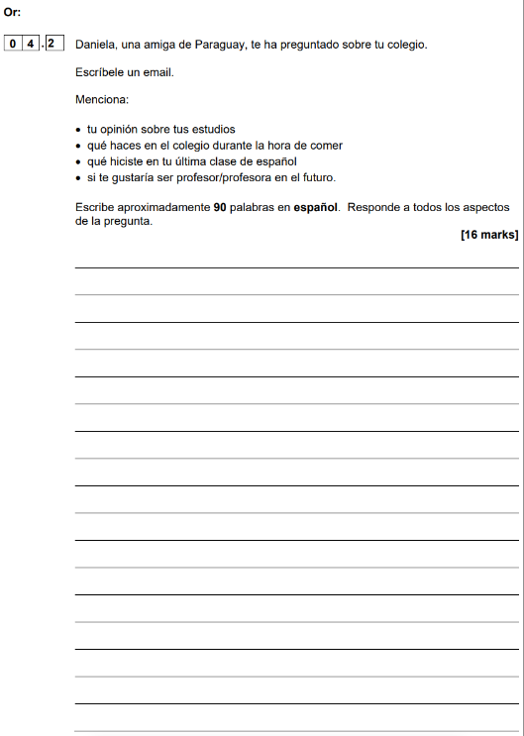
Target 5 Writing
Taking it one step at a time makes the difference!
First focus on writing 10 words per bullet point
Skip 3 lines between each answer!
(That’s so you can add more details later)
You reached 38 words!
Now go back and try to add 10 more words per bullet points by:
adding an extra or contrasting opinion
adding an extra activity
And just like that, you reached 77 words!
Me gustan mis estudios porque son interesantes.
Durante la hora de comer, juego al fútbol.
En mi última clase de español, estudié mucho.
Era muy fácil.
Me gustaría ser profe en el futuro ya que
es bien pagado.
Me encanta el español dado que mi profe es muy buena.
Sin embargo, no como nada porque la comida en mi insti es horrible.
Además, repasé para los exámenes.
Sin embargo no me gustaría ser médico porque es difícil.
Notes:
Step 2 – start by giving a relevant answer to each bullet point – transfer what has been learnt on 40-word by giving a relevant justified opinion about each BP.

Slide 55
Target 5 Writing
Taking it one step at a time makes the difference!
When word count matters, remember that you can:
gain 3 words by saying who you do an activity with (con mi familia, con mis amigos)
gain 2-3 words by saying where (al/en el cine, al/en el parque)
gain 2-3 by adding time expressions (el fin de semana pasado, el próximo año …)
And now you have 89 words!!!
Me gustan mis estudios porque son interesantes. Me encanta el español dado que mi profe es muy buena.
Durante la hora de comer, juego al fútbol con mis amigos en el patio. Sin embargo, no como nada porque la comida en el comedor de mi insti es horrible.
En mi última clase de español, estudié mucho. Era muy fácil. Además, repasé para los exámenes la semana pasada.
Me gustaría ser profe en el futuro ya que es bien pagado. Sin embargo, no me gustaría ser médico porque es difícil.
Notes:
Step 2 – start by giving a relevant answer to each bullet point – transfer what has been learnt on 40-word by giving a relevant justified opinion about each BP.

Slide 56
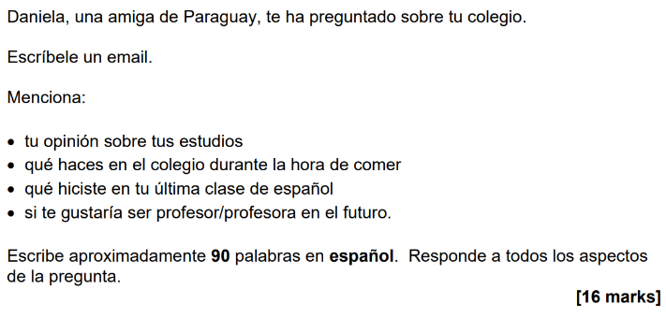
Target 5 Writing
When writing your 90-word answer, start by:
either giving a relevant justified opinion about each bullet point like you would do for the 40-word
or a relevant point (rather than an opinion) if it makes more sense.
Notes:
Step 2 – start by giving a relevant answer to each bullet point – transfer what has been learnt on 40-word by giving a relevant justified opinion about each BP.

Slide 57
Target 5 Writing
Grammar
Grammar
The words I need to change in my answers!
Just like in the speaking role-play, you will need to change words in the bullet points, addressing you. Remember:
‘tú’ + verb must change to « yo » and correct verb form
‘usted’ + verb must change to « yo » and correct verb form
‘tu’, ‘su’ must change to « mi »
‘tus’ and ‘sus’ must change to « mis »
‘te’ and ‘le’ must change to « me »

Slide 58
Target 5 Writing
Grammar
Grammar
Produce an initial short, simple answer for each bullet point, making sure that you do not repeat the references to ‘you’ or ‘your’.
Me gustan mis estudios …
Juego al fútbol…
Hice mucho trabajo
En el futuro me gustaría…
Recientemente con mi familia fui …
En mi opinión el matrimonio es …
Con el ordenador, hago mis deberes
En el futuro me gustaría…

Slide 59
Target 5 Writing
= 45 words
Durante un día de excursión con mi colegio fui al museo de arte.
Mi profe ideal es un profe muy simpático e interesante.
En mi opinión, creo que los exámenes son bastante estresantes.
El año próximo voy a estudiar el español porque es muy fascinante.
Era muy emocionante porque visité la sección de arte contemporánea.
Sin embargo mi profe ideal no sería super estricto.
Además pienso que son demasiado difíciles a veces.
Pero si no saco buenas notas, me gustaría estudiar el arte porque es mi asignatura favorita.
=88 words.
To reach 90 words, add an opinion or a contrasting opinion.
Notes:
Step 3 – add contrastive opinions to get to 90 words

Slide 60
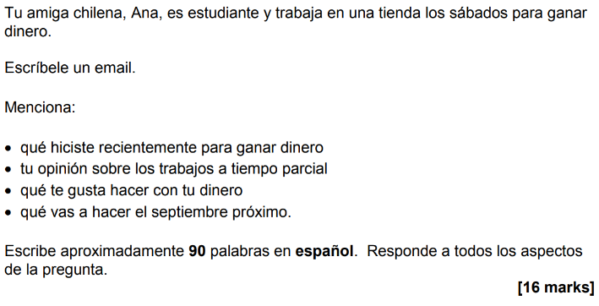
Target 5 Writing
PA
OP
OP
FU
Read the bullet points and identify which one is in the past (PA), which one is in the future (FU), and which one requires an opinion (OP).
Use the following sentence starters to start answering each bullet points.
Recientemente para ganar dinero … Gané …
En mi opinión, creo que los trabajos a tiempo parcial son …
Con mi dinero me gusta …
El septiembre próximo voy a …
5 minutes

Slide 61
Exam question
Target 5 Writing
Now on your own!
Apply all the strategies:
start by producing 10w per bullet points and skip 3 lines
remove all references to ‘you’
build-up 10 extra words by giving extra/contrasting opinions, add an extra activity, say who with, where
Aim to:
- use simple language
- communicate clearly
- answer each bullet point
Give a relevant justified opinion about each bullet point.
10 minutes
Notes:
From June 2021

Slide 62
Target 5 Speaking
Exit Ticket
Ensure you address the 4 bullet points in the 40-word and 90-word questions.
When you are not sure about what a bullet point means, you can still try to give a justified opinion about each bullet point.
Practise doing so with :
las tareas domésticas
las deberes
tu programa de televisión favorito
tus proyectos de viaje
No me gustan las tareas domésticas porque son cansadoras.
Odio los deberes, creo que son aburridos.
Mi programa de televisión favorito es ‘Survivors’.
El próximo año me gustaría viajar a España con mi familia.

Slide 63
Week Date | Module / Topic | Writing | Key language
WEEK 8 11/12/23 | Family and hobbies | Q1 photo description: writing other statements: Hace buen/mal tiempo/calor/frío Hay muchas personas, review 3rd person singular and plural with 'estar' + adjectives (contento/triste) | Está + ADJ Están + ADJ contento / triste HACE + ADJ calor / frío buen / mal tiempo
 | Hobbies and past and future weekends | Q3 translation: focus on accuracy of key verbs in the near future tense | near future IR/yo, él/ella

Slide 64
Target 5 Writing
Session objectives: Question
practising the photo description for the writing paper Q1 Photo
being able to translate key verbs in the future tense Q3 Translation
Do Now:
Translate the sentences into Spanish.
example: In the photo there is 1 family = En la foto hay 1 familia.
In the photo, there are 3 people. =
In the photo, there is a girl. =
there is also a woman. =
She is happy. =
They are sad. =
The weather is good. =
Extra:
¿Cómo se dice …?
there is
there are
it is
he is
she is
they are
it is (+weather)

Slide 65
LAS RESPUESTAS – THE ANSWERS
Session objectives: Question
knowing how to describe a photo for the writing paper Q1 Photo
being able to translate key verbs in the past tense Q3 Translation
Do Now:
Translate the sentences into Spanish.
example: In the photo there is 1 family = En la foto hay 1 familia.
In the photo, there are 3 people. =
In the photo, there is a girl. =
there is also a woman. =
She is happy. =
They are sad. =
The weather is good. =
Extra:
¿Cómo se dice …?
there is
there are
it is
he is
she is
they are
it is (+weather)
hay
En la foto hay 3 personas.
hay
En la foto hay una chica / niña.
es OR está
También hay una mujer.
es OR está
Está contenta.
es OR está
Están tristes.
son / están
Hace buen tiempo.
hace

Slide 66
Target 5 Writing
Vocabulary
People
Hay… There is/are…
1/2/3/4 personas 1/2/3 person/people
1/2/3 mujer(es) 1/2/3 woman/women
1/2/3 hombre(s) 1/2/3 man/men
1/2/3 niña(s) 1/2/3 girl(s)
1/2/3 niño(s) 1/2/3 boy(s)
2/3 niños 2/3 child(ren)
1/2/3 amigo/a(s) 1/2/3 friend(s)
un padre a father
una madre a mother
unos padres parents
unos abuelos grandparents
Mood
Está … she/he is
Están … they are
contento/a(s) happy
triste(s) sad
Description
Es … she/he is
Son … they are
alto/a(s) tall
bajo/a(s) short
Tiene He/She has
Tienen They have
el pelo corto short hair
el pelo largo long hair
los ojos marrones brown eyes
Location
Está en He/She/It is in (+location)
Están en They are in (+location)
casa home
un comedor a canteen
un insti a school
un parque a park
un restaurante a restaurant
un hotel a hotel
una tienda a shop
una piscina a swimming-pool
una oficina an office
el campo the countryside
la costa the coast
las montañas the mountains
Weather
Hace…
buen tiempo good weather
mal tiempo bad weather
calor hot
frío cold

Slide 67
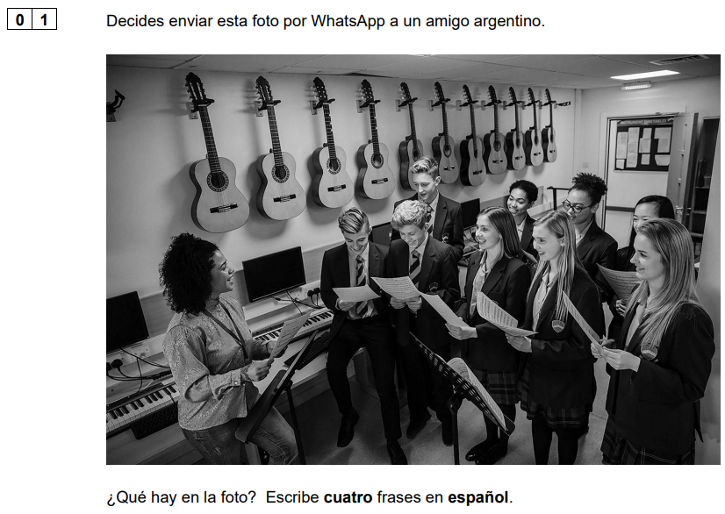
Exam question - Assessing progress
Target 5 Writing
Before the Christmas break, we practised the photo description.
Use the strategies you can remember to answer Q1 successfully.
3 minutes
Notes:
From June 2021 - Keep sentences VERY simple: students can use ‘il y a’ 4 times and write numbers in digit. They will get full marks by doing so.

Slide 68
Target 5 Writing
Reminder:
In Foundation, you will describe a photo in:
the speaking exam, for the photo card
the writing exam, in the first question
The expectations are different, as in the writing, you are allowed to use
‘hay’ 4 times, followed by a noun.
En la foto hay 10/muchas personas.
En la foto hay 3 chicos.
En la foto hay 6 chicas.
En la foto hay 1 profesora.
Notes:
Keep sentences VERY simple: students can use ‘il y a’ 4 times and write numbers in digit. They will get full marks by doing so.

Slide 69
Target 5 Writing
Reminder:
If you feel more confident, you can start using the strategy from the speaking photo card to describe photos in the writing.
What is the acronym we learnt and what does it stand for?
People, Action, Location, Mood/Description, (Weather)
Here is an example:
En la foto hay 10/muchas personas.
Están estudiando.
Están en el instituto.
Están contentos.

Slide 70
Target 5 Writing
Let’s practise a variety of structures for the photo description!
Listen to the teacher and write the sentences in Spanish.
example: En la foto hay 1 hombre y 2 mujeres.
_________________________ 5. ____________________________
_________________________ 6. ____________________________
_________________________ 7. ____________________________
_________________________ 8. ____________________________

Slide 71
Target 5 Writing
Complete gaps in the sentences in Spanish, using the sentence builder below:
example: En la foto hay 3 niños.
H__ u____ a___________. 5. E_____n e__ u__ i_______.
E_____n c___________s. 6. E_____n e___ u__ r___________.
Ella e_ muy a______. 7. E_____ e__ c_________.
T_____e e__ p______ c______. 8. H____ bastante f____.

Slide 72
Target 5 Writing
LAS RESPUESTAS – THE ANSWERS
example: En la foto hay 3 niños.
H__ u____ a___________. 5. E_____n e__ u__ i_______.
E_____n c___________s. 6. E_____n e___ u__ r___________.
Ella e_ muy a______. 7. E_____ e__ c_________.
T_____e e__ p______ c______. 8. H____ bastante f____.
Hay unos abuelos.
Están en un insti.
Están contentos.
Están en un restaurante.
Ella es muy alta.
Están en casa.
Tiene el pelo corto.
Hace bastante frío.
Notes:
Il y a 3 femmes/filles.
Il y a 2 garçons.
Il y a 5 enfants.
Il y a 3 amis.
Elle est triste.
Ils sont grands.
Elles sont petites.
Il fait beau.

Slide 73
Target 5 Writing
Without using the sentence builder, rewrite the words in the correct order to make a sentence:
example: personas / la / en / hay / 4 / foto
→ En la foto hay 4 personas.
están / casa / en _____________________________
contentos / muy / están _____________________________
tiene / pelo / largo / el _____________________________
buen / tiempo / hace _____________________________
oficina / una / en / están _____________________________
Extra:
Translate the sentences 1-5 into English from memory.
Notes:
Il y a 5 femmes.
Il y a 2 garçons.
Elle est contente.
Ils sont petits.
Il fait froid.

Slide 74
Target 5 Writing
LAS RESPUESTAS – THE ANSWERS
example: personas / la / en / hay / 4 / foto
→ En la foto hay 4 personas.
están / casa / en _____________________________
contentos / muy / están _____________________________
tiene / pelo / largo / el _____________________________
buen / tiempo / hace _____________________________
oficina / una / en / están _____________________________
Están en casa.
They are at home.
Están muy contentos.
They are happy.
Tiene el pelo largo.
(S)he has long hair.
Hace buen tiempo.
The weather is nice.
Están en una oficina.
They are in an office.
Extra:
Translate the sentences 1-5 into English from memory.
Notes:
Il y a 5 femmes.
Il y a 2 garçons.
Elle est contente.
Ils sont petits.
Il fait froid.

Slide 75
Target 5 Speaking
Grammar
Grammar
When using a variety of structures, it is really important not to confuse them.
Let’s look at the most common misconceptions:
there is and there are are the same phrase in Spanish: ‘hay’
a/an in English is the same as one (1). In Spanish, it is ‘un’ or ‘una’ (NOT ‘uno chico’)
you are allowed to use digit numbers in Q1, if you’re hesitant with the spelling.
in English, there are and they are may sound similar but means different things;
there are = hay
they are = son OR están
it is is almost always ‘es’ OR ‘está’ but when describing the weather, we use ‘hace’

Slide 76
Target 5 Speaking
Grammar - SER (to be) vs ESTAR (to be)
Grammar
Do you remember why in Spanish we have two ways of saying ‘is’ (Es and Está)?
SER is used in contexts deemed more permanent.
ESTAR is used in contexts deemed more temporary.
Here are 2 acronyms to remember when to use SER or ESTAR:
SER (to be - permanent) | ESTAR (to be - temporary)
Description (Es genial) | Place
Occupation (Es médico) | Location (El niño está en clase)
Characteristic (Son altos) | Action (Está trabajando)
Time (Son las siete) | Condition (Está roto)
Origin (Soy inglesa) | Emotion (Están tristes)
Relation (Es mi madre)

Slide 77
Target 5 Speaking
Grammar - SER (to be) vs ESTAR (to be)
Grammar
In the context of the photo description, only these apply:
Circle the correct verb ‘to be’, according to the context:
En la foto hay una casa. Es / Está moderna.
En la foto hay una casa. Es / Está en el centro de la ciudad.
En la foto hay 4 personas. Son / Están altos.
En la foto hay 4 personas. Son / Están contentos.
Son / Están mi padre y mi madre. Son / Están muy simpáticos.
Hay 5 personas. Son / Están trabajando.

Slide 78
Target 5 Speaking
Grammar
LAS RESPUESTAS – THE ANSWERS
In the context of the photo description, only these apply:
Circle the correct verb ‘to be’, according to the context:
En la foto hay una casa. Es / Está moderna.
En la foto hay una casa. Es / Está en el centro de la ciudad.
En la foto hay 4 personas. Son / Están altos.
En la foto hay 4 personas. Son / Están contentos.
Son / Están mi padre y mi madre. Son / Están muy simpáticos.
Hay 5 personas. Son / Están trabajando.

Slide 79
Target 5 Speaking
Grammar
Grammar
Complete the gaps with the correct verb phrase:
example: En la foto ____________ una familia.
_______________ en el insti. (They are in school.)
_______________ tristes. (They are sad.)
También _______________ 1 chica. (They is also a girl.)
_______________ buen tiempo. (The weather is nice.)
_______________ unos padres. (There are parents.)
_______________ en el parque. (They are in the park.)
_______________ jugando al fútbol. (She is playing football.)
hay

Slide 80
Target 5 Speaking
Grammar
LAS RESPUESTAS – THE ANSWERS
Complete the gaps with the correct verb phrase:
example: En la foto ____________ una familia.
_______________ en el insti. (They are in school.)
_______________ tristes. (They are sad.)
También _______________ 1 chica. (They is also a girl.)
_______________ buen tiempo. (The weather is nice.)
_______________ unos padres. (There are parents.)
_______________ en el parque. (They are in the park.)
_______________ jugando al fútbol. (She is playing football.)
hay
Están
Están
hay
Hace
Hay
Están
Está

Slide 81
Target 5 Writing
Reminder: This is the mark scheme for question 1:
For 2 marks
• The response must be a sentence, using an appropriate conjugated verb.
• The same verb/grammatical structure may be repeated in more than one sentence,
example: ‘hay’ plus different nouns.
• The most important is to ensure you communicate clearly!
Notes:
For 2 marks
• The response must be in the form of a sentence, using an appropriate conjugated verb. The only exception to this is in French, where voici/voilà may be used in place of a verb. The same verb/grammatical structure may be repeated in more than one sentence, eg il y a/es gibt/hay plus different nouns.
• Any sentence that is broadly relevant to the photo is given 2 marks. For example, imagine that the photo is of a man in a café. The student writes, in the target language: It’s a man. He’s old (even if to your eyes he may not be – ‘old’ to a 16-year old may be different from your perception of ‘old’). He’s a father (even if this is not apparent from the photo, it would potentially be true). He’s a teacher (he could be, for all we know).
• The first person of the verb is acceptable, for example: ‘I am/we are playing tennis’.
• There may be linguistic errors, but the message must be communicated without ambiguity.

Slide 82
Target 5 Writing
Write 4 sentences to describe the photo. Do so within the time!
You can only use “hay” 3 times!
3 minutes

Slide 83
Target 5 Writing
RESPUESTAS POSIBLES – POSSIBLE ANSWERS
Hay una madre.
Hay un padre.
Hay 2 niños.
Están contentos.

Slide 84
Target 5 Writing
Write 4 sentences to describe the photo. Do so within the time!
You can only use “hay” twice!
3 minutes

Slide 85
Target 5 Writing
RESPUESTAS POSIBLES – POSSIBLE ANSWERS
Hay una madre.
Hay un padre.
Están en el campo.
Hace buen tiempo.

Slide 86
Target 5 Writing
Write 4 sentences to describe the photo. Do so within the time!
You can only use “hay” once!
3 minutes

Slide 87
Target 5 Writing
RESPUESTAS POSIBLES – POSSIBLE ANSWERS
Hay 1 familia.
Están en Barcelona.
Están contentos.
Hace buen tiempo.

Slide 88
Exam question - Assessing progress
Target 5 Writing
Now on your own!
Describe this photo again, using a variety of structures if you can.
End
3 minutes
Notes:
From June 2021 - Keep sentences VERY simple: students can use ‘il y a’ 4 times and write numbers in digit. They will get full marks by doing so.

Slide 89
Target 5 Writing
Session objectives: Question
practising the photo description for the writing paper Q1 Photo
being able to translate key verbs in the future tense Q3 Translation

Slide 90
Target 5 Writing
This is how you will be assessed for the translation:
Conveying key messages (5 marks)
5: All key messages are conveyed.
4: Nearly all key messages are conveyed.
3: Most key messages are conveyed.
2: Some key messages are conveyed.
1: Few key messages are conveyed.
Application of grammatical knowledge of language and structures (5 marks)
5: Very good knowledge of vocabulary and structures; highly accurate.
4: Good knowledge of vocabulary and structures; generally accurate.
3: Reasonable knowledge of vocabulary and structures; more accurate than inaccurate.
2: Limited knowledge of vocabulary and structures; generally inaccurate.
1: Very limited knowledge of vocabulary and structures; highly inaccurate.
Today we will focus on this.
Notes:
Perfection is not required for full marks. For example, occasional missing accents and minor spelling errors do not preclude a top band mark. However, if there are numerous minor errors and incorrect use of accents which change the meaning of a word, this is likely to have an impact on the mark for Application of grammatical knowledge of language and structures.

Slide 91
Target 5 Writing
Grammar
Grammar
To describe actions in the future, we use the near future tense. There are 3 steps:
What are they?
Conjugate ‘ir’ (to go) in the present example: (yo) voy, (tú) vas, (él) va,
Add ‘a’
Keep the verb in the infinitive example: comer
That’s it! example: (yo) voy a comer
Now spot the error and correct:
example: voy jugar → voy a jugar
(yo) ir a escuchar _______________ 4. (ella) voy a visitar ______________
(él) va a trabaja _______________ 5. (él) vas a ver ______________
(ellas) va a visitar _______________ 6. (ella) va nadar ______________
(yo) voy a nado _______________ 8. (ellos) escuchar ______________
Notes:
j’ai
il / elle a
on a
ils / elles ont
past participles of -ER verbs
je suis allé(e)

Slide 92
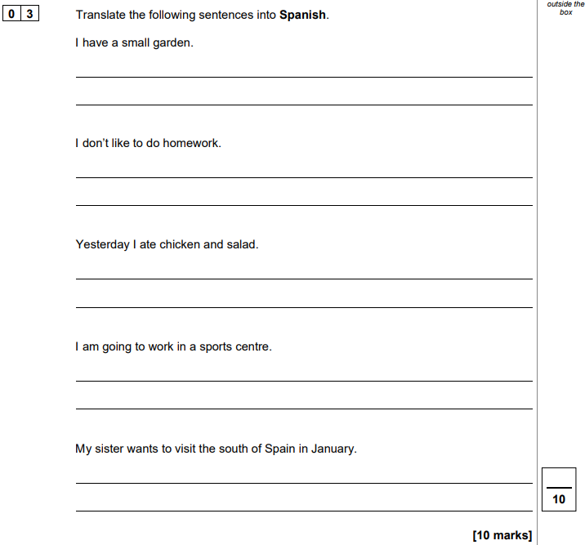
Target 5 Writing
This is what the translation question looks like.
Where is the sentence in the future tense?
The fourth sentence you need to translate is sometimes in the future tense.
Ensure you read all the sentences first and identify where the sentence in the future tense is.
Notes:
French Nov 2021

Slide 93
Target 5 Writing
Vocabulary
Future tense time phrases
mañana tomorrow
el próximo lunes/martes next Monday/Tuesday
el próximo miércoles next Wednesday
el próximo jueves/viernes next Thursday/Friday
el próximo sábado/domingo next Saturday/Sunday
la próxima semana next week
el próximo año next year
el próximo fin de semana next weekend
en 2 años in 2 years
después de los examenes after the exams
en el futuro / porvenir in the future
Location
al/en el parque to/in the park
al/en el insti to/in school
al/en el estadio to/in the stadium
al/en un partido to/at a match
al/en un restaurante to/in a restaurant
a/en la piscina to/in the swimming-pool
People
con… with
mi tío my uncle
mi tía my aunt
mis amigos/as my friends
mi hermano menor my younger brother
mi hermana mayor my older sister

Slide 94
Target 5 Writing
Listen to the teacher and write down the sentences in French, using the sentence builder below:
example: El próximo fin de semana voy a jugar an el parque con mi tío.
_________________________ 5. ____________________________
_________________________ 6. ____________________________
_________________________ 7. ____________________________
_________________________ 8. ____________________________

Slide 95
Target 5 Writing
Choose the correct translations:
ENGLISH | 1 | 2 | 3
Next week I am going to go to the match. | La próxima semana ir al partido. | La próxima semana fui al partido. | La próxima semana voy a ir al partido.
I’m going to play in the park with my friends. | Jugué en el parque con mis amigos. | Voy a jugar en el parque con mis amigos. | Voy a juego en el parque con mis amigos.
Next Sunday, I’m going to celebrate Christmas. | El próximo domingo voy a celebro la navidad. | El próximo domingo voy a celebrar la navidad. | El domingo celebro la navidad.
Tomorrow I’ll watch TV. | Mañana voy a ver la tele. | Ayer voy a ver la tele. | Mañana vi la tele.
Next week, I will go to school with my friends. | La semana pasada fui al insti con mis amigos. | La próxima semana voy a ir al insti con mis amigos. | Hoy fui al insti con mis amigos.
Next Monday I’m going to go to the library. | El próximo lunes voy a ir a la biblioteca. | El lunes pasado fui a la biblioteca. | El lunes voy a la biblioteca.
Notes:
.

Slide 96
Exam question
Target 5 Writing
Now on your own!
Tomorrow I’m going to do my homework.
In the future, I’m going to eat a lot of vegetables.
Next weekend I’m going to buy a mobile phone.
Next Monday I’m going to go to school by bus.
3 minutes
Notes:
All past paper questions:
Yesterday I did a lot of homework.
Today I ate a lot of vegetables.
Last weekend I bought a mobile phone.
Last Monday I went to school by bus.
+
Last week I went to a match with my uncle.
I played football in the park with my friends.
Last Saturday, I celebrated my birthday at a good restaurant.

Slide 97
Target 5 Writing
Exit Ticket
Listen and write the sentences :
En la foto hay 2 hombres.
Están en una oficina.
Son muy altos.
Hace calor.
El próximo fin de semana voy a ir al estadio.
La próxima semana voy a comer al restaurante.
En el futuro voy a estudiar las ciencias.
Notes:
Transcript:
En la foto hay 2 hombres.
Están en una oficina.
Son muy altos.
Hace calor.
El próximo fin de semana voy a ir al estadio.
La próxima semana voy a comer al restaurante.
En el futuro voy a estudiar las ciencias.

Slide 98
Week Date | Module / Topic | Writing | Key language
WEEK 2 15/01/24 | Town | Q2 40-word: tackling bullet points that are unknown, using a generic opinion; spotting if the BP is singular or plural to justify opinion accurately (es vs son) | me gusta el/la me gustan los/las me encanta el/la me encantan los/las no me gusta(n) odio prefiero porque / ya que es / son + ADJ
 | Town and hobbies | Q4 90-word: producing 3 verbs in 3 tenses accurately | yo …o yo …é/í + fui + hice yo voy a present with yo preterite with yo near future with yo

Slide 99
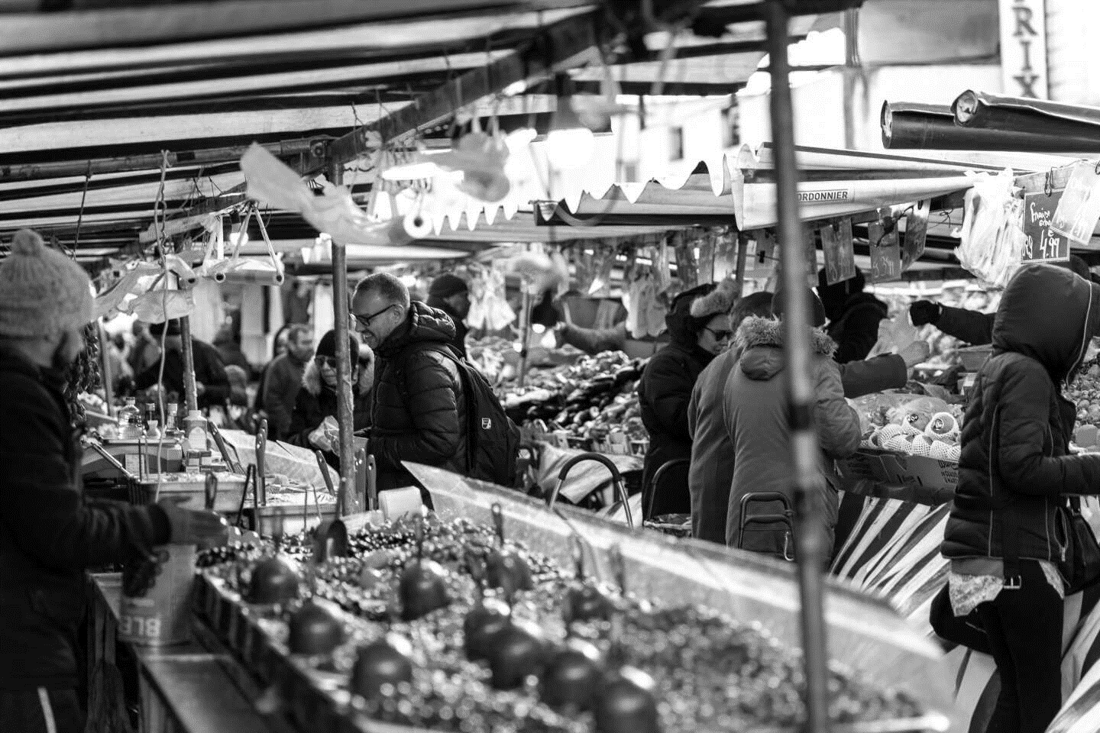
Target 5 Writing
Session objectives: Question
tackling bullet points that are unknown Q2 40-word
producing 3 verbs in 3 tenses accurately Q4 90-word
Do Now:
Write 4 sentences to describe this photo.
Extra:
¿Cómo se dice …?
I play
I played
I am going to play
it is
it was
it is going to be

Slide 100
LAS RESPUESTAS – THE ANSWERS
Session objectives: Question
tackling bullet points that are unknown Q2 40-word
producing 3 verbs in 3 tenses accurately Q4 90-word
Do Now:
Write 4 sentences to describe this photo.
Extra:
¿Cómo se dice …?
I play
I played
I am going to play
it is
it was
it is going to be
En la foto hay muchas personas.
juego
jugué
Hay un mercado.
voy a jugar
Hay hombres.
es
era/fue
Hay mujeres.
va a ser

Slide 101
Exam question
Target 5 Writing
In previous weeks, we have practised translating sentences in the past and future accurately.
Translate these sentences without support in exam conditions:
Last week-end, I played football in the park.
Last year, I went on holiday to Spain.
Yesterday, I ate in a restaurant with my family.
Past
In the future, I’m going to study Spanish.
Next week, I’m going to buy a new tablet.
Future
3 minutes
Notes:
All past paper questions:
Yesterday I did a lot of homework.
Today I ate a lot of vegetables.
Last weekend I bought a mobile phone.
Last Monday I went to school by bus.
+
Last week I went to a match with my uncle.
I played football in the park with my friends.
Last Saturday, I celebrated my birthday at a good restaurant.

Slide 102
Target 5 Writing
LAS RESPUESTAS – THE ANSWERS
Translate these sentences without support in exam conditions:
Last weekend, I played football in the park.
Last year, I went on holiday to Spain.
Yesterday, I ate in a restaurant with my family.
In the future, I’m going to study Spanish.
Next week, I’m going to buy a new tablet.
El fin de semana pasado, jugué al fútbol en el parque.
El año pasado, fui de vacaciones a España.
Ayer, comí en un restaurante con mi familia.
En el futuro, voy a estudiar español.
La próxima semana, voy a comprar una nueva tableta.
Notes:
All past paper questions:
Yesterday I did a lot of homework.
Today I ate a lot of vegetables.
Last weekend I bought a mobile phone.
Last Monday I went to school by bus.
+
Last week I went to a match with my uncle.
I played football in the park with my friends.
Last Saturday, I celebrated my birthday at a good restaurant.

Slide 103
Target 5 Writing
Vocabulary – 40-word question
Instructions – common phrases
Estás… You are…
de vacaciones on holiday
Escribes … You are writing…
una carta a letter
a tu amigo español to your Spanish friend
un blog a blog
Sobre … about…
tu vida your life
tu tiempo libre your free time
tu salud your health
tu instituto your school
Bullet points – common phrases/nouns
el tiempo/el clima the weather
los profesores the teachers
las redes sociales social networks
las asignaturas school subjects
los edificios the buildings
la comida the food
tu deporte favorito your favourite sport
el alojamiento accommodation
tu ciudad / pueblo your city / town
donde vives where you live
donde estás where you are
Key structures to use for the 40-word
me gusta(n) el/la/los/las I like (the)
me encanta(n) el/la/los/las I love (the)
no me gusta(n) el/la/los/las I do not like (the)
odio el/la/los/las. I hate (the)
pienso que es I think that it is
porque son because they are
interesante(s) interesting
genial(es) great
divertido/a(s) fun
terrible(s) terrible
horrible(s) horrible
aburrido/a(s) boring
☺
☹

Slide 104
Target 5 Writing
1 | 2 | 3 | 4 | 5
me gusta(n) el/la/los/las
me encanta(n) el/la/los/las
no me gusta(n)el/la/los/las
odio el/la/los/las
tiempo
profesores
redes sociales
asignaturas
edificios
comida
deportes
alojamiento
ciudad / pueblo
pienso que
porque
ya que
dado que
puesto que
es
son
interesante(s)
genial(es)
divertido/a(s)
terrible(s)
horrible(s)
aburrido/a(s)
Listen to the teacher and write down the sentences in Spanish, using the sentence builder above:
____________________________________________________________________
____________________________________________________________________
____________________________________________________________________
____________________________________________________________________
____________________________________________________________________
challenge!

Slide 105
LAS RESPUESTAS – THE ANSWERS
Target 5 Writing
1 | 2 | 3 | 4 | 5
me gusta(n) el/la/los/las
me encanta(n) el/la/los/las
no me gusta(n)el/la/los/las
odio el/la/los/las
tiempo
profesores
redes sociales
asignaturas
edificios
comida
deportes
alojamiento
ciudad / pueblo
pienso que
porque
ya que
dado que
puesto que
es
son
interesante(s)
genial(es)
divertido/a(s)
terrible(s)
horrible(s)
aburrido/a(s)
Listen to the teacher and write down the sentences in Spanish, using the sentence builder above:
____________________________________________________________________
____________________________________________________________________
____________________________________________________________________
____________________________________________________________________
____________________________________________________________________
Me gusta el alojamiento porque es genial.
Me encantan los edificios ya que son interesantes.
No me gusta la comida dado que es horrible.
Odio las asignaturas, pienso que son aburridas.
Pienso que las redes sociales son divertidas.

Slide 106
Target 5 Writing
Grammar
Grammar
«me gusta» versus « me gustan»
Remember, when you give your opinion, you need to pay attention to the following:
if the noun is singular, you must use « me gusta » to say ‘I like’.
example: me gusta la geografía.
if the noun is plural, you must use « me gustan» to say ‘I like’.
example: me gustan las redes sociales.
Note that the same happens with « me encanta » and « me encantan ».
Note that « odio » and « prefiero » are not affected and do not take « me » at
the beginning.
Give an opinion, carefully choosing the singular or plural version
el transporte …
la contaminación …
las tiendas benéficas …
los coches eléctricos …

Slide 107
Target 5 Writing
Grammar
Grammar
«me gusta» versus « me gustan»
Remember, when you give your opinion, you need to pay attention to the following:
if the noun is singular, you must use « me gusta » to say ‘I like’.
example: me gusta la geografía.
if the noun is plural, you must use « me gustan» to say ‘I like’.
example: me gustan las redes sociales.
Note that the same happens with « me encanta » and « me encantan ».
Note that « odio » and « prefiero » are not affected and do not take « me » at
the beginning.
Give an opinion, carefully choosing the singular or plural version
el transporte …
la contaminación …
las tiendas benéficas …
los coches eléctricos…
me gusta / me encanta
no me gusta / odio
me gustan / me encantan
me gustan / me encantan

Slide 108
Target 5 Writing
Grammar
Grammar
«es» versus « son»
When you justify your opinion, you will need to pay attention to the following:
if the noun is singular, you must use « es » in the justification.
example: me encanta la geografía porque es interesante.
if the noun is plural, you must use « son» in the justification.
example: me encantan las redes sociales porque son divertidas.
Note that your adjective will need to also be plural.
Justify each of the opinions, carefully choosing «es» or «son»
Me gusta el transporte …
Odio la contaminación …
Me encantan las tiendas benéficas, …
Me gustan los coches eléctricos, …

Slide 109
Target 5 Writing
Grammar
LAS RESPUESTAS – THE ANSWERS
«es» versus « son»
When you justify your opinion, you will need to pay attention to the following:
if the noun is singular, you must use « es » in the justification.
example: me encanta la geografía porque es interesante.
if the noun is plural, you must use « son» in the justification.
example: me encantan las redes sociales porque son divertidas.
Note that your adjective will need to also be plural.
Justify each of the opinions, carefully choosing «es» or «son»
Me gusta el transporte …
Odio la contaminación …
Me encantan las tiendas benéficas, …
Me gustan los coches eléctricos, …
porque es práctico.
porque es mala para el medio ambiente.
son útiles.
son buenos para el medio ambiente.

Slide 110
Target 5 Writing
Estás escribiendo un blog sobre tu zona.
Menciona:
donde vives
las atracciones turísticas
los transportes
los problemas
Escribe aproximadamente 40 palabras en español.
Vivo en Londres, está en el sureste de Inglaterra.
Vivo en Londres en el sureste de Inglaterra.
En mi zona, hay muchas atracciones turísticas, son geniales.
Hay atracciones turísticas.
Me encantan los transportes ya que son muy prácticos.
Me encantan los transportes porque son prácticos.
Sin embargo, también hay muchos problemas en mi región.
Hay muchos problemas.
=36 words.
=21 words.
Reminder: when writing your 40-word answer, you should aim to:
- use simple language
- communicate clearly
- answer ALL bullet points
You can do this by giving a relevant justified opinion about each bullet point.

Slide 111
Target 5 Writing
What do you think about this student’s answer?
Estás escribiendo un blog sobre tu zona.
Menciona:
donde vives
las atracciones turísticas
los transportes
los problemas
Escribe aproximadamente 40 palabras en español.
Me gusta mi zona porque hay atracciones turísticas. Por ejemplo, hay el museo de arte moderno. Pienso que es muy interesante. Sin embargo, no me gustan los transportes dado que son horribles. En mi ciudad, hay contaminación. Es bastante triste.
40 words
✓
✓
✓
Content out of 10: A minimum number of bullet points must be covered for the award of marks for Content, as follows:
•9-10 marks: 4 bullet points
•5-8 marks: 3 bullet points
•3-4 marks: 2 bullet points
•1-2 marks: 1 bullet point
Language out of 6:
• 5-6: Uses a variety of appropriate vocabulary and grammatical structures. Generally accurate.
• 3-4: Vocabulary and grammatical structures generally appropriate to the task, with some attempt at variety. More accurate than inaccurate.
You must cover the 4 bullet points to get full marks!
Notes:
1–2
Vocabulary and structures used may be limited, repetitive or inappropriate. There may be frequent errors.
0
The language produced does not meet the standard required for Level 1 at this tier.

Slide 112
Target 5 Writing
The secret key to covering all 4 bullet points!
Remember: If you don’t know what a bullet point means, use an opinion structure:
an opinion phrase + the words from + a justification with a the bullet point general adjective
Ex: Me gustan + los edificios + porque son interesantes.
Estás escribiendo un blog sobre tu colegio.
Menciona:
les edificios
-s at the end of the noun
los/las/tus/sus in front of the noun
Just check if the bullet point is singular or plural.
What are the two clues to indicate if a noun is singular or plural?
How will it change how you justify your opinion?
‘son’ instead of ‘es’
adjective in the plural form
Notes:
1–2
Vocabulary and structures used may be limited, repetitive or inappropriate. There may be frequent errors.
0
The language produced does not meet the standard required for Level 1 at this tier.

Slide 113
Target 5 Writing
For each of these obscure bullet points, use the secret key to write a simple opinion:
las tiendas
la contaminación
el alojamiento
los sin techos
les estudios
el matrimonio
Me gustan las tiendas porque son fantásticas.
Odio la contaminación ya que es horrible.
Remember:
You can vary your conjunctions to say ‘because’:
porque
ya que
dado que
puesto que
Pienso que el alojamiento es genial.
En mi opinión los sin technos son tristes.
Odio los estudios dado que son aburridos.
Me encanta el matrimonio puesto que es genial.
¡Enhorabuena! You now know how to fool the examiners!
Notes:
1–2
Vocabulary and structures used may be limited, repetitive or inappropriate. There may be frequent errors.
0
The language produced does not meet the standard required for Level 1 at this tier.

Slide 114
Exam question
Target 5 Writing
Estás escribiendo un blog sobre tu zona.
Menciona:
donde vives
las atracciones turísticas
los transportes
los problemas
Escribe aproximadamente 40 palabras en español.
Now on your own!
Apply all the strategies:
- if you don’t know a bullet point, use the secret key!
- pay attention to “me gusta” versus “me gustan” and “es” versus “son”
Aim to:
- use simple language
- communicate clearly
- answer each bullet point
Give a relevant justified opinion about each bullet point.
End
10 minutes

Slide 115
Target 5 Writing
Session objectives: Question
tackling bullet points that are unknown Q2 40-word
producing 3 verbs in 3 tenses accurately Q4 90-word

Slide 116
Target 5 Writing
Vocabulary – 90-word question
Past time phrases
ayer por la tarde yesterday (evening)
el fin de semana pasado last weekend
el sábado pasado last Saturday
la semana pasada last week
recientemente recently
un(a) … reciente a recent …
Future time phrases
el próximo … / que viene next …
en el futuro in the future
para tus próximo/as … for your next …
Bullet points – common vocabulary
tus relaciones your relationships
tus proyectos/planes your projects
tus actividades your activities
tu opinión de/sobre your opinion about
tu … preferido/a your favourite …
tu preferencia para … your preference for …
quieres you want
lo que te gusta what you like
Sequencers
primero first
después after
luego then
finalmente finally
Conjunctions
dado que given that
ya que because
además in addition
pero but
sin embargo however
no obstante nevertheless
también also
Opinion phrases
prefiero I prefer
en mi opinión in my opinion
diría que I would say that
creo que I believe that
pienso que I think that
Adjectives
emocionante exciting
fascinante fascinating
entretenido entertaining
Key verbs:
fui I went
visité I visited
era it was
me gustaría/quisiera + INF
I would like to + verb
sería it would be
si pudiera if I could

Slide 117
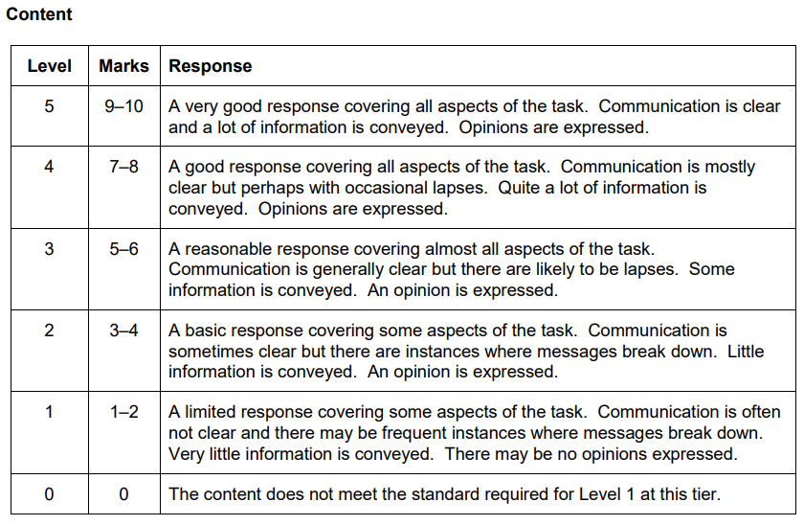
Target 5 Writing
How the 90-word is assessed
The 90-word is awarded marks in the same way as the 40-word question:
What it means:
1. A minimum number of bullet points must be covered for the award of marks for Content, as follows:
10-7 marks: 4 bullet points
6-5 marks: 3 bullet points
4-3 marks: 2 bullet points
2-1 marks: 1 bullet point
2. Keep to the structures you are confident with to maintain clear communication.
3. Express opinions in a variety of ways and justify them.

Slide 118
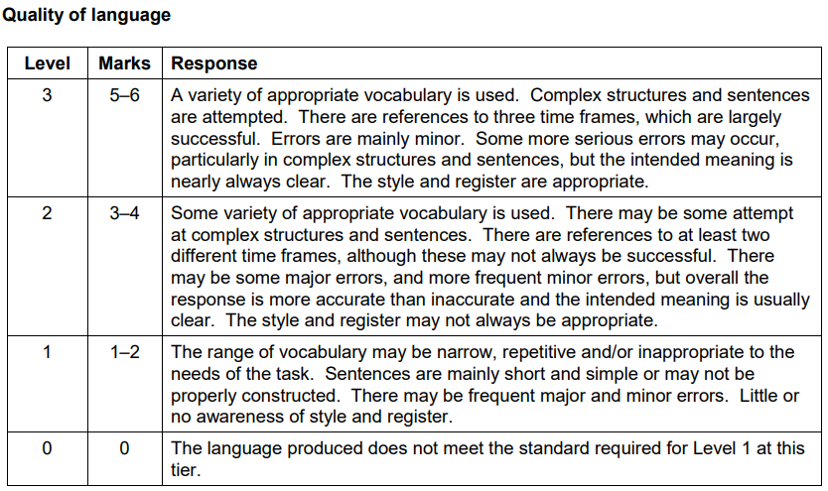
Target 5 Writing
How the 90-word is assessed
The 90-word is awarded marks in the same way as the 40-word question:
What it means:
1. Use vocabulary that is specific to the topic.
2. Use the present, past and future confidently. Have 3 verbs for each tense and prepare them before you write.
3. Link your sentences with a variety of conjunctions.
4. Use some pre-learnt complex phrases.

Slide 119
Target 5 Writing
Remember, taking it one step at a time makes the difference!
First focus on writing 10 words per bullet point
Skip 3 lines between each answer!
(That’s so you can add more details later)
You reached 38 words!
Now go back and try to add 10 more words per bullet points by:
adding an extra or contrasting opinion
adding an extra activity
And just like that, you reached 77 words!
Me gustan mis estudios porque son interesantes.
Durante la hora de comer, juego al fútbol.
En mi última clase de español, estudié mucho.
Era muy fácil.
Me gustaría ser profe en el futuro ya que
es bien pagado.
Me encanta el español dado que mi profe es muy buena.
Sin embargo, no como nada porque la comida en mi insti es horrible.
Además, repasé para los exámenes.
Sin embargo no me gustaría ser médico porque es difícil.
Notes:
Step 2 – start by giving a relevant answer to each bullet point – transfer what has been learnt on 40-word by giving a relevant justified opinion about each BP.

Slide 120
Target 5 Writing
Remember, taking it one step at a time makes the difference!
When word count matters, remember that you can:
gain 3 words by saying who you do an activity with (con mi familia, con mis amigos)
gain 2-3 words by saying where (al/en el cine, al/en el parque)
gain 2-3 by adding time expressions (el fin de semana pasado, el próximo año …)
And now you have 89 words!!!
Me gustan mis estudios porque son interesantes. Me encanta el español dado que mi profe es muy buena.
Durante la hora de comer, juego al fútbol con mis amigos en el patio. Sin embargo, no como nada porque la comida en el comedor de mi insti es horrible.
En mi última clase de español, estudié mucho. Era muy fácil. Además, repasé para los exámenes la semana pasada.
Me gustaría ser profe en el futuro ya que es bien pagado. Sin embargo, no me gustaría ser médico porque es difícil.
Notes:
Step 2 – start by giving a relevant answer to each bullet point – transfer what has been learnt on 40-word by giving a relevant justified opinion about each BP.

Slide 121
Target 5 Writing
Grammar
Grammar
Reminder: the words I need to change in my answers!
The task will have words in the bullet points, which you must remember to change! For instance, they will address you as ‘tú’ or ‘usted’, so we need to know how to change these appropriately in our answers. Do you remember how to change these?
‘tú’ + verb must change to « yo » and correct verb ending in -o
‘usted’ + verb must change to « yo » and correct verb ending in -o
‘tu’, ‘su’ must change to « mi »
‘tus’ and ‘sus’ must change to « mis »

Slide 122
Target 5 Speaking
Grammar - the 3 tenses
Grammar
Conjugated verbs are also an element to adapt in your answer. Do you remember the ways to change the verbs for each tense?
in the present:
verbs in the ‘tú’ form ends in -as or -es. Ex: escuchas , comes , vives
verbs in the ‘usted’ form ends in -a or -e. Ex: escucha , come , vive
Remove these and put -o. Ex: escucho , como , vivo
in the past:
verbs in the ‘tu’ form ends in -aste or -iste. Ex: escuchaste , comiste , viviste
verbs in the ‘usted’ form ends in -ó or -ío. Ex: escuchó , comío , vivío
Remove these and put -é or -í. Ex: escuché , comí , viví
in the future or in the conditional:
‘vas a’ and ‘va a’ becomes ‘voy a’
‘te gustaría’ and ‘le gustaría’ becomes ‘me gustaría’
the final verb remains the same. Examples: jugar, hacer, comprar, vivir …
Exceptions:
estoy = I am
soy = I am
voy = I go
hago = I do
Exceptions:
fui = I went
estuve = I was
fui = I was
hice = I did

Slide 123
Target 5 Writing
Grammar - the 3 tenses
Grammar
Change the verb below into the ‘I’ form. Be careful of the tense:
example: visitaste → visité.
comes _______________ 6. haces ______________
estudias _______________ 7. jugaste ______________
vives _______________ 8. hiciste ______________
fuiste _______________ 9. vas a reciclar ______________
vas a hacer _______________ 10. estás ______________
Remember that some generic verbs can be used for any topic! How do we say:
example: I play→ juego I played → jugué I’m going to play → voy a jugar
I eat → __ ________ I ate → __ _________ I’m going to eat → voy a _______
I listen → __ _______ I listened→ __ ________ I’m going to listen →____________
I go → __ ________ I went → __ ___________ I’m going to go → ____________

Slide 124
Target 5 Writing
Grammar
LAS REPUESTAS – THE ANSWERS
Change the verb below into the ‘I’ form. Be careful of the tense:
example: visitaste → visité.
comes _______________ 6. haces ______________
estudias _______________ 7. jugaste ______________
vives _______________ 8. hiciste ______________
fuiste _______________ 9. vas a reciclar ______________
vas a hacer _______________ 10. estás ______________
como
hago
estudio
jugué
vivo
hice
fui
voy a reciclar
voy a hacer
estoy
Remember that some generic verbs can be used for any topic! How do we say:
example: I play→ juego I played → jugué I’m going to play → voy a jugar
I eat → __ ________ I ate → __ _________ I’m going to eat → voy a _______
I listen → __ _______ I listened→ __ ________ I’m going to listen →____________
I go → __ ________ I went → __ ___________ I’m going to go → ____________
como
comí
comer
escucho
escuché
voy a escuchar
voy
fui
voy a ir

Slide 125
Target 5 Writing
Prepare 2 key elements before starting your essay!
Daniel, tu amigo chileno, te ha preguntado sobre tu ciudad y las tiendas.
Menciona:
• tu opinión sobre hacer compras
• tu transporte preferido para ir en el centro
• una visita a las tiendas el último sábado
• tus actividades en tu ciudad el próximo fin de semana
Escribe aproximadamente 90 palabras en español. (Total 16 marks)
fui; compré; fue
Past
Future
voy a comer; voy a jugar; voy a ver
1.
Identify the bullet point in the past and the bullet point in the future.
Prepare 3 verbs for each tense to make sure they are accurate. Use generic verbs that you have learnt off by heart when you are unsure.
Remember to include them in your essay and you have secured that most of your references to the past and future are successful! Congratulations!

Slide 126
Target 5 Writing
Prepare 2 key elements before starting your essay!
Your turn! Identify the bullet points in the past and future tenses.
Prepare 3 conjugated verbs for each tense.
Estás escribiendo un blog sobre tu región.
Menciona:
• lo que haces normalmente los fines de semana
• las ventajas y las desventajas de vivir en une ciudad grande
• lo que visitaste recientemente en tu región
• lo que vas a hacer el próximo fin de semana
Escribe aproximadamente 90 palabras en español.
(Total 16 marks)
Past
fui, visité, fue
Future
voy a jugar, voy a ir, va a ser
Notes:
Step 2 – start by giving a relevant answer to each bullet point – transfer what has been learnt on 40-word by giving a relevant justified opinion about each BP.

Slide 127
Target 5 Writing
Prepare 2 key elements before starting your essay!
2.
Next, it is important to prepare one complex and justified opinion in advance. The most effective way to do that is by using contrasting opinions and linking them with conjunctions of contrast. If done well, you can easily reach 20-words!
Daniel, tu amigo chileno, te ha preguntado sobre tu ciudad.
Menciona:
• tu opinión sobre hacer compras
• tu transporte preferido para ir en el centro
• una visita a las tiendas el último sábado
• tus actividades en tu ciudad el próximo fin de semana
Escribe aproximadamente 90 palabras en español.
Remember:
use a variety of opinion phrases: pienso que, creo que, diría que, en mi opinión
use conjunctions of contrast: pero, sin embargo, no obstante,
por un lado … por otro lado
Example: Diría que mi transporte favorito para ir al centro es el autobús, porque creo que es muy práctico. Sin embargo, mi hermana odia el autobús, prefiere el metro porque piensa que es más rápido. (37 words)
Notes:
Step 2 – start by giving a relevant answer to each bullet point – transfer what has been learnt on 40-word by giving a relevant justified opinion about each BP.

Slide 128
Target 5 Writing
Prepare 2 key elements before starting your essay!
Your turn! Identify the bullet point requiring opinions.
Prepare complex, justified opinions, using a contrasting structure:
Estás escribiendo un blog sobre tu región.
Menciona:
• lo que haces normalmente los fines de semana
• las ventajas y las desventajas de vivir en une ciudad grande
• lo que visitaste recientemente en tu región
• lo que vas a hacer el próximo fin de semana
Escribe aproximadamente 90 palabras en español. (Total 16 marks)
Example: Diría que es genial vivir en una ciudad grande porque hay muchas actividades y tiendas. Sin embargo, mi mamá odia vivir en una ciudad grande ya que piensa que hay mucha contaminación. (37 words)

Slide 129
Target 5 Writing
Summary of strategies for the 90-words
Let’s recap all the strategies we talked about:
spot the bullet points in the past and the future tenses
write down 3 verbs in the past and 3 verbs in the future
spot the bullet point requiring an opinion
write a complex, justified opinion, using contrast
You are ready to write your essay, but remember:
tackle it like the 40-word, write 10 words per bullet point and skip 3 lines
then come back to it and write another 10 words
keep to structures that you are confident with to maintain clarity
vary your opinion phrases, your conjunctions and your adjectives
Notes:
Step 2 – start by giving a relevant answer to each bullet point – transfer what has been learnt on 40-word by giving a relevant justified opinion about each BP.

Slide 130
Exam question
Target 5 Writing
Now on your own!
Apply all the strategies for:
- the 3 tenses
- the complex opinion
Tu amigo Miguel, te ha preguntado sobre tu región.
Menciona:
• donde vives
• tus actividades los fines de semana
• lo que hiciste recientemente para proteger el medio ambiente
• tus proyectos para ayudar a las personas en dificultades
Escribe aproximadamente 90 palabras en español. (Total 16 marks)
Aim to:
- answer each bullet point
- use structures you feel confident with
- communicate clearly
- give a relevant justified opinion about one of the bullet points
End
10 minutes
Notes:
From June 2021

Slide 131
Exam question
Target 5 Writing
Check your work!
Use the check list below:
I wrote about all 4 bullet points - write B1,B2,B3,B4 next to each paragraph.
Tu amigo Miguel, te ha preguntado sobre tu región.
Menciona:
• donde vives
• tus actividades los fines de semana
• lo que hiciste recientemente para proteger el medio ambiente
• tus proyectos para ayudar a las personas en dificultades
Escribe aproximadamente 90 palabras en español. (Total 16 marks)
I conjugated 3 verbs in the past and 3 verbs in the future - highlight them in your essay.
I gave my opinions - write O next to them; and I justified them - write J next to them
I used a variety of conjunctions - circle them.
I used a variety of opinion phrases - underline them.
I didn’t reuse the following words from the bullet points: vives, tus, hiciste, tus
Notes:
From June 2021

Slide 132
Target 5 Writing
Exit Ticket
Tu amigo Miguel, te ha preguntado sobre tu región.
Menciona:
• donde vives
• tus actividades los fines de semana
• lo que hiciste recientemente para proteger el medio ambiente
• tus proyectos para ayudar a las personas en dificultades
Escribe aproximadamente 90 palabras en español. (Total 16 marks)
Self-assess your work!
Use the mark scheme below:
Decide the level for Content and Quality of language.
10-7 marks: 4 BP
6-5 marks: 3 BP
4-3 marks: 2 BP
2-1 marks: 1 BP

Slide 133
Week Date | Module / Topic | Writing | Key language
WEEK 3 22/01/24 | School and jobs | Q2 40-word: tackling bullet points that are unknown, using a generic opinion; spotting if the BP is singular or plural to justify opinion accurately (es vs son) | me gusta el/la me gustan los/las me encanta el/la me encantan los/las no me gusta(n) odio prefiero porque / ya que es / son + ADJ
 | School | Q4 90-word: producing 3 verbs in 3 tenses accurately | yo …o yo …é/í + fui + hice yo voy a present with yo preterite with yo near future with yo

Slide 134
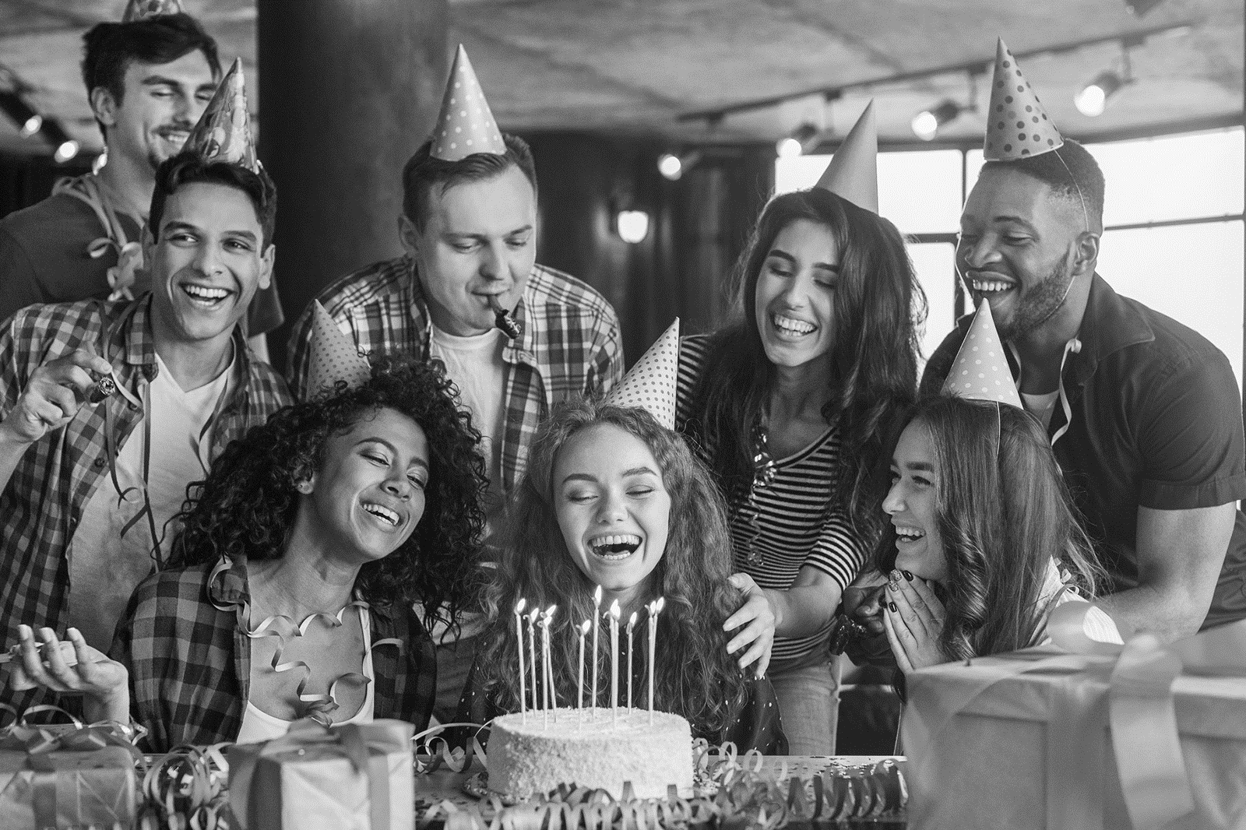
Target 5 Writing
Session objectives: Question
practising the photo description for the writing paper Q1 Photo
using the present tense accurately Q3 Translation
Do Now:
Write 4 sentences to describe this photo.
Extra:
¿Cómo se dice …?
I play
I am
I have
I go
it is
there is/are

Slide 135
LAS RESPUESTAS – THE ANSWERS
Session objectives: Question
practising the photo description for the writing paper Q1 Photo
being able to translate key verbs in the future tense Q3 Translation
Do Now:
Write 4 sentences to describe this photo.
Extra:
¿Cómo se dice …?
I play
I am
I have
I go
it is
there is/are
En la foto hay un hombre.
juego
soy/estoy
En la foto hay una mujer.
tengo
En la foto hay un niño.
voy
es/está
En la foto hay un niña.
hay

Slide 136
Target 5 Writing
Vocabulary
People
Hay… There is/are…
1/2/3/4 personas 1/2/3 person/people
1/2/3 mujer(es) 1/2/3 woman/women
1/2/3 hombre(s) 1/2/3 man/men
1/2/3 niña(s) 1/2/3 girl(s)
1/2/3 niño(s) 1/2/3 boy(s)
2/3 niños 2/3 child(ren)
1/2/3 amigo/a(s) 1/2/3 friend(s)
un padre a father
una madre a mother
unos padres parents
unos abuelos grandparents
unos estudiantes students
un coche a car
una moto a motorbike
una mesa a table
una silla a chair
un escritorio a desk
comida food
bebidas drinks
edificios buildings
árboles trees
Action
Está + (s)he is
Están + they are
jugando play[ing]
comiendo eat[ing]
bebiendo drink[ing]
hablando talk[ing]
escuchando listen[ing]
viendo watch[ing]
trabajando work[ing]
visitar visit[ing]
Mood
Está … she/he is
Están … they are
contento/a(s) happy
triste(s) sad
Description
Es … she/he is
Son … they are
alto/a(s) tall
bajo/a(s) short
Tiene He/She has
Tienen They have
el pelo corto short hair
el pelo largo long hair
los ojos marrones brown eyes
Location
Está en He/She/It is in (+location)
Están en They are in (+location)
casa home
un comedor a canteen
un insti a school
un parque a park
un restaurante a restaurant
un hotel a hotel
una tienda a shop
una piscina a swimming-pool
una oficina an office
el campo the countryside
la costa the coast
las montañas the mountains
Weather
Hace…
buen tiempo good weather
mal tiempo bad weather
calor hot
frío cold

Slide 137
Target 5 Writing
Describing the photo in the Writing
Reminders:
In the Writing Q1 Photo description, you can use ‘Sur la photo il y a …’ four times.
You can use digit numbers if you are unsure about your spelling.
You can also use the PALMW strategy from the Speaking Photo card:
Ensure you keep your sentences simple, short to communicate clearly.
Now let’s review how to increase your accuracy in the photo description.

Slide 138
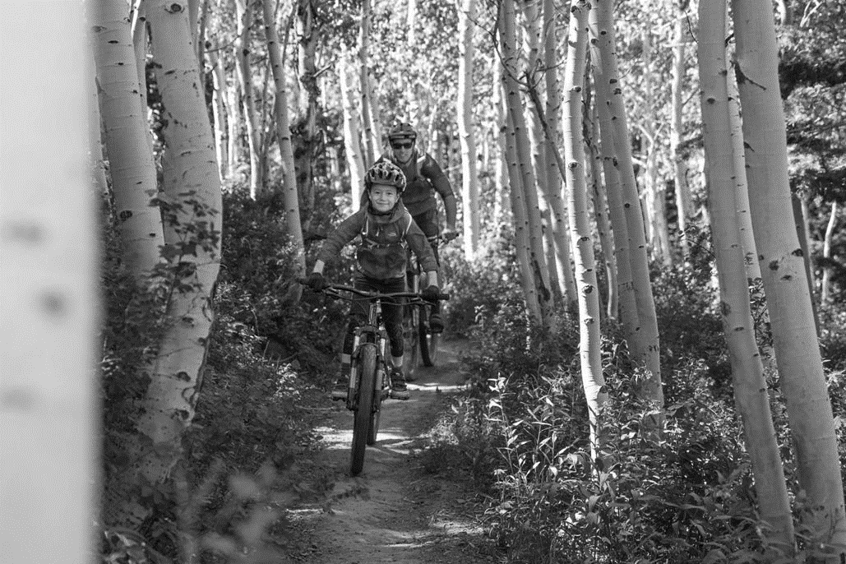
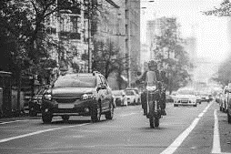
Target 5 Writing
Describing the photo in the Writing
People
Hay… There is/are…
1/2/3/4 personas 1/2/3 person/people
1/2/3 mujer(es) 1/2/3 woman/women
1/2/3 hombre(s) 1/2/3 man/men
1/2/3 niña(s) 1/2/3 girl(s)
1/2/3 niño(s) 1/2/3 boy(s)
2/3 niños 2/3 child(ren)
1/2/3 amigo/a(s) 1/2/3 friend(s)
un padre a father
una madre a mother
unos padres parents
unos abuelos grandparents
unos estudiantes students
un coche a car
una moto a motorbike
una mesa a table
una silla a chair
un escritorio a desk
comida food
bebidas drinks
edificios buildings
árboles trees
Complete each photo description with a noun:
En la foto hay
En la foto hay
En la foto hay
En la foto hay
En la foto hay
En la foto hay
En la foto hay
En la foto hay

Slide 139
Target 5 Writing
LAS RESPUESTAS – THE ANSWERS
People
Hay… There is/are…
1/2/3/4 personas 1/2/3 person/people
1/2/3 mujer(es) 1/2/3 woman/women
1/2/3 hombre(s) 1/2/3 man/men
1/2/3 niña(s) 1/2/3 girl(s)
1/2/3 niño(s) 1/2/3 boy(s)
2/3 niños 2/3 child(ren)
1/2/3 amigo/a(s) 1/2/3 friend(s)
un padre a father
una madre a mother
unos padres parents
unos abuelos grandparents
unos estudiantes students
un coche a car
una moto a motorbike
una mesa a table
una silla a chair
un escritorio a desk
comida food
bebidas drinks
edificios buildings
árboles trees
Complete each photo description with a noun:
En la foto hay 1 hombre
En la foto hay 1 niño
En la foto hay 1 bici
En la foto hay arboles
En la foto hay 1 moto
En la foto hay 1 coche
En la foto hay edificios
En la foto hay arboles

Slide 140
Target 5 Writing
Grammar - articles
Grammar
Articles are little words that comes before the nouns. There are several types of articles:
definite articles [the] indefinite articles [a/an/some]
Like nouns and adjectives, articles are affected by gender/number, so they must match the gender/number of the noun. Do you remember them all?
UNOS/UNAS are not compulsory. e.g. Hay [unos] hombres.
Getting the articles accurately in a photo description will secure you communicate clearly, without ambiguity so let’s practise!
definite articles [the]
masc. | fem. | masc. pl. | fem. pl.
el | la | los | las
indefinite articles [a/an/some]
masc. | fem. | masc. pl. | fem. pl.
un | una | [unos] | [unas]

Slide 141
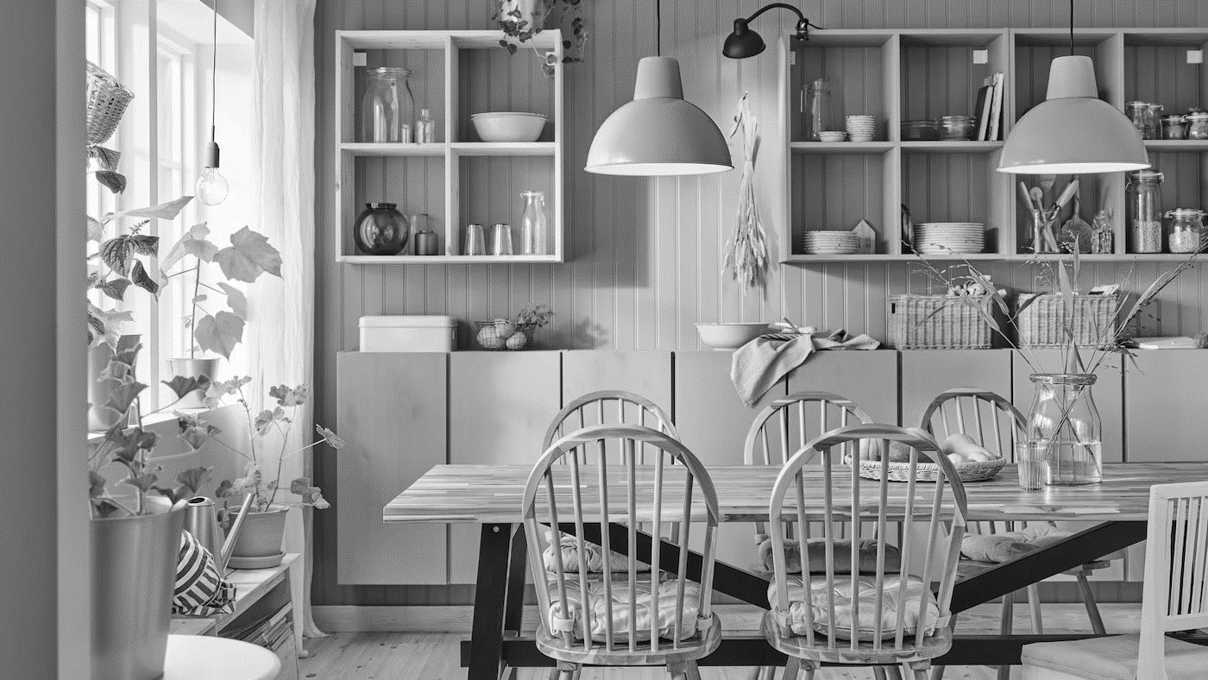
Target 5 Writing
Grammar - articles
Grammar
In the photo description, you should use indefinite articles [a/an/some].
Do you remember how to recognise the gender of nouns in Spanish?
Complete the sentences below to get full marks:
En la foto hay ____ mesa.
En la foto hay ____ sillas.
En la foto hay ____ jarrón.
En la foto hay ____ ventana.

Slide 142
Target 5 Writing
Grammar
LAS RESPUESTAS – THE ANSWERS
In the photo description, you should use indefinite articles [a/an].
Do you remember how to recognise the gender of nouns in Spanish?
Complete the sentences below to get full marks:
una
En la foto hay ____ mesa.
[unas]
En la foto hay ____ sillas.
un
En la foto hay ____ jarrón.
una
En la foto hay ____ ventana.

Slide 143
Target 5 Writing
Grammar - articles
Grammar
When you express your opinion, you usually use the definite articles [the].
This is particularly important in Q2 [40-word].
Complete the sentences below to get full marks:
Estás escribiendo un blog sobre tu insti. Menciona: • Tu asignatura favorita • las reglas • el uniforme escolar • el día escolar Escribe unas 40 palabras en español.
Mi asignatura favorita es ____ español. Me encanta _____ español porque es interesante. Sin embargo, odio _____ reglas porque son muy estrictas. Me gusta ____ uniforme escolar porque es cómodo y práctico. Creo que _____ día escolar es largo y aburrido.

Slide 144
Target 5 Writing
Grammar
LAS RESPUESTAS – THE ANSWERS
When you express your opinion, you usually use the definite articles [the].
Complete the sentences below to get full marks:
Estás escribiendo un blog sobre tu insti. Menciona: • Tu asignatura favorita • las reglas • el uniforme escolar • el día escolar Escribe unas 40 palabras en español.
Mi asignatura favorita es ____ español. Me encanta _____ español porque es interesante. Sin embargo, odio _____ reglas porque son muy estrictas. Me gusta ____ uniforme escolar porque es cómodo y práctico. Creo que _____ día escolar es largo y aburrido.
el
el
las
el
el
Often, in the Q2 40-word essay, the article will be given to you so you can reuse it. It will give you a clue about the gender/number of the noun.

Slide 145
Target 5 Writing
Grammar - articles
Grammar
Translate the following phrases accurately on your mini-whiteboard:
man
a man
some men
there is a man
there are some men

Slide 146
Target 5 Writing
Grammar - articles
Grammar
Translate the following phrases accurately on your mini-whiteboard:
girl
a girl
some girls
there is a girl
there are some girls

Slide 147
Target 5 Writing
Grammar - articles
Grammar
Translate the following phrases accurately on your mini-whiteboard:
table
a table
some table
there is a table
there are some tables

Slide 148
Target 5 Writing
Grammar - articles
Grammar
Translate the following phrases accurately on your mini-whiteboard:
chair
a chair
the chair
there is a chair
I love the chairs
I hate the chair

Slide 149
Target 5 Speaking
Grammar - SER (to be) vs ESTAR (to be)
Grammar
Do you remember why in Spanish we have two ways of saying ‘is’ (Es and Está)?
SER is used in contexts deemed more permanent.
ESTAR is used in contexts deemed more temporary.
Here are 2 acronyms to remember when to use SER or ESTAR:
SER (to be - permanent) | ESTAR (to be - temporary)
Description (Es genial) | Place
Occupation (Es médico) | Location (El niño está en clase)
Characteristic (Son altos) | Action (Está trabajando)
Time (Son las siete) | Condition (Está roto)
Origin (Soy inglesa) | Emotion (Están tristes)
Relation (Es mi madre)

Slide 150
Target 5 Speaking
Grammar
Grammar
Complete the gaps with the correct verb phrase:
example: El hombre ____________ el padre. (The man is the father.)
_______________ en el insti. (They are in school.)
_______________ tristes. (They are sad.)
La chica ________ rubia. (The girl is blond.)
_______________ contentos. (They are happy.)
_______________ español. (He is Spanish.)
_______________ en el parque. (They are in the park.)
_______________ jugando al fútbol. (She is playing football.)
es

Slide 151
Target 5 Speaking
Grammar
LAS RESPUESTAS – THE ANSWERS
Complete the gaps with the correct verb phrase:
example: El hombre ____________ el padre. (The man is the father.)
_______________ en el insti. (They are in school.)
_______________ tristes. (They are sad.)
La chica ________ rubia. (The girl is blond.)
_______________ contentos. (They are happy.)
_______________ español. (He is Spanish.)
_______________ en el parque. (They are in the park.)
_______________ jugando al fútbol. (She is playing football.)
es
Están
Están
es
Son
Es
Están
Está

Slide 152
Target 5 Speaking
Grammar
Grammar
To describe actions, we need to use the present continuous. There are 3 steps:
‘ESTAR’ (to be) example: Está (He or She is)
Drop the last 2 letters of the infinitive example: jugar OR comer
Add:
-ando for AR verbs example: jugando
OR -iendo for ER/IR verbs example: comiendo
Now translate:
example: He is eating → Está comiendo.
She is playing _______________ 4. They are listening ______________
He is working _______________ 5. They are eating ______________
They are listening _______________ 6. He is reading ______________
She is eating _______________ 8. They are watching ______________
está jugando
están escuchando
está trabajando
están comiendo
están escuchando
está leyendo
está comiendo
están viendo

Slide 153
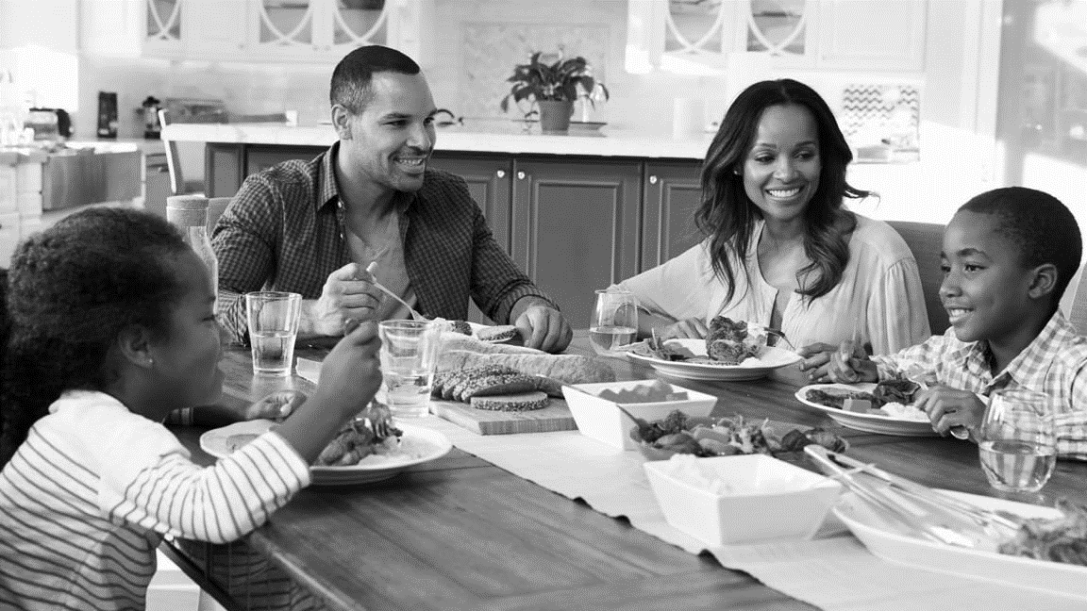
Target 5 Writing
Grammar
Grammar
1. Complete the sentences below:
La familia _______ en la cocina.
La mujer _______ sonriendo.
Los niños _______ contentos.
La mesa _______ grande.
2. Correct the errors in the sentences below:
En la foto, el hombre es alta.
La madre es contenta.
Los niños está muy pequeño.
La cocina es pequeño.

Slide 154
Target 5 Writing
Grammar
LAS RESPUESTAS – THE ANSWERS
1. Complete the sentences below:
está
La familia _______ en la cocina.
está
La mujer _______ sonriendo.
están
Los niños _______ contentos.
es
La mesa _______ grande.
2. Correct the errors in the sentences below:
En la foto, el hombre es alta.
La madre es contenta.
Los niños está muy pequeño.
La cocina es pequeño.
En la foto, el hombre es alto.
La madre está contenta
Los niños son muy pequeños.
La cocina es pequeña.

Slide 155
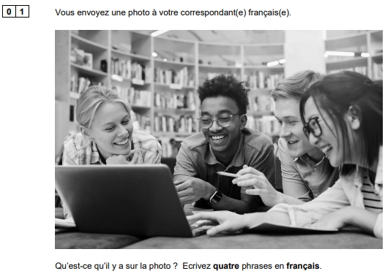
Exam question - Assessing progress
Target 5 Writing
Now on your own!
Describe this photo, translating accurately the English models into French.
Pay attention to the gender/number of the articles and adjectives.
Use “SER” and “ESTAR” accurately.
[In the photo, there are some students.]
[A girl is blond.]
[There is also a computer.]
[They are happy.]
End
3 minutes
Notes:
From June 2021 - Keep sentences VERY simple: students can use ‘il y a’ 4 times and write numbers in digit. They will get full marks by doing so.

Slide 156
Exam question - Assessing progress
Target 5 Writing
LAS RESPUESTAS – THE ANSWERS
[In the photo, there are some students.]
En la foto, hay [unos] estudiantes.
[A girl is blond.]
Una niña es rubia.
[There is also a computer.]
Hay un ordenador.
[They are happy.]
Están contentos.
Notes:
From June 2021 - Keep sentences VERY simple: students can use ‘il y a’ 4 times and write numbers in digit. They will get full marks by doing so.

Slide 157
Target 5 Writing
Session objectives: Question
practising the photo description for the writing paper Q1 Photo
using the present tense accurately Q3 Translation

Slide 158
Target 5 Writing
Accuracy when conjugating verbs will secure you more marks in Q3 Translation.
Previously, we practised the past tense and the future tense.
With a partner, translate the highlighted sentences, paying attention to the tense.
Series 2019
I send messages on my mobile.
I want a good job in the future.
I like to play basketball.
I do more sport in the summer.
We went to a concert in the bullring.
Series 2020
I live in a white house.
I go to school on the bus.
I went to the swimming pool on Sunday.
I like to drink a lot of water.
My brother does not want to get married.
Series 2021
My brother is good-looking.
I do homework in the bedroom.
I love to play video games on the computer.
I want to visit Spain again next summer.
I went to a friend’s party last Friday.
Series 2022
I have a small garden.
I don’t like to do homework.
Yesterday I ate chicken and salad.
I am going to work in a sports centre.
My sister wants to visit the south of Spain in January.

Slide 159
Target 5 Writing
LAS RESPUESTAS – THE ANSWERS
Series 2019
I send messages on my mobile.
I want a good job in the future.
I like to play basketball.
I do more sport in the summer.
We went to a concert in the bullring.
Series 2020
I live in a white house.
I go to school on the bus.
I went to the swimming pool on Sunday.
I like to drink a lot of water.
My brother does not want to get married.
Fuimos a un concierto en la plaza de toros.
Fui a la piscina domingo.
Series 2021
My brother is good-looking.
I do homework in the bedroom.
I love to play video games on the computer.
I want to visit Spain again next summer.
I went to a friend’s party last Friday.
Series 2022
I have a small garden.
I don’t like to do homework.
Yesterday I ate chicken and salad.
I am going to work in a sports centre.
My sister wants to visit the south of Spain in January.
Ayer comí pollo y ensalada.
Voy a trabajar en el polideportivo.
Fui a la fiesta de un amigo el viernes pasado.

Slide 160
Target 5 Writing
This week, let’s focus on accuracy in the present tense.
First, highlight the verbs in each sentence.
Series 2019
I send messages on my mobile.
I want a good job in the future.
I like to play basketball.
I do more sport in the summer.
We went to a concert in the bullring.
Series 2020
I live in a white house.
I go to school on the bus.
I went to the swimming pool on Sunday.
I like to drink a lot of water.
My brother does not want to get married.
Series 2021
My brother is good-looking.
I do homework in the bedroom.
I love to play video games on the computer.
I want to visit Spain again next summer.
I went to a friend’s party last Friday.
Series 2022
I have a small garden.
I don’t like to do homework.
Yesterday I ate chicken and salad.
I am going to work in a sports centre.
My sister wants to visit the south of Spain in January.

Slide 161
Target 5 Writing
LAS RESPUESTAS – THE ANSWERS
First, highlight the verbs in each sentence.
Series 2019
I send messages on my mobile.
I want a good job in the future.
I like to play basketball.
I do more sport in the summer.
We went to a concert in the bullring.
Series 2020
I live in a white house.
I go to school on the bus.
I went to the swimming pool on Sunday.
I like to drink a lot of water.
My brother does not want to get married.
Series 2021
My brother is good-looking.
I do homework in the bedroom.
I love to play video games on the computer.
I want to visit Spain again next summer.
I went to a friend’s party last Friday.
Series 2022
I have a small garden.
I don’t like to do homework.
Yesterday I ate chicken and salad.
I am going to work in a sports centre.
My sister wants to visit the south of Spain in January.

Slide 162
Target 5 Writing
Grammar
Grammar – the present
There are 3 steps to conjugate verbs in the present (like other tenses):
What are they?
Choose a subject (noun or pronoun) example: yo, tú, él, ella, nosotros
Remove the last 2 letters from the infinitive example: comer, vivir, escuchar
Add an ending example: (yo) como
(nosostros) vivimos
(él) escucha
The step 3 (adding an ending) varies according to the type of verbs:
-ar verb | -er verbs | -ir verbs
(yo) escucho | (yo) como | (yo) vivo
(él) escucha | (él) come | (él) vive
(nosotros) escuchamos | (nosotros) comemos | (nosotros) vivimos
(ellas) escuchan | (ellas) comen | (ellas) viven
Notes:
j’ai
il / elle a
on a
ils / elles ont
past participles of -ER verbs
je suis allé(e)

Slide 163
Target 5 Writing
Grammar
Grammar – the present
Conjugate these verbs in the present tense:
I live vivo
We play jugamos
He listens escucha
I eat como
She lives vive
Some verbs are irregular, so you need to learn them off by hard.
Translate the most common ones:
I go voy 5. it is es/está
I do hago 6. there is/are hay
I am soy/estoy 7. it does hace
I have tengo 8. we go vamos
I listen escucho
They eat comen
She eats come
We live vivimos
We listen escuchamos
Notes:
j’ai
il / elle a
on a
ils / elles ont
past participles of -ER verbs
je suis allé(e)

Slide 164
Target 5 Writing
Now translate each verb with a partner.
Series 2019
I send messages on my mobile.
I want a good job in the future.
I like to play basketball.
I do more sport in the summer.
We went to a concert in the bullring.
Series 2020
I live in a white house.
I go to school on the bus.
I went to the swimming pool on Sunday.
I like to drink a lot of water.
My brother does not want to get married.
Series 2021
My brother is good-looking.
I do homework in the bedroom.
I love to play video games on the computer.
I want to visit Spain again next summer.
I went to a friend’s party last Friday.
Series 2022
I have a small garden.
I don’t like to do homework.
Yesterday I ate chicken and salad.
I am going to work in a sports centre.
My sister wants to visit the south of Spain in January.

Slide 165
Target 5 Writing
LAS RESPUESTAS – THE ANSWERS
Now translate each verb with a partner.
Series 2019
I send messages on my mobile.
I want a good job in the future.
I like to play basketball.
I do more sport in the summer.
We went to a concert in the bullring.
Series 2020
I live in a white house.
I go to school on the bus.
I went to the swimming pool on Sunday.
I like to drink a lot of water.
My brother does not want to get married.
envio/mando
quiero
me gusta
hago
vivo
voy
me gusta
no quiere
es
hago
me encanta
quiero
Series 2021
My brother is good-looking.
I do homework in the bedroom.
I love to play video games on the computer.
I want to visit Spain again next summer.
I went to a friend’s party last Friday.
tengo
no me gusta
quiere
Series 2022
I have a small garden.
I don’t like to do homework.
Yesterday I ate chicken and salad.
I am going to work in a sports centre.
My sister wants to visit the south of Spain in January.

Slide 166
Exam question - Assessing progress
Target 5 Writing
Now on your own!
Translate the full sentences.
Series 2019
I send messages on my mobile.
I want a good job in the future.
I like to play basketball.
I do more sport in the summer.
We went to a concert in the bullring.
Series 2022
I have a small garden.
I don’t like to do homework.
Yesterday I ate chicken and salad.
I am going to work in a sports centre.
My sister wants to visit the south of Spain in January.
End
3 minutes
Notes:
From June 2021 - Keep sentences VERY simple: students can use ‘il y a’ 4 times and write numbers in digit. They will get full marks by doing so.

Slide 167
Exam question - Assessing progress
Target 5 Writing
Now on your own!
Translate the full sentences.
LAS RESPUESTAS – THE ANSWERS
Series 2019
I send messages on my mobile.
I want a good job in the future.
I like to play basketball.
I do more sport in the summer.
We went to a concert in the bullring.
Mando/Envío mensajes en mi móvil. Quiero un buen trabajo en el futuro. Me gusta jugar al baloncesto. Hago más deporte en (el) verano. Fuimos a un concierto en la plaza de toros.
Series 2022
I have a small garden.
I don’t like to do homework.
Yesterday I ate chicken and salad.
I am going to work in a sports centre.
My sister wants to visit the south of Spain in January.
Tengo un pequeño jardín / jardín pequeño. No me gusta hacer (los) deberes. Ayer comí pollo y ensalada. Voy a trabajar en un centro deportivo. Mi hermana quiere visitar el sur de España en enero.
Notes:
From June 2021 - Keep sentences VERY simple: students can use ‘il y a’ 4 times and write numbers in digit. They will get full marks by doing so.

Slide 168
Week Date | Module / Topic | Writing | Key language
WEEK 4 29/01/24 | Health, lifestyle and food/drinks | Q2 40-word: using the present tense accurately to describe actions | present with yo, él/ella present common irregular (voy, hago, tengo, soy, estoy, puedo)
 | Customs, celebrations and food/drinks | Q4 90-word: producing answers with narration in the past and in the future | hice mucho voy a hacer mucho primero después / luego finalmente fui / hice me gustaría preterite tense with yo near future with yo

Slide 169
Lessons will be uploaded weekly
Please check again each Friday for the following week’s plan!
If you spot typos or errors, please email: julien.violette@harrisfederation.org.uk
Please give us feedback or suggestions by completing a short feedback ticket: HFLanguages Feedback Ticket

