Slide 1
Welcome to this event! Please ‘take your seats’, read our ‘etiquette’, and feel free to chat . We will start in Zoom at 16:00
ALL London etiquette
In summary – we aim to be professional and kind!
The purpose of this webinar is for language professionals to share ideas and resources relating to teaching languages in a relaxed, friendly and supportive environment.
This is recorded. If any contributions are not relaxed, friendly and supportive, the host will suspend the contributor immediately.
Any problems – tell the host in chat so that we can deal with it e.g. by removing participants and resolving amicably later! (No time to negotiate during webinar!)
Do not share this address with others. It is a private event for registered participants.
Disclaimer
ALL London is very happy to host these events. It does not charge participants, speakers kindly offer their service without payment and volunteers run the events.
Speakers and participants are responsible for what they say.

Slide 2
Housekeeping!
#ALL4language
#mfltwitterati
If you need a new name, tell us in the chat and we can rename you!
Please feel free to use the chat – we love interactivity! Add ‘Q’ in front of a question.
The session is recorded. Links will be sent tomorrow to recordings / any presentations available / download of chat
Due to run about 60 minutes..no need to apologise if you need to leave early … we understand!
Video and audio disabled during presentation.

Slide 3
Recording starts now …!
This session is being recorded.
If you do not wish your name and chat to appear, please leave the room.

Slide 4
Preparing for Summer 2023

Slide 5
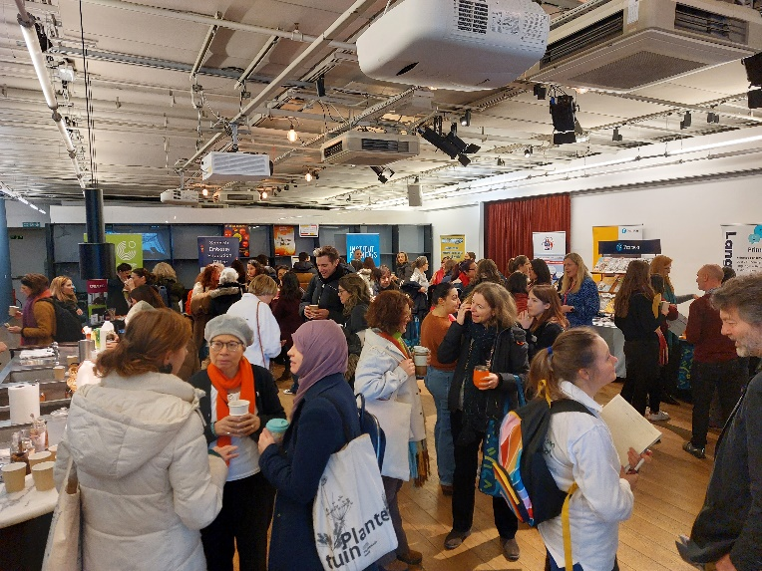
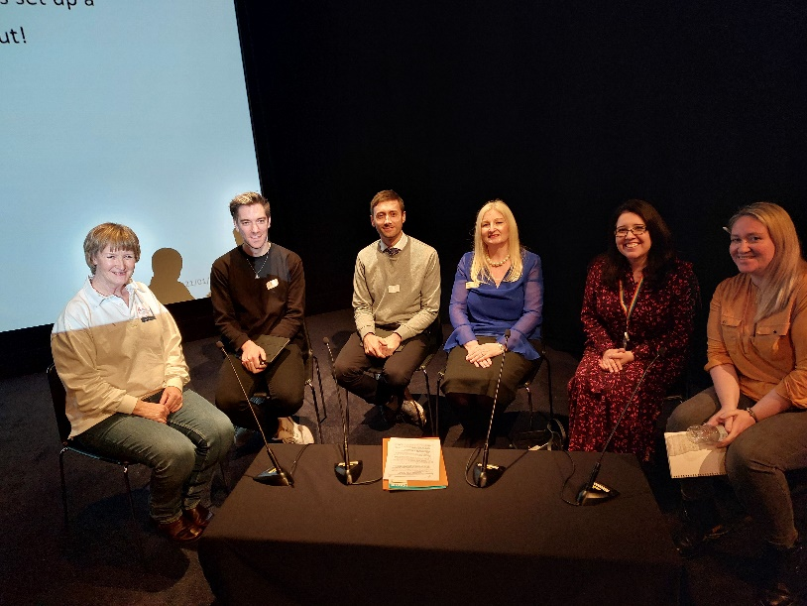
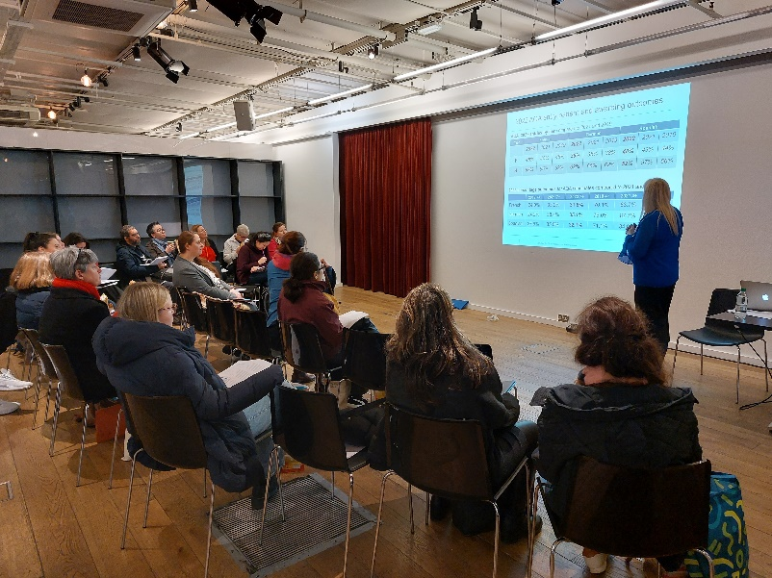
Saturday 21st January: GCSE 2024

Slide 6
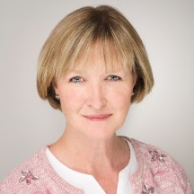
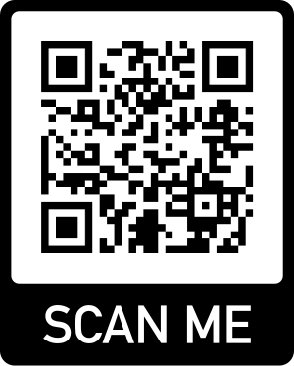
Join us today become a member!
Helen Myers, @HelenMyers, ALL London Chair
Receive 10% discount on membership with ALLJan10 (Offer runs until 30 January)
www.all-languages.org.uk
info@all-languages.org.uk
01332 227779
Association for Language Learning
@all4language

Slide 7
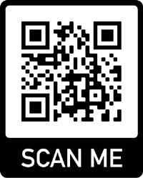
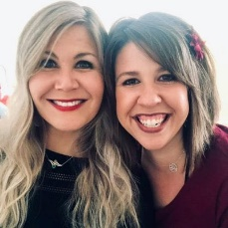
Coming soon …..
http://www.all-london.org.uk/site/index.php/webinars/
Thursday 9th February 20:45 – 21:45
A TiLT Webinar with Caroline Schlegel and Aubrey Swisher - Authentic Grammar Acquisition: DUU It Right!
Tuesday 21st February 2023 8 – 9 pm
A TiLT Webinar with Julia Morris-
Chat GPT
Thu 9th Feb 2023

Slide 8
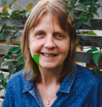
ALL National: Language World!
https://www.delegate-reg.co.uk/lw2023/

Slide 9
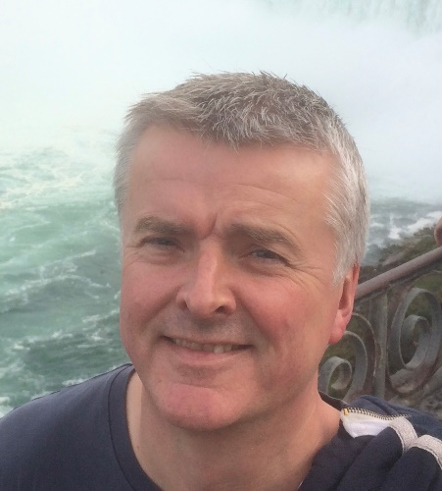
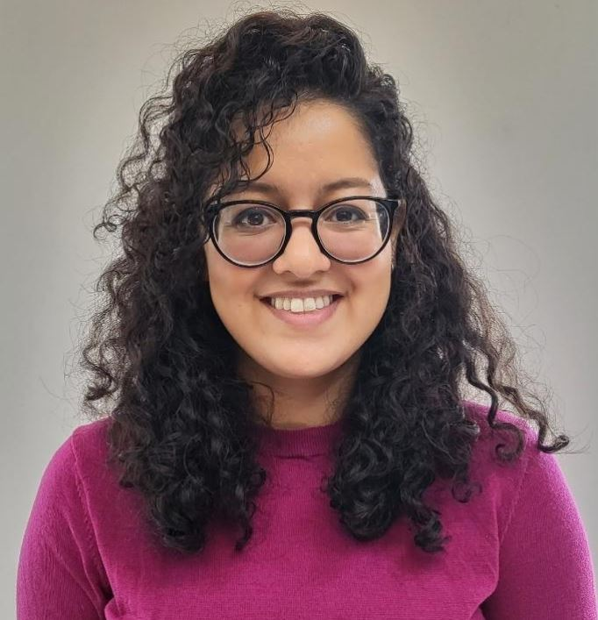
Preparing for Summer 2023
This session will cover:
National entry picture for French, German, Spanish – 2022 compared to 2019
Overview of 2022 outcomes and grade boundaries
Key messages across the skills from the 2022 exams
Areas of focus for 2023 exams
GCSE reform update
Support from AQA
Ian is the Curriculum Manager at AQA in the Languages Curriculum team, with many years of experience as a former MFL head of department and Senior French editor for Authentik Language Learning before joining AQA.
Sadaf Najib, AQA Curriculum Support Manager, will also be helping to answer any questions you may have during the session.

