Slide 1
Maud WARET
Anti-racism advocate, decolonising the curriculum presentator, and podcaster

Slide 2
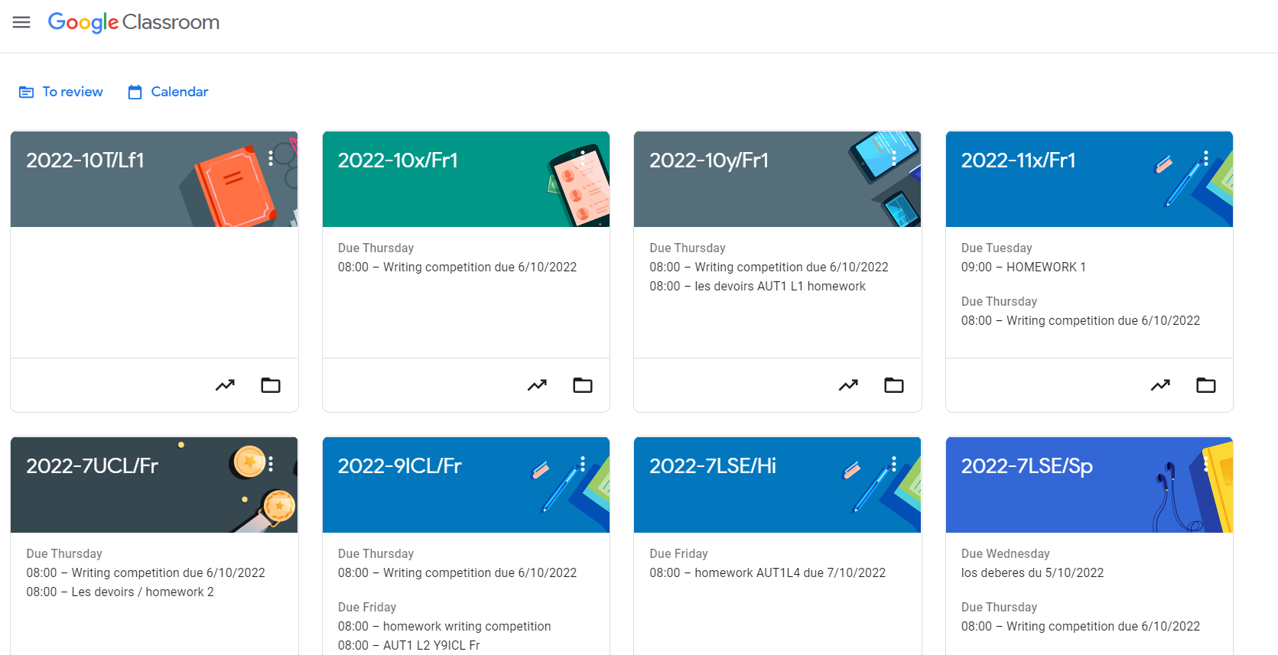
Humanities and Languages teacher by day

Slide 3
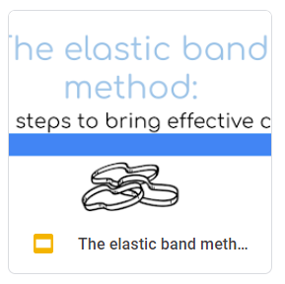
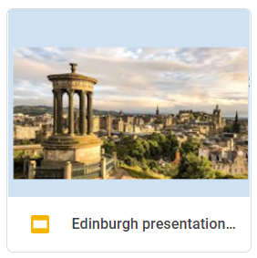
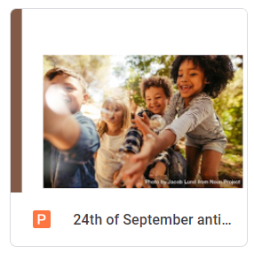
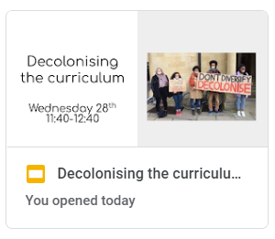
Webinars, presentations and CPDs
For school staff
For Y12-Y13
For KS3
For teaching assistants
For MFL teachers
For councils

Slide 4
Reflecting on
Racism
Institutionalised racism
Tribalism
Colorism
Terminology
Concepts

Slide 5
What is colonisation?
the action or process of settling among and establishing control over the indigenous people of an area.

Slide 6
WHAT IS ‘DECOLONISING’ THE CURRICULUM
First, ‘decolonising the curriculum’ asks us to look at our shared assumptions about how the world is. It is questioning the impact of colonisation in history, economy and cultural representations.
Second, ‘decolonising the curriculum’ asks us to think about the implications of a more diverse student body in terms of pedagogy and achievement.
Third, ‘decolonising the curriculum’ means making BAME public and historical figures more predominant, making BAME artists seen and heard.

Slide 7
WHAT IS ‘DECOLONISING’ THE GAZE
First, it is necessary to recognise that the way we perceive others is biased and at times prejudiced.
Then it is important to alter our perspective:
To change the way we look at others
To decolonise our gaze.

Slide 8
Providing
Pragmatic
Classroom tested
Functional
Accessible
Good value
Resources and ideas

Slide 9
WHAT CAN I DO TO STOP RACISM?
Use inclusive posters

Slide 10
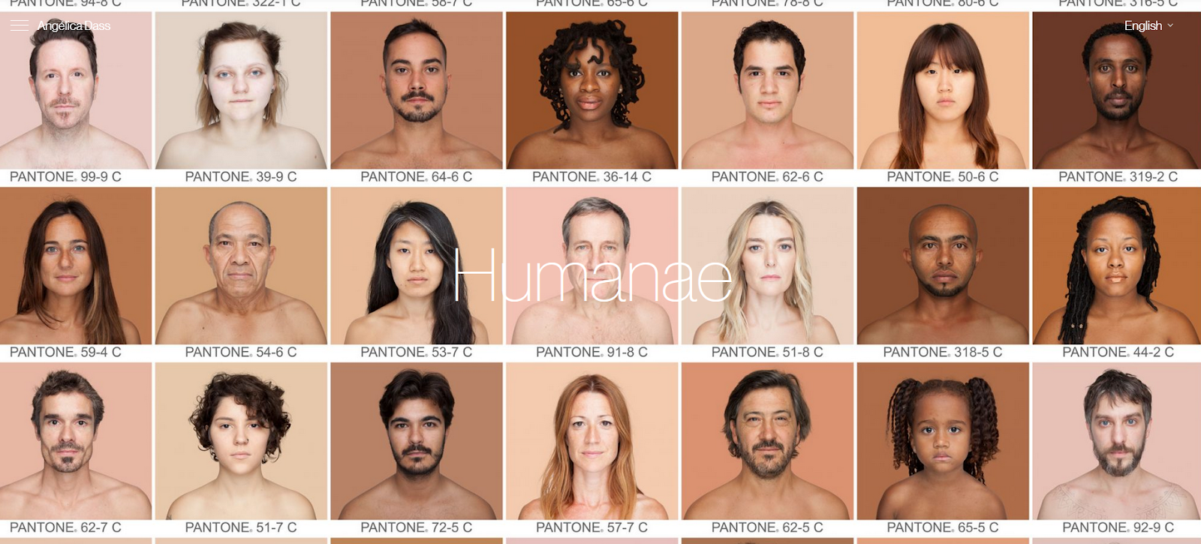
https://angelicadass.com/photography/humanae/

Slide 11
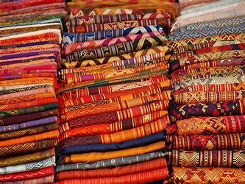
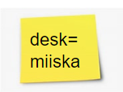
Decolonise the EAL classroom
FLAGS FABRICS POSTERS
desk=
miiska
WORLD MAP with PINS
TEXTBOOKS
POST IT NOTES
DICTIONARIES

Slide 12
Primary school library
https://rootseditions.com/boutique/
https://youtu.be/D9Ihs241zeg

Slide 13
MOVIES FOR FILM CLUB

Slide 14
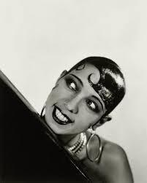
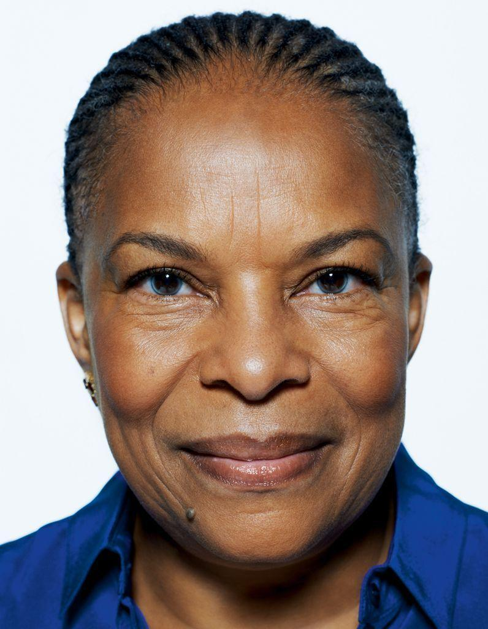
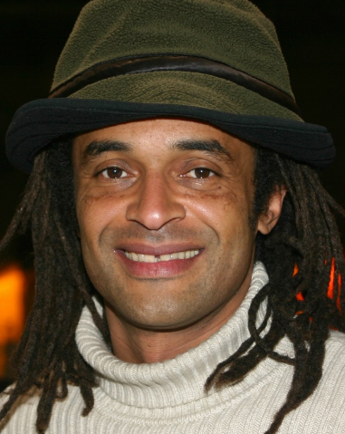
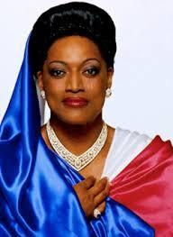
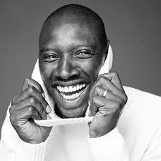
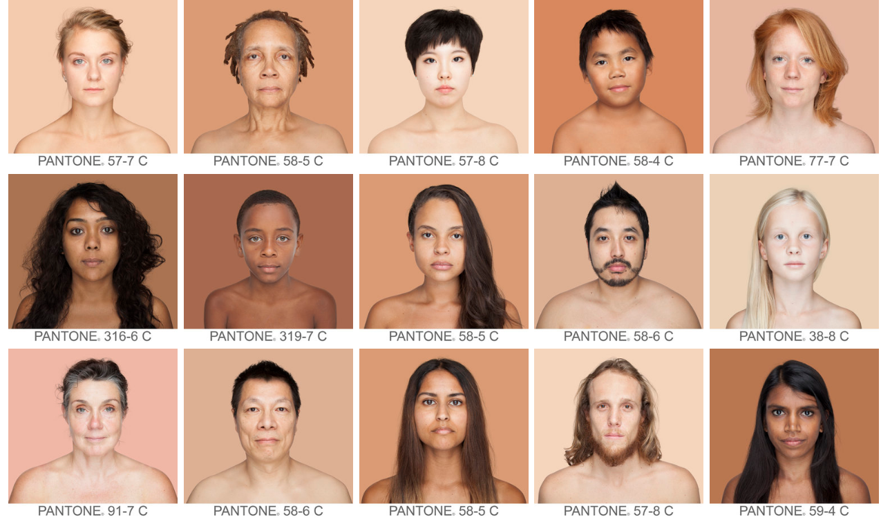
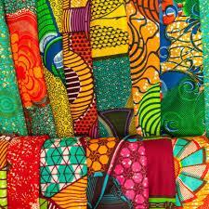
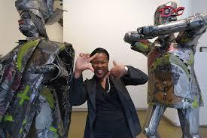
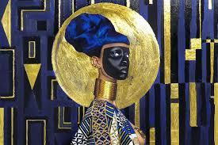
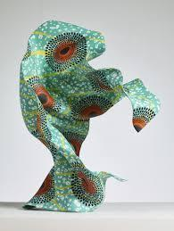
RESOURCES IDEAS FOR THE ‘DECOLONISED’ CLASSROOM
Posters
VIPs
African art and fabrics
DVDs
Books
School Policies
Read the uniform policy.
Is it inclusive?
Is it discriminating?
Consult the Equality Act 2010.
Ask for a redraft.

Slide 15
Books for your Black and African American library

Slide 16
Providing
Inclusive
Practical
Empirical
Honest
professional
Case studies

Slide 17
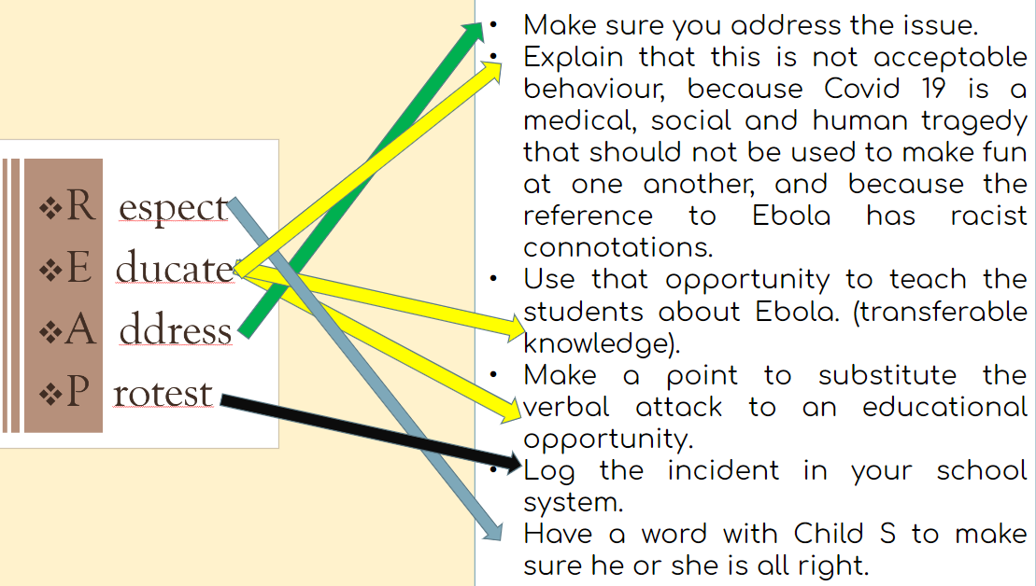
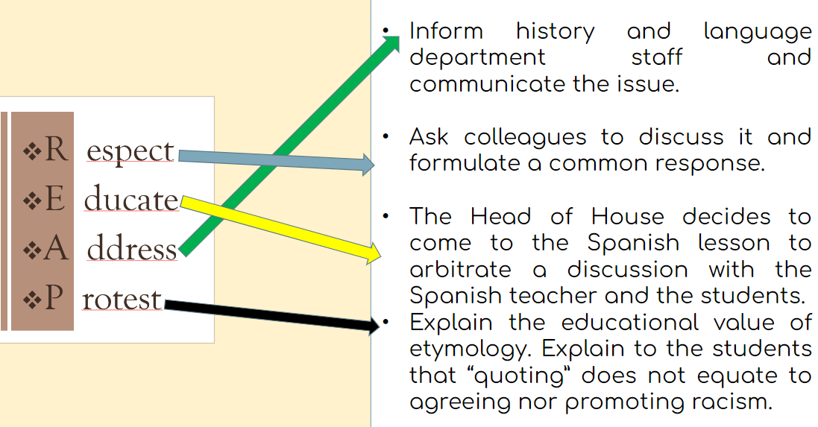
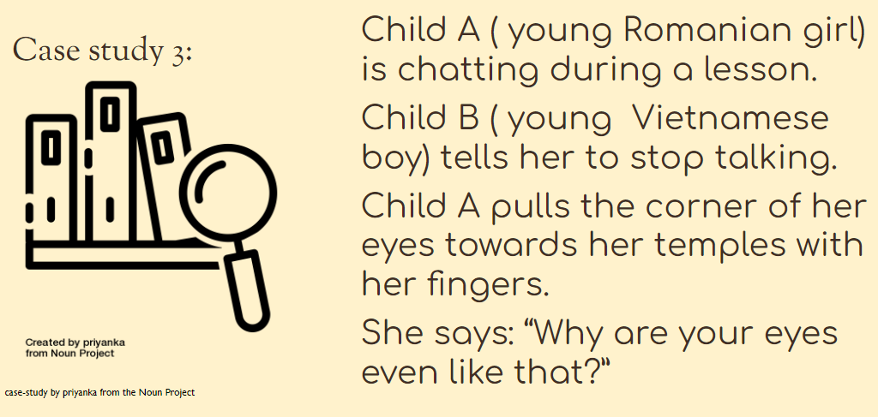
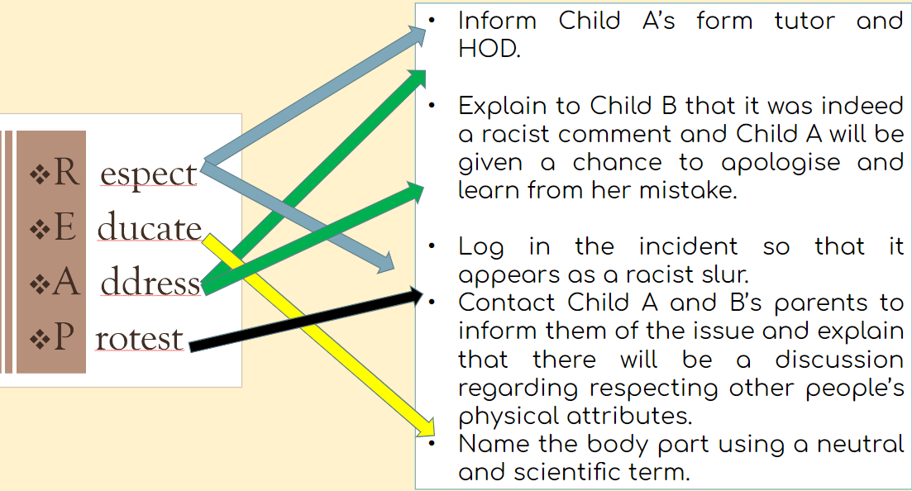
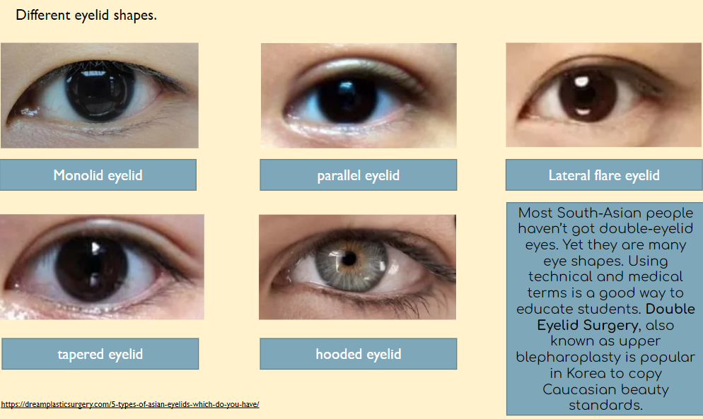

Slide 18
Providing
School-friendly
Activity ideas
Different visions
Applicable change
Acti-visions

Slide 19
A school calendar of anti-racism ‘activisions’.
September: 15/09 Afro Hair Day
October: Black History month
November: Josephine Baker’s ashes at the Panthéon
La mulâtresse Solitude (29/11/1802)
December: a decolonised Christmas
January: The Three Kings: Balthasar, king of Ethiopia.
February: Mardi-Gras in New Orleans, USA.
March: 13/03/2020 Breonna Taylor’s murder, BLM movement
April: Pâques dans les DOM-TOMs/Easter around the world.
The Bristol Bus Boycott (30/04/1963)
June: Dido Elisabeth Belle ( Kenwood House, Hampstead)
July: Patrice Lumumba’s birthday (02/07/1925)

Slide 20
Afro Hair Day
15th of September 2022

Slide 21
https://angelicadass.com/photography/humanae/

Slide 22
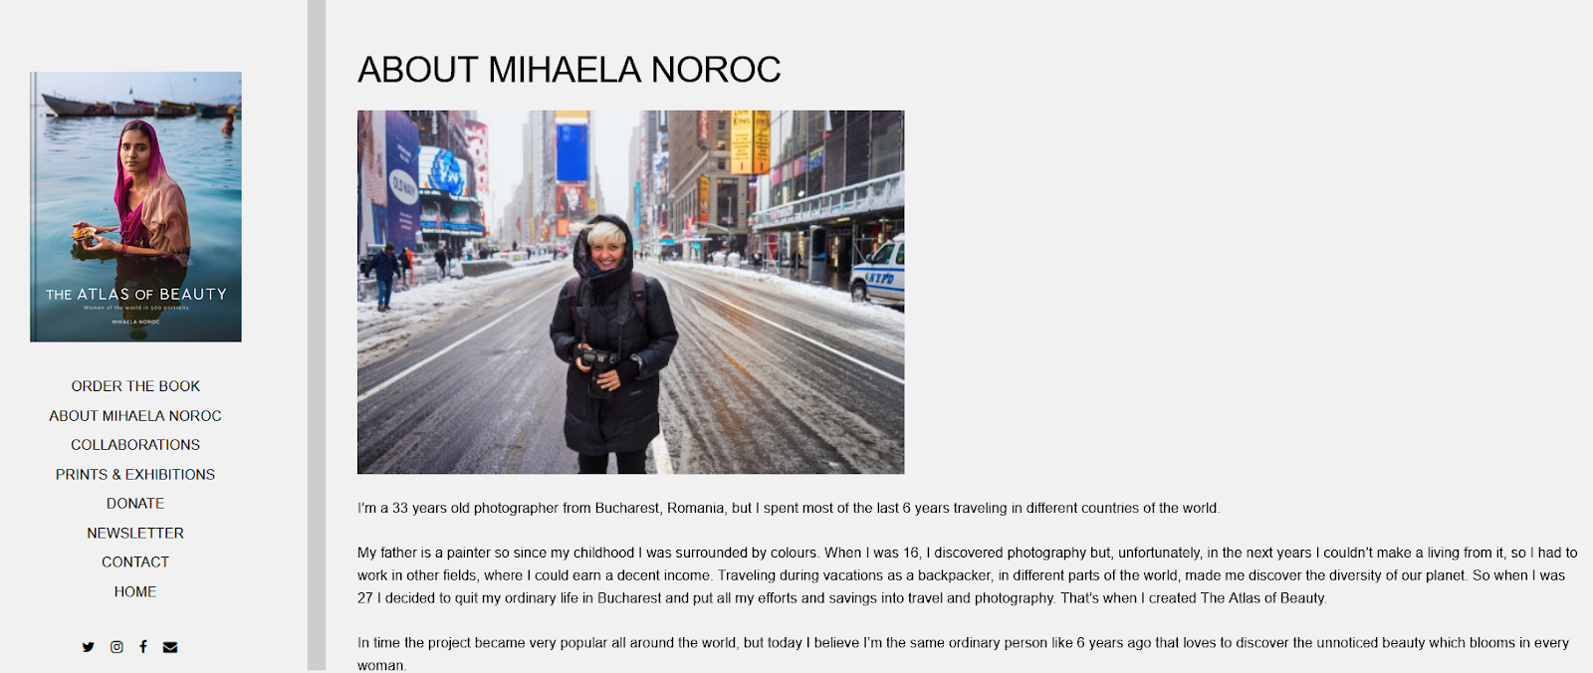
https://theatlasofbeauty.com/about

Slide 23
If you want to know more about Afro hair

Slide 24
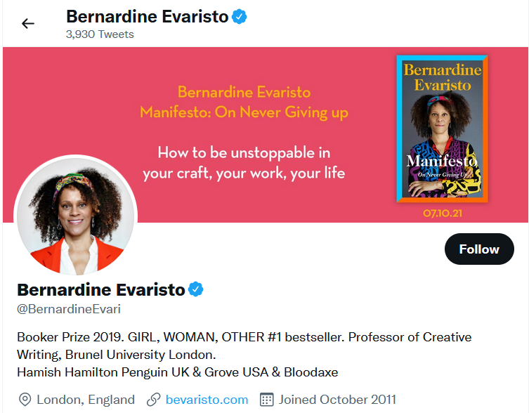
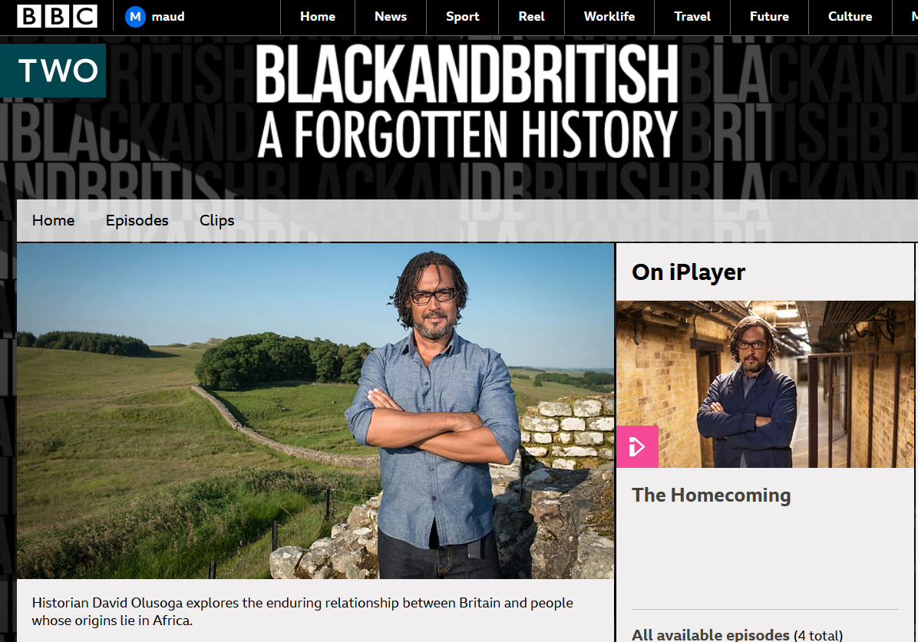
Make these intellectual Black UK figures national treasures for the next generation. Make them famous.

Slide 25
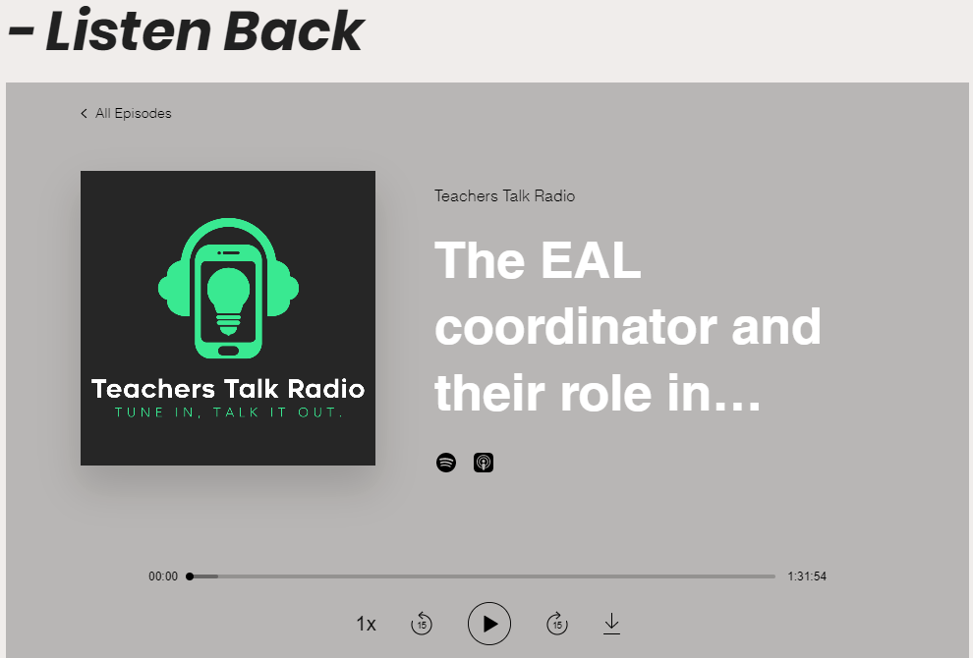
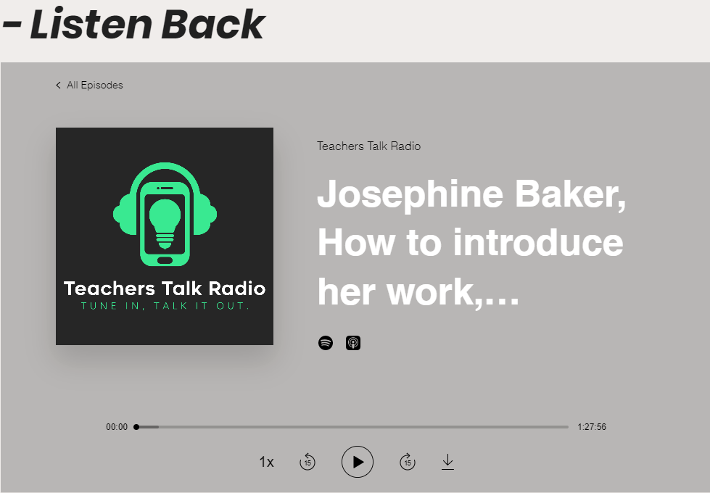
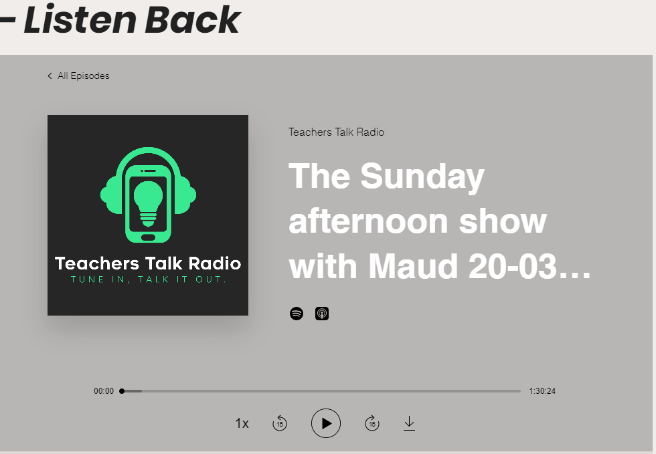
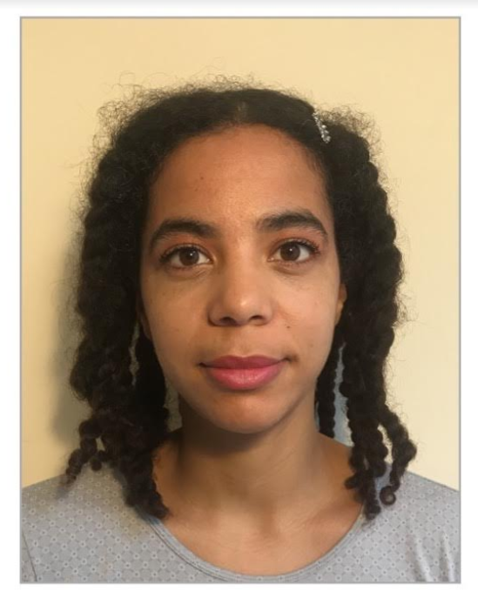
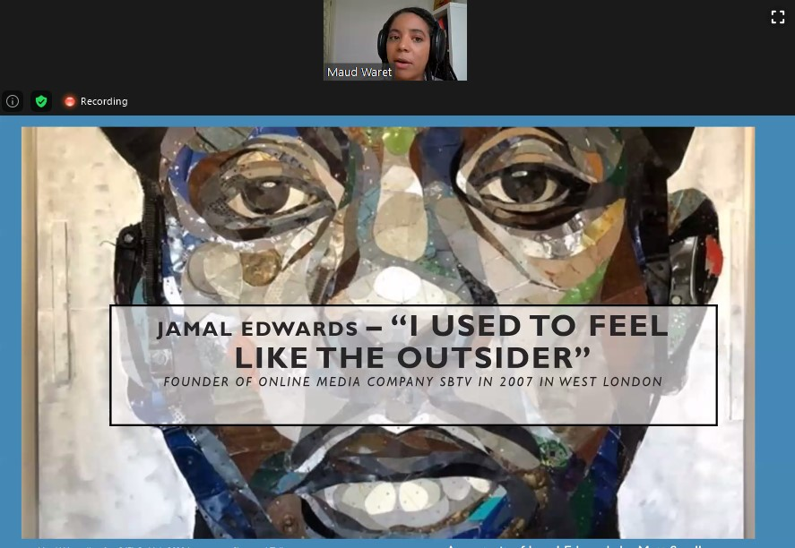
Decolonise EAL teaching
Josephine Baker podcast
Institutionalised racism podcast
#profprofMFL profile details
Beyond Black History Month: decolonising the curriculum

Slide 26
Contact me for more information:
@profprofMFL

