Slide 1
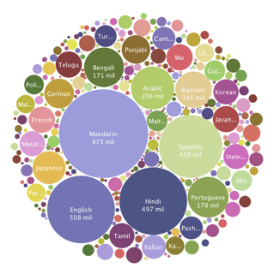
Welcome to the world of Language Teaching!
ALL London Trainee Teacher Event
hosted by King’s College London
October 2022

Slide 2
Language teachers
help young people explore languages
and cultures
and communication
and self-expression
and creativity
We are unique!
Notes:
Please feel free to elaborate on any of these points

Slide 3
Language teachers
need each other
need awareness of professional history and research and examples of how theory and practice link
need connections to the wider world
need refreshment and opportunities to share
have a home in ALL

Slide 4
What is ALL?
The Membership Association for teachers of Languages
At all points in their career
In all sectors
Around the country

Slide 5
What does ALL do for the Language teacher?
REPRESENTATION
Represents your interests nationally e.g. articulates views in Consultations
Has a Council with elected representatives from all career stages
Works with significant national partners
CPD
Provides you with information and support
Produces regular peer-created publications, such as Languages Today magazine, Language Learning Journal and online Language Zones
Offers opportunities for you to get together
Runs events and training courses tailored to your needs
Offers the opportunity for you to present and write for others
Runs the annual Language World conference.
Notes:
Examples:
ALL local events
Working with DfEE and national bodies
ALLNet and website
Previous Erasmus+ projects: THE LANGUAGE MAGICIAN, ELAPSE
Current Erasmus+ project : GRAIL KNIGHTS
Events on website are listed here: https://www.all-languages.org.uk/calendar_events/events/
ALL members can get involved in running training through local events, and can suggest articles blogs etc. for publication through info@all-languages.org.uk

Slide 6
Especially for you
ALL hosts an annual online event for trainees and ECTs at the start of the academic year
ALL London hosts an annual in-person event for trainees in and around the capital in October
ALL hosts a monthly informal online meeting for ECTs and trainees
Details of all of these events appear in ALLNet and on the webpage following …
https://www.all-languages.org.uk/student/

Slide 7
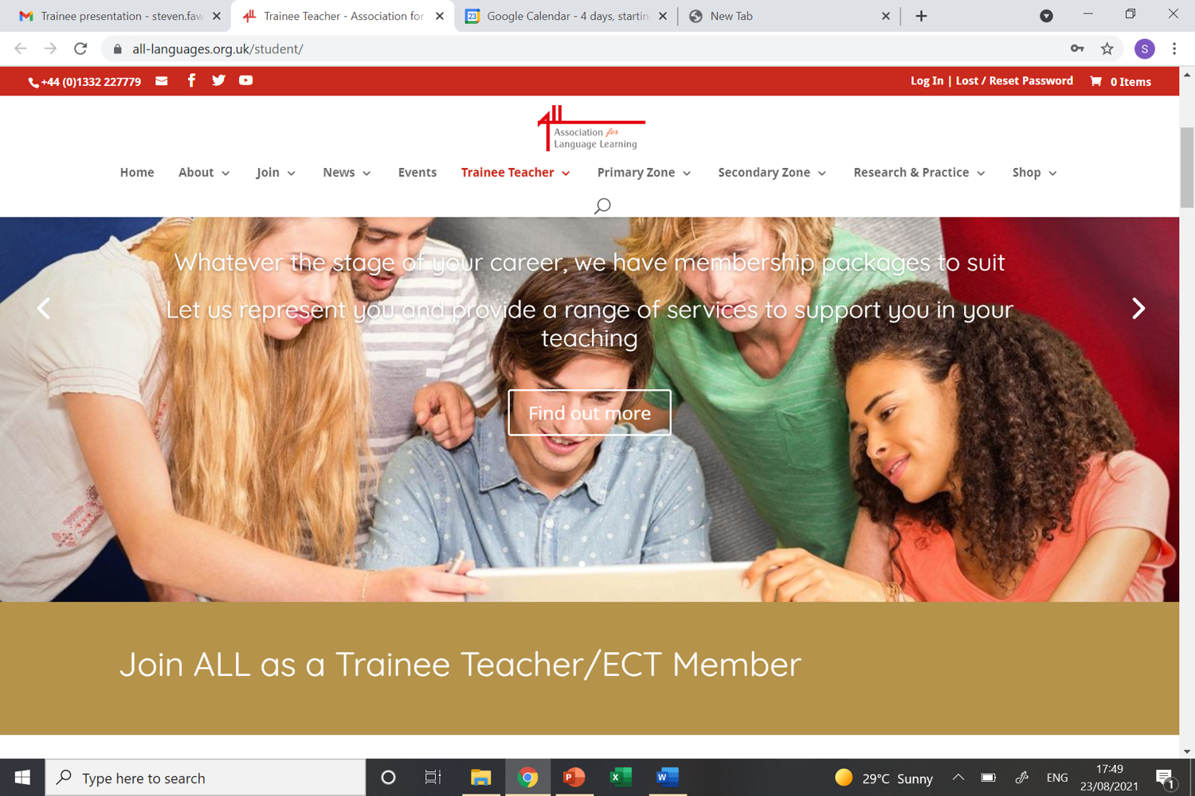

Slide 8
The ALL Website
Your page : https://www.all-languages.org.uk/student/
Scroll down to a ‘post-it’ called ‘Shortcut’ to download a document pointing you to lots of resources and sources of information especially relevant to your training year.

Slide 9
Main areas of the website
The strip at the top of each page guides you:
News and events
Primary Zone
Secondary Zone
Research and Practice: a rich area and includes the individual Language Zones (HHCL (Home, Heritage, Community Languages) French, Spanish, German, Arabic, Chinese, Italian, Russian)
Notes:
NB Some areas are only available to ALL members

Slide 10
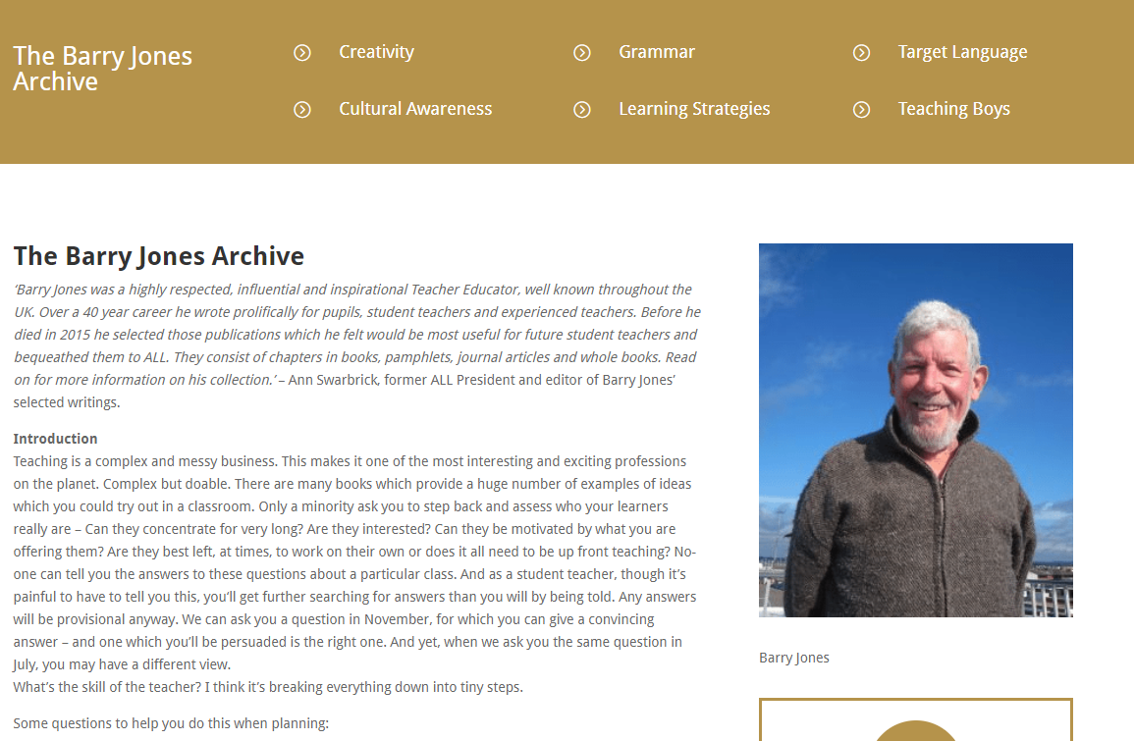

Slide 11
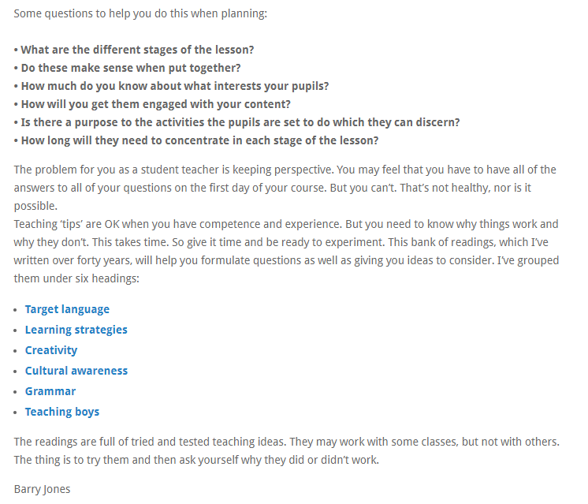
Notes:
This area is highly relevant to trainees

Slide 12
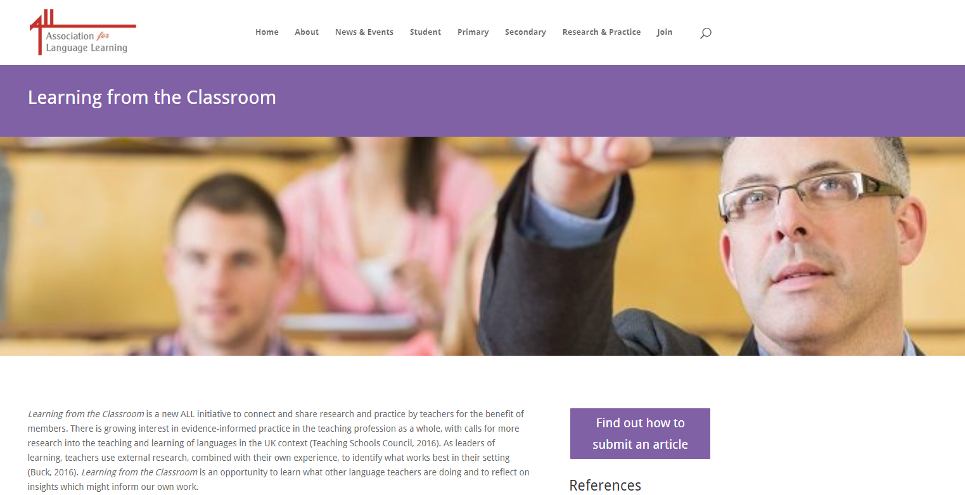
Notes:
Article from practising teachers

Slide 13
Languages Today magazine
Your termly glossy
See a sampler here:
https://www.all-languages.org.uk/product/languages-today-spring-summer-2021-digital-sample/

Slide 14
Why join ALL?
- To be well informed: Up to date with news and developments from the world of languages through our magazine, journals and e-newsletter.
- To be adaptable: Discovering and applying new teaching methods, resources and technologies, from other teachers eager to share their practice.
To be proactive: Taking control of your own professional development, and taking advantage of the many training events on offer.
- To be networked: Part of the national community of language teachers, sharing support and encouragement.
- To be motivated: With regular boosts of ideas and inspiration, keeping you on the top of your game, and reminding you why you became a teacher!
ESPECIALLY IMPORTANT POST-TRAINING
Notes:
You might remind of the risk of getting isolated professionally once the training year is over

Slide 15
Events announced in weekly ALLNet email to members
ALL Local group events
in Primary Hubs
in Networks and Branches
Large programme of online events and recordings
including monthly social webinars for trainees and ECTs

Slide 16
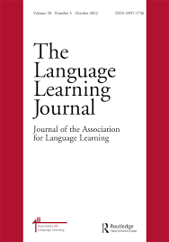
LLJ and resources
Language Learning Journal is ALL’s flagship research publication, essential for your essay-writing and research; you get free access as a member
https://www.all-languages.org.uk/research-practice/language-learning-journal-llj/
Language Zones – enjoy and contribute – articles on the Languages you love
https://www.all-languages.org.uk/research-practice/language-zones/
ALL Literature wiki – resources from other teachers on the exploitation of authentic texts, and much more!
http://all-literature.wikidot.com/

Slide 17
What do members get?
Languages Today magazine
Regular e-newsletter - ALLNet
Online access to the members’ area, and electronic issues of journals
Discounted or free training courses locally and nationally, tailored to your needs
Great special offers from our Corporate Members
Discounts on delegate fee to the annual conference, Language World.
The sense of ‘community’ and friendships.
Notes:
In 202s Language World is called ‘Languages for Social Justice’ and is in March.

Slide 18
Special membership rate for trainee teachers and ECTs!
£27.50 per year
(for the 3 years of training and ECT)
https://www.all-languages.org.uk/product-category/membership/individual/student/
Notes:
Because you are special to the community!
https://www.all-languages.org.uk/product-category/membership/individual/student/

Slide 19
How do I join ALL?
Special promo code for attendees of the ALL London October 2022 Teacher Trainee Event
ECT10 which is valid until 30th November 2022.
Online https://www.all-languages.org.uk/join/
By phone 01332 227779
By email info@all-languages.org.uk
Also follow ALL on Twitter: @ALL4Language
Or on Facebook: https://www.facebook.com/alllanguages.org.uk

Slide 20
Save the date
Making a great start:
https://www.all-languages.org.uk/student/ect-years/
Regular ECT/Trainee Teacher Events
See ALLNet or ALL Calendar

Slide 21
News from some of our partners

Slide 24
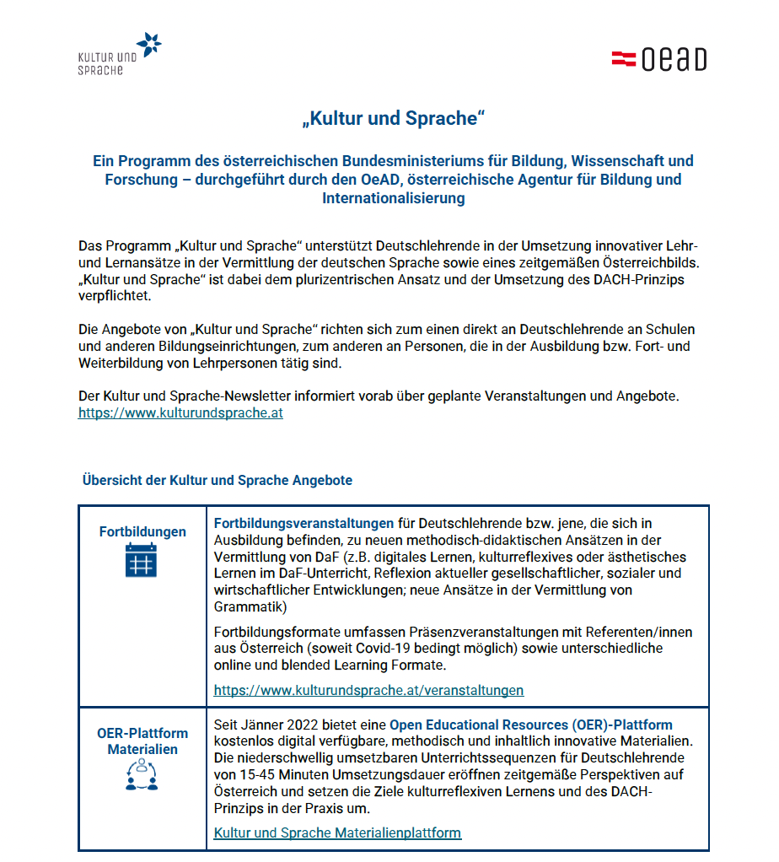
16th October
Austrian Day
London

Slide 25
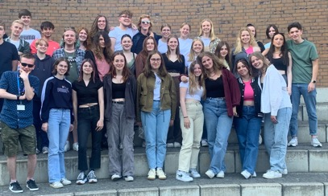
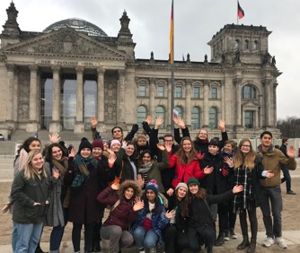
UK-German Connection
We are dedicated to increasing contacts and understanding between young people in the UK and Germany.
What we offer:
Funding for school partnerships:
Staff planning visits
First-time taster trips
Thematic projects and activities
Bursaries to maintain school partnerships
https://ukgermanconnection.org/pp/funding/
Partnership support:
Advisory service
Facilitation of planning discussions
'Café Connect’: virtual cultural exchange for school partnerships
https://ukgermanconnection.org/pp/partnerships/

Slide 26
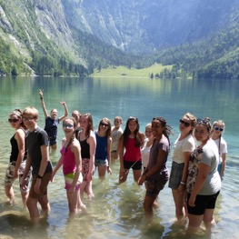
UK-German Connection
What we offer:
Opportunities for schools:
Host a German teacher at your school
Cultural Exchange Ambassadors: for language assistants
Become a German Pupil Course group leader
Pupil exchange with a partner school in NRW or Bavaria
https://ukgermanconnection.org/pp/programmes/
Opportunities for young people:
Thematic youth seminars and webinars
Language & culture immersion courses
Café Connect: moderated virtual exchange
UK-German Youth Council
Still & Sparkling UK-German youth newsletter
https://ukgermanconnection.org/yp/
Get in touch: info@ukgermanconnection.org / 020 7824 1570
Twitter: @ukgconnection / Facebook: @ukgermanconnection

Slide 33
The IOE Confucius Institute Annual Conference is on 12th November
https://ci.ioe.ac.uk/annual-chinese-teaching-conference-2/2022-annual-chinese-teaching-conference/

Slide 34
CPD programme for the Arabic Teachers’ Council in London and Southern England.
The Arabic Teachers’ Council will soon share a free booklet; one has games’ templates with instructions and the second has been developed by a primary school teacher and covers a topic with scaffolded activities.
The Arabic Certificate Course at Goldsmiths will start on 8th October with all sessions online this year.

Slide 36
https://www.linguascope.com/

Slide 37
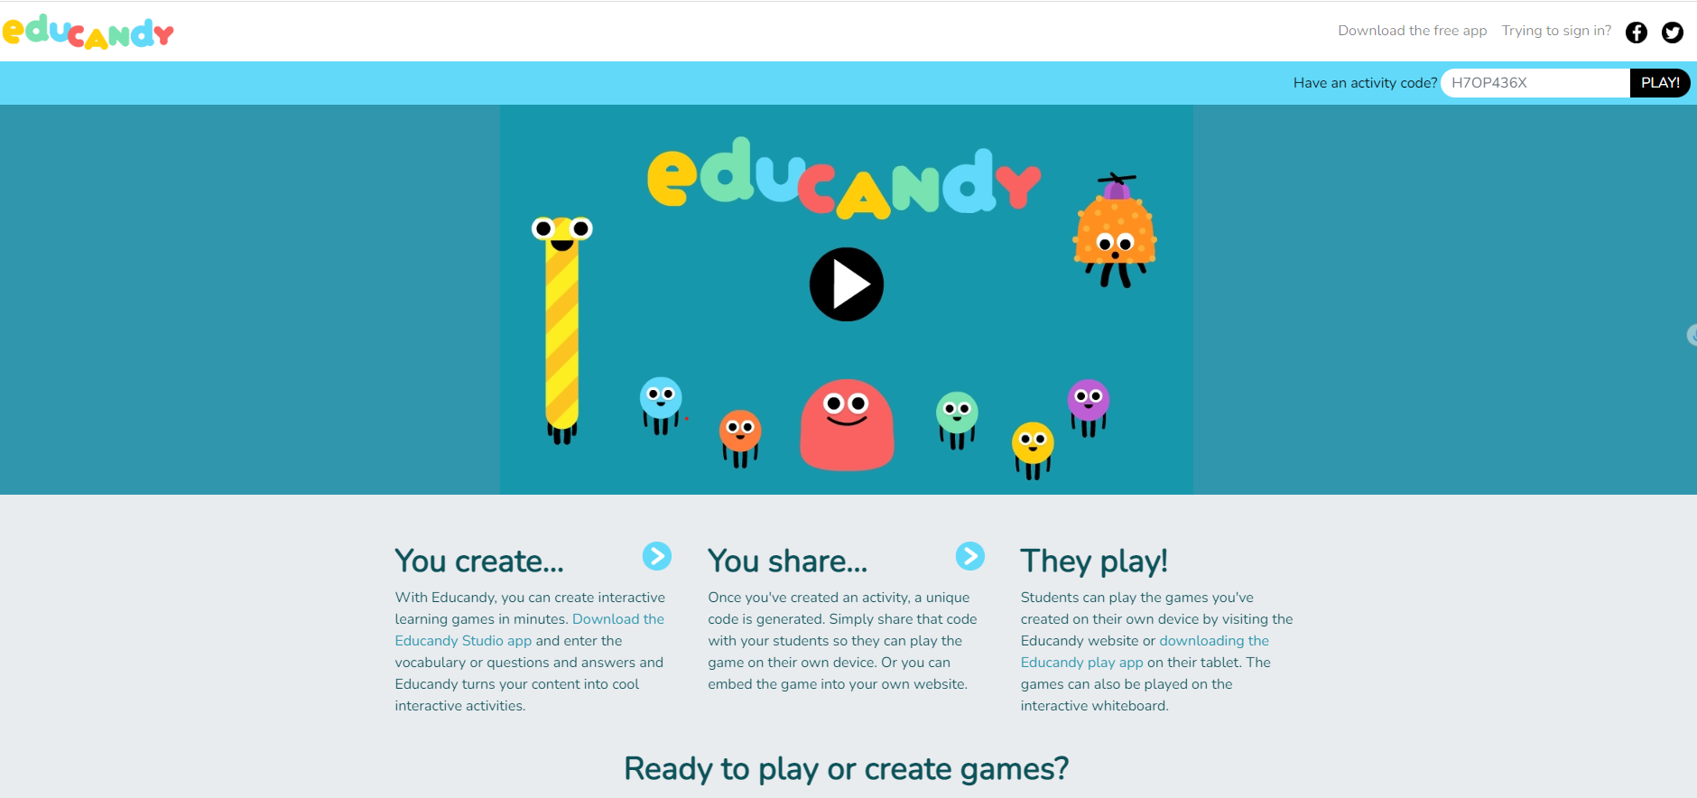
https://www.educandy.com/

Slide 38
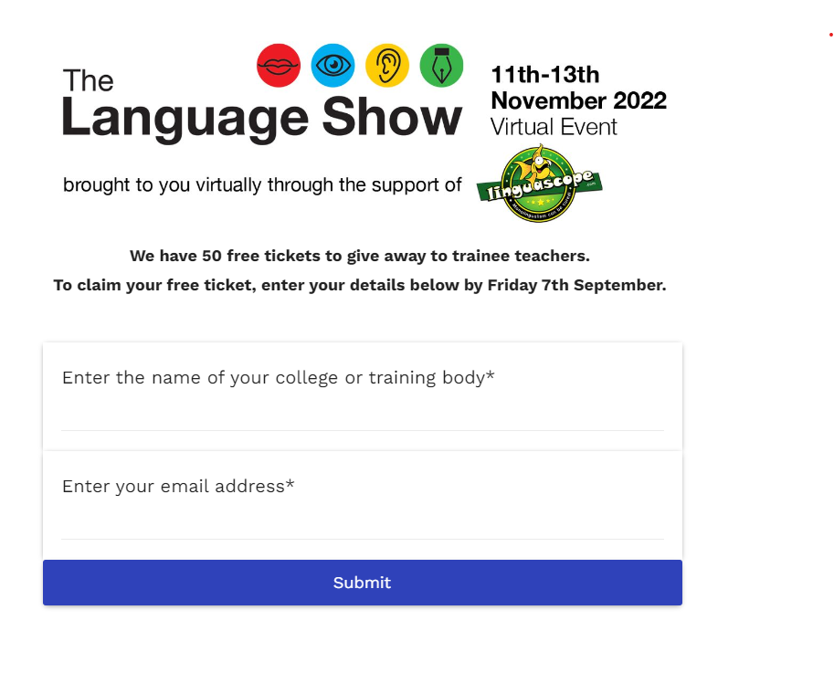
https://langshow.paperform.co/
Featuring:
Friday 11th November
4.45 - 6 pm
ALL London’s Show and Tell!

Slide 39
Thank you for joining us today.
Special thanks to
Dr. Simon Coffey
for hosting this event.

