Slide 1
ALL London Reception for Trainee Teachers 2022
Monday 3rd October 2022, 4:30-6:00pm
6-7 Ideas to Enhance Languages Learning
Julien Violette – Harris Federation
Julien.violette@harrisfederation.org.uk
@HFLanguages / @HFedFrench / @HFedSpanish / @HFedChinese / #MFLTwitterati
STARTER ACTIVITY:
What is your favourite tech/app/website for the classroom?
Notes:
JVI

Slide 2
1 Quizlet – for vocabulary practice
Free for individual teachers (limited classes)
£32/year for full subscription (one per department)
Find ready-made quizzes
Create your own quizzes
Front-of-class activities
Independent learning

Slide 3
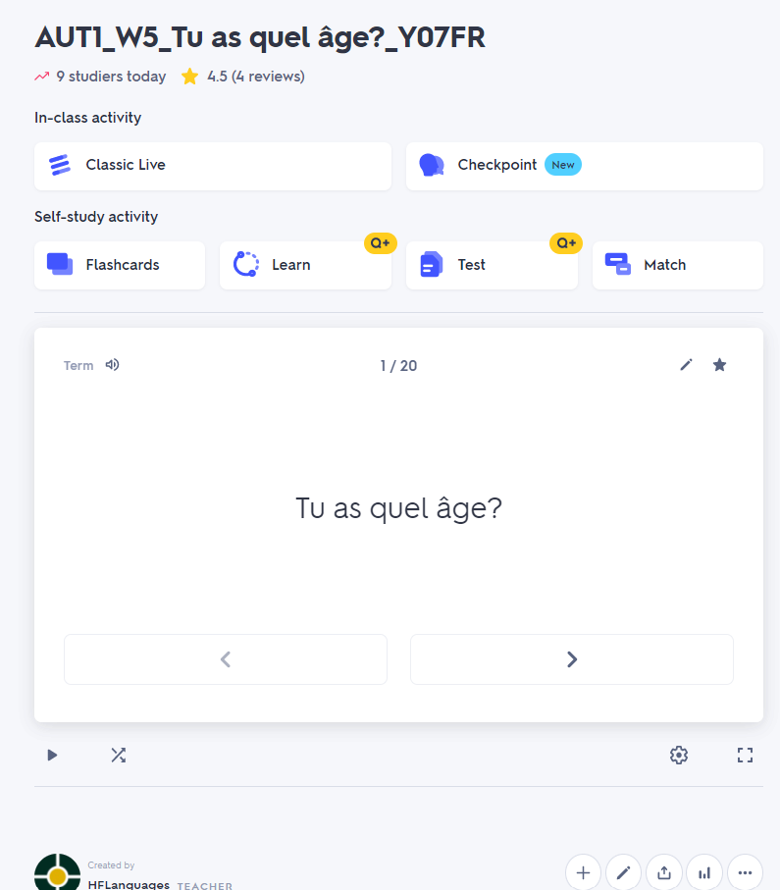
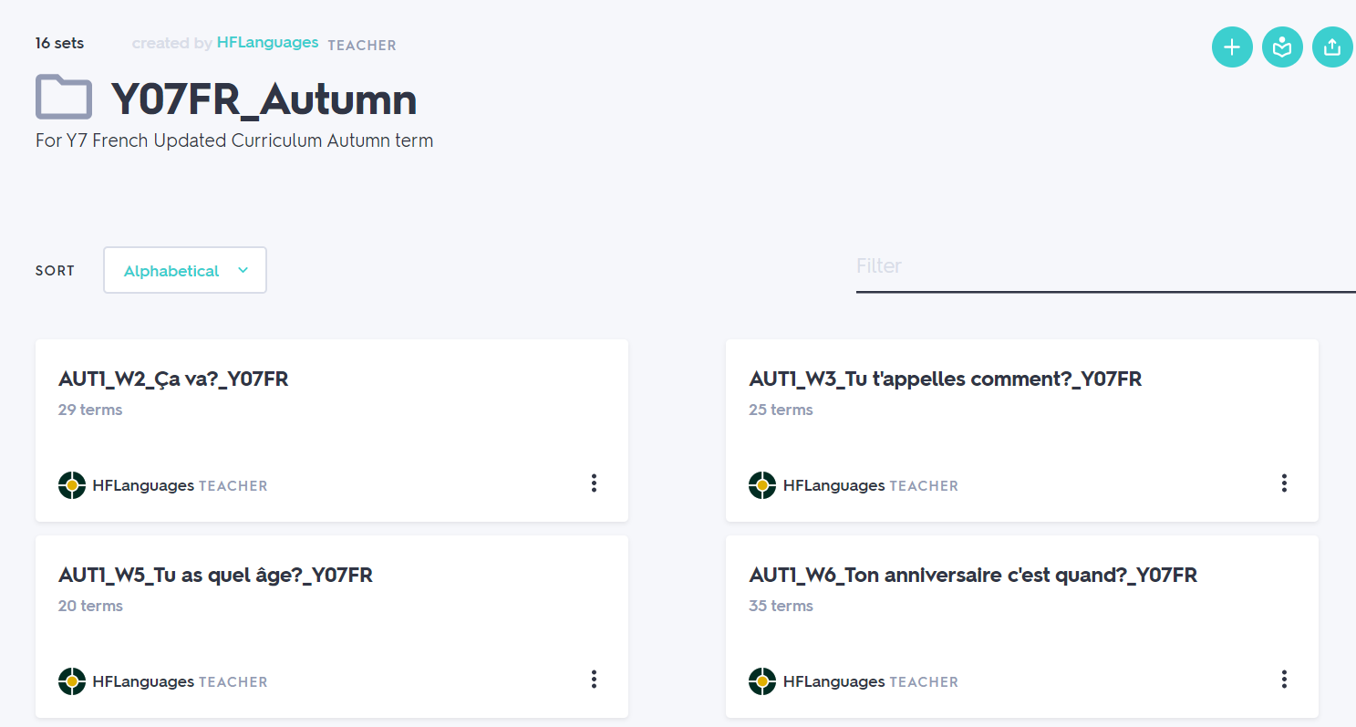
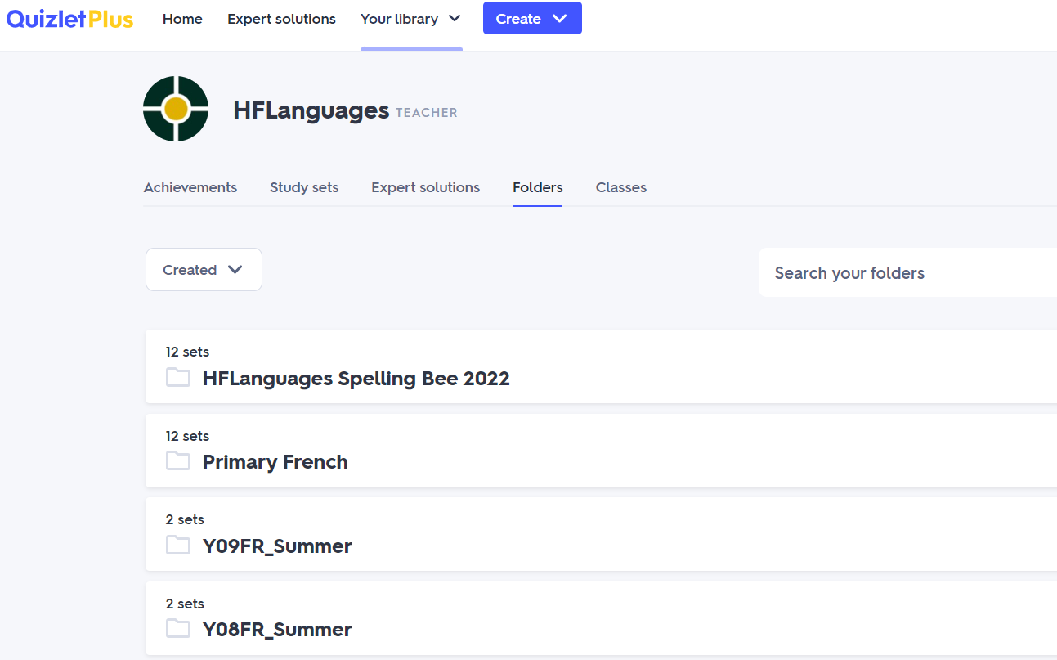
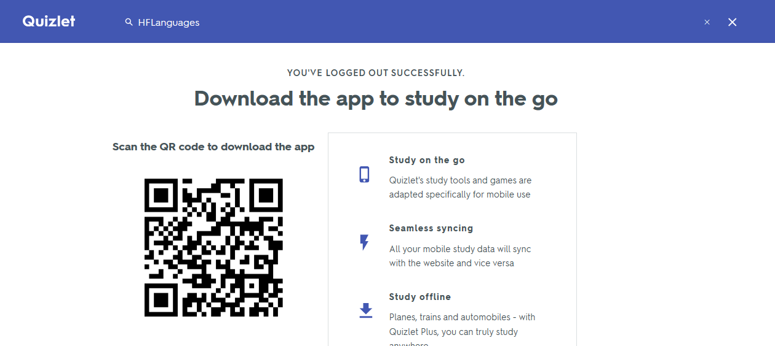
Getting started with Quizlet
Find ready-made quizzes
Save them for your own
Edit/Copy quizzes
Set them to your classes
Track progress

Slide 4
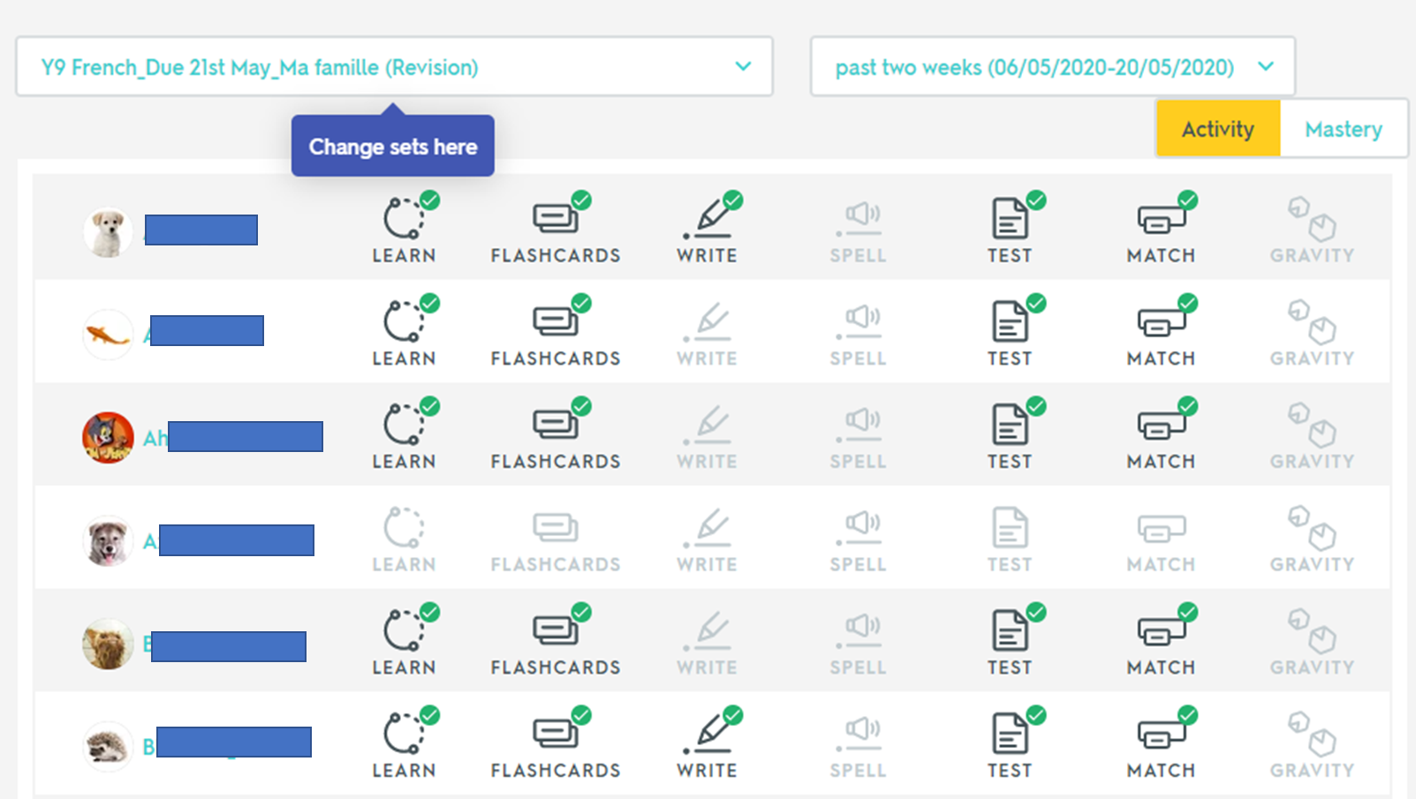
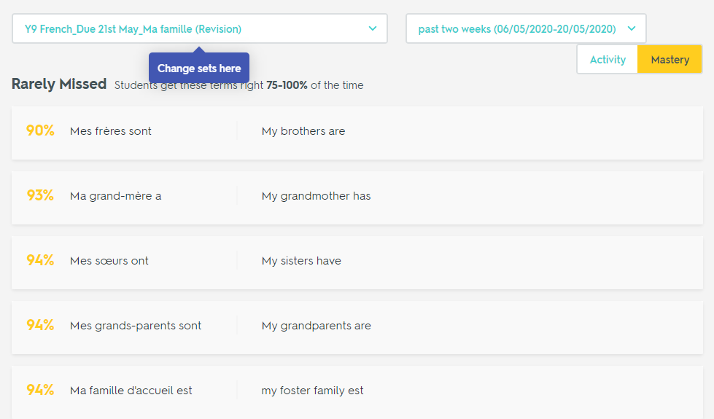
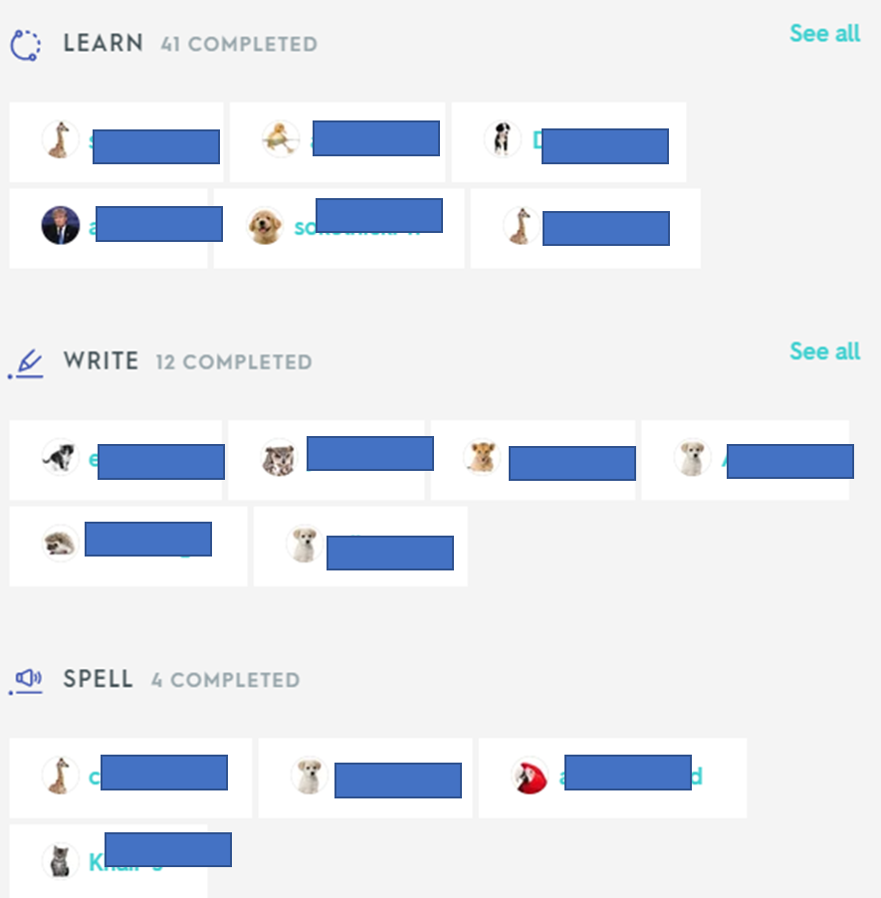
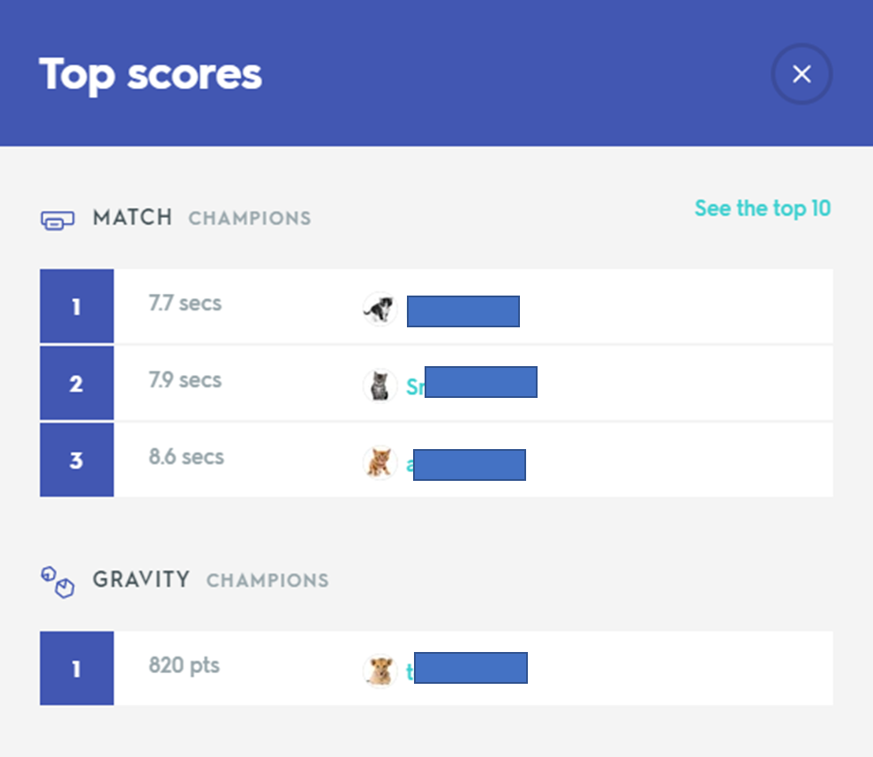
Using Quizlet for homework
Notes:
HABS
Quizlet top tip – everyone using it consistently, compulsory as part of dpt policy, KS3 – only 16 words, KS4 – 20 words (no cognates) (word or chunk-level) (words that can be transferred topic to topic)
High Intensity Retrieval task based on Quizlet – used to be first thing in the lesson every lesson: 8 Eng>Fr and 8 Fr>Eng – pupils cans see their progress between first and second attempt
During Home Learning, Quizlet is used first thing in the lesson

Slide 5
2 Blooket – for assessment for learning
Free for individual teachers (limited classes)
Approx. £65/year for full subscription (one per department)
Find ready-made quizzes or create your own quizzes
Engaging for students, requires no tech for them!
Quick assessment for learning and data collection
Free Individualised QR code cards – no copying!

Slide 6
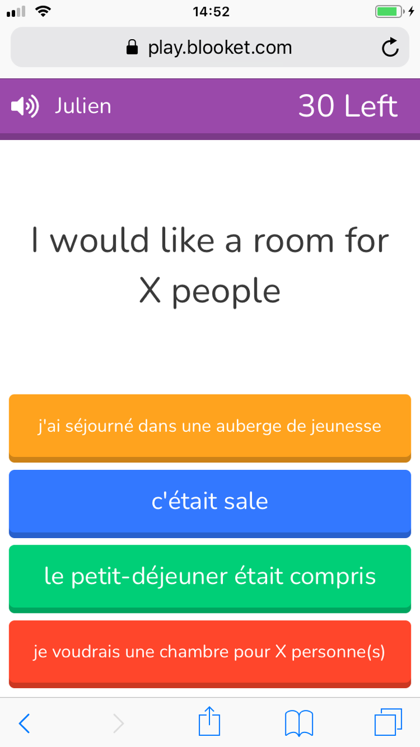
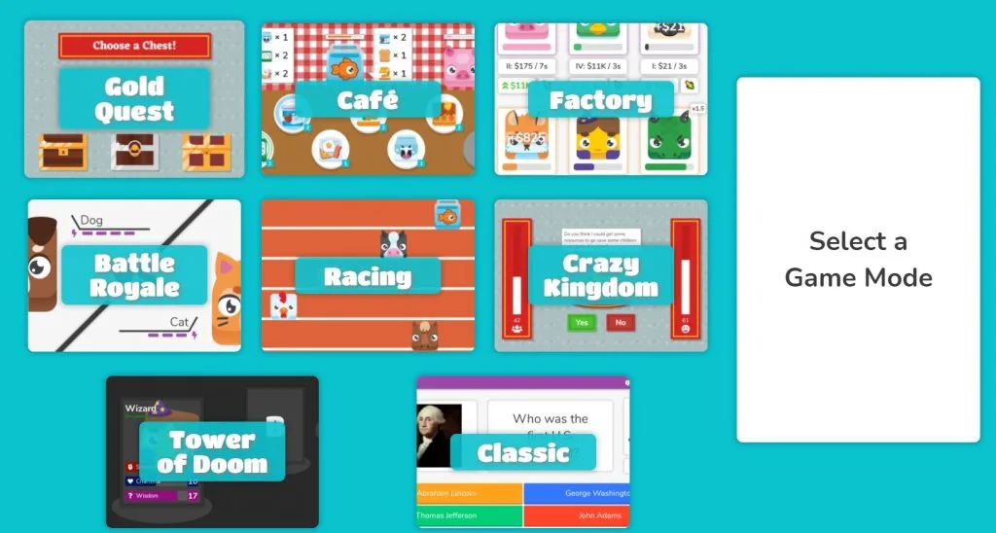
2 Blooket – for assessment for learning

Slide 7
3 Plickers – for assessment for learning
Free for individual teachers (limited classes)
Approx. £65/year for full subscription (one per department)
Find ready-made quizzes or create your own quizzes
Engaging for students, requires no tech for them!
Quick assessment for learning and data collection
Free Individualised QR code cards – no copying!

Slide 8
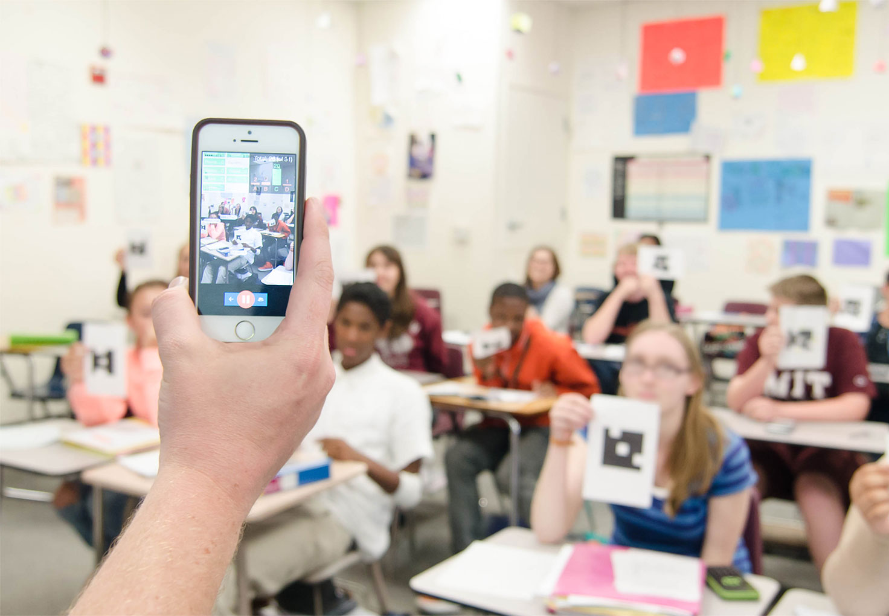
3 Plickers – for assessment for learning

Slide 9
4 Active Learn – for independent homework
Requires subscription
Bank of extra interactive activities for Dynamo, Viva and Stimmt textbooks
Skill practice (Listening, Reading, Grammar, Vocabulary)
Set homework quickly
Automatically marked and generate data

Slide 10
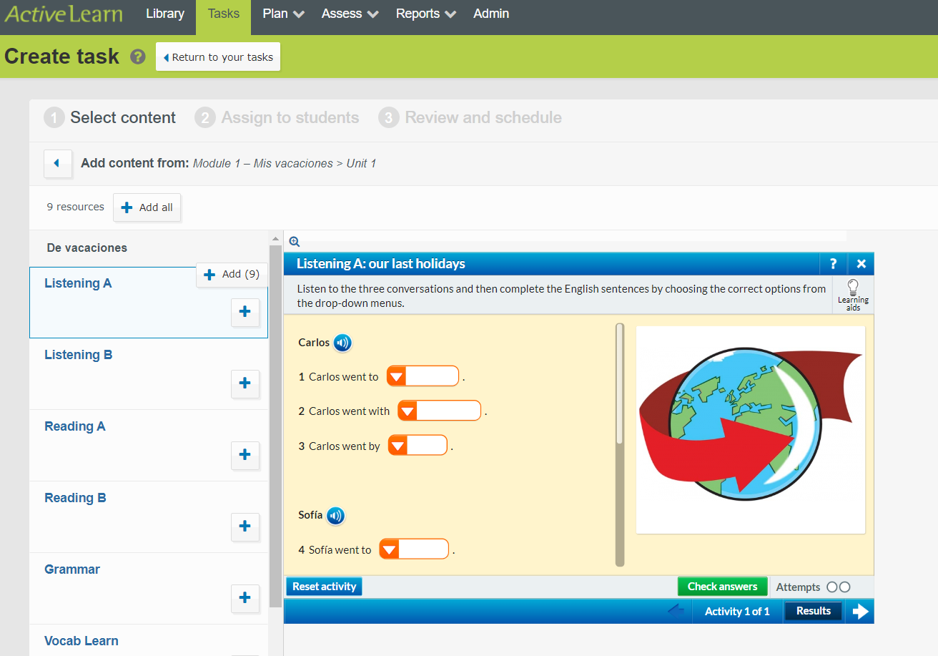
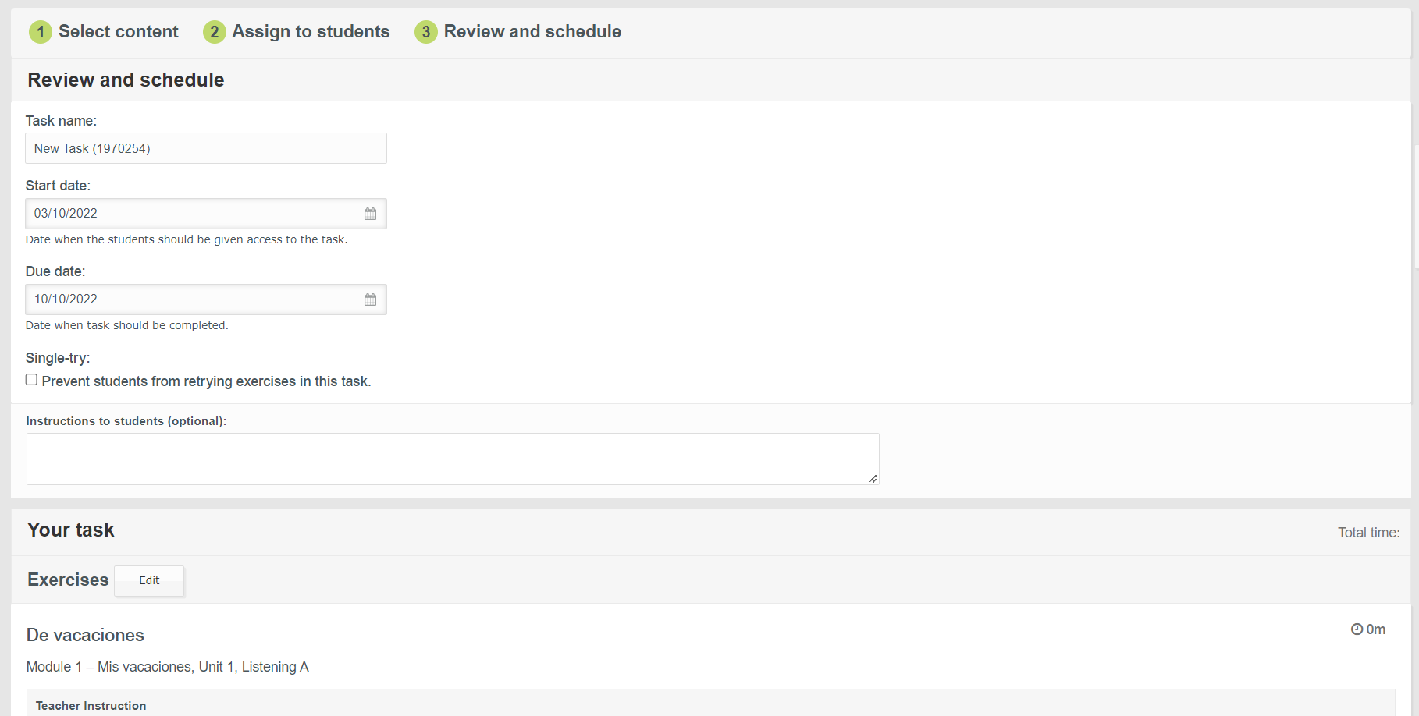
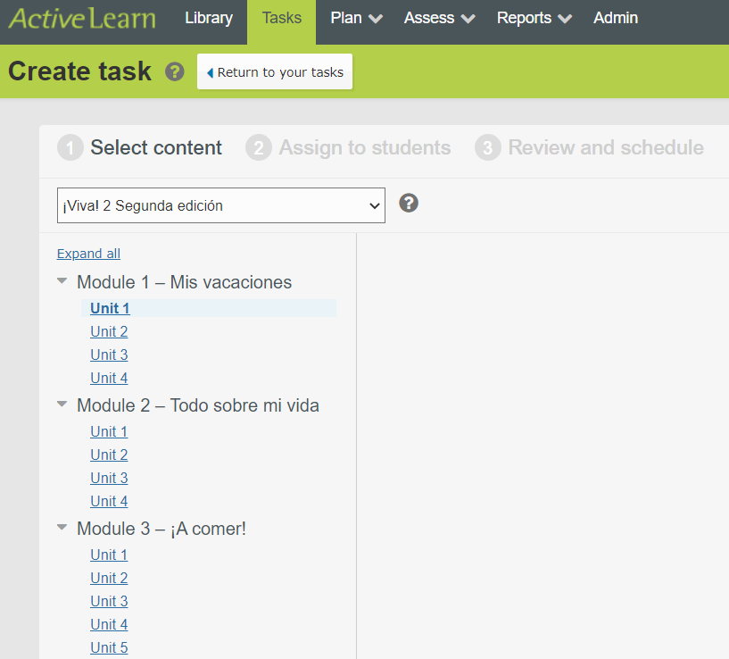
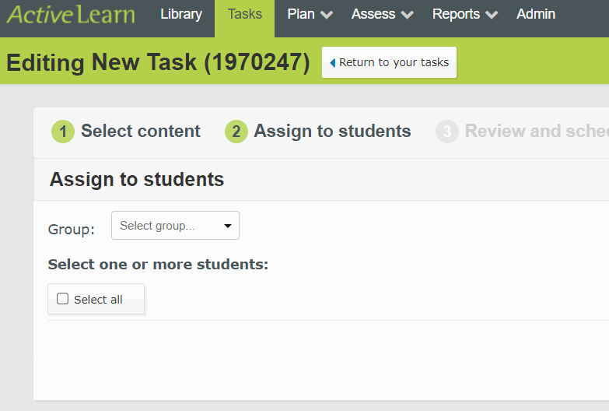
4 Active Learn – for independent homework

Slide 11
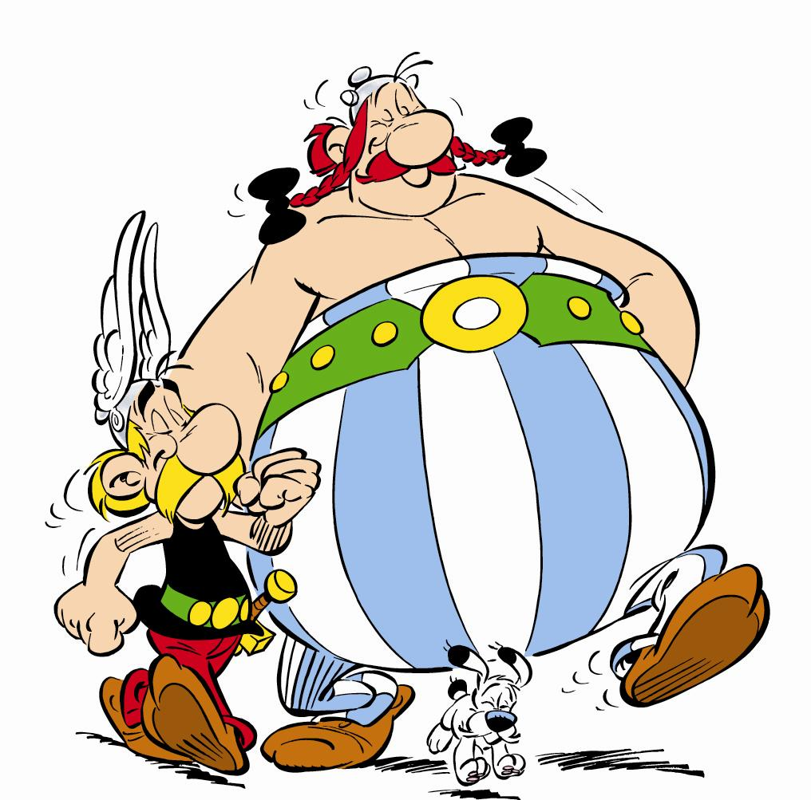
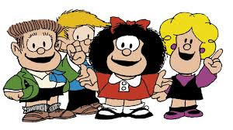
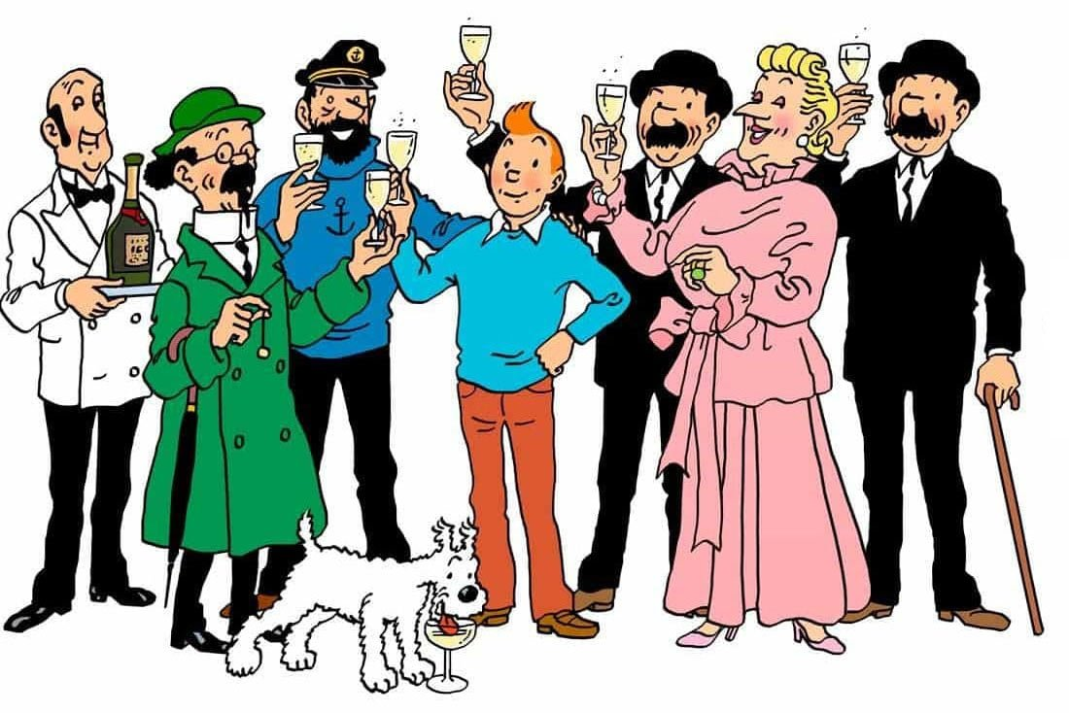
5 Languages libraries
Promoting a love for reading in a foreign language!
Set up a languages section in your library or department
Access a wide range of free PDF books: French / Spanish / Chinese / German
Organise a book collect within staff, friends
Participate in our raffle ticket competition and get your first free book!
Notes:
3 pillars: vocabulary / phonics / grammar
vocabulary: how to chunk the language
phonics: resources coming (Pearson)
grammar: after input, explicit, practice and production, Unlocking languages
love of reading: languages library (Storybooks ; free PDF books ; ideas for purchases)

Slide 12
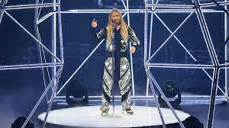
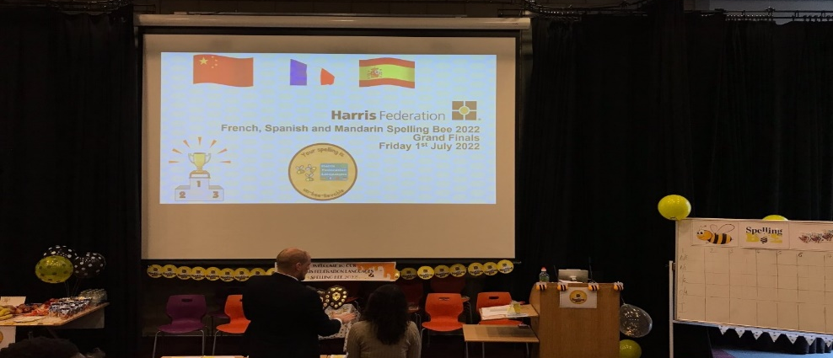
Harris Federation Languages Events and Competitions
6 Languages Competitions
Sept ‘22 - Idiom Calendar Competition
Spring ‘23 – LinguaChef
Spring/Summer ‘23 –MundoVision
Summer ‘23 - Spelling Bee

Slide 13
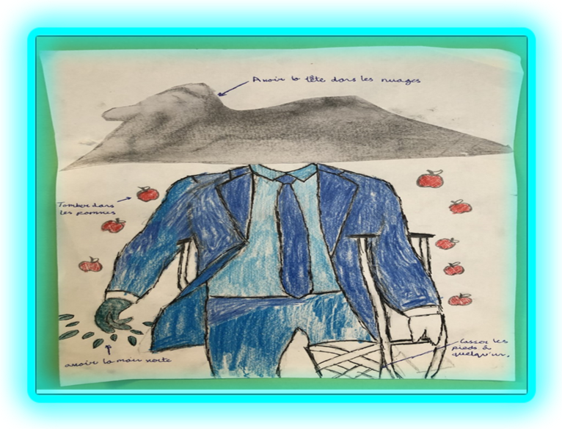
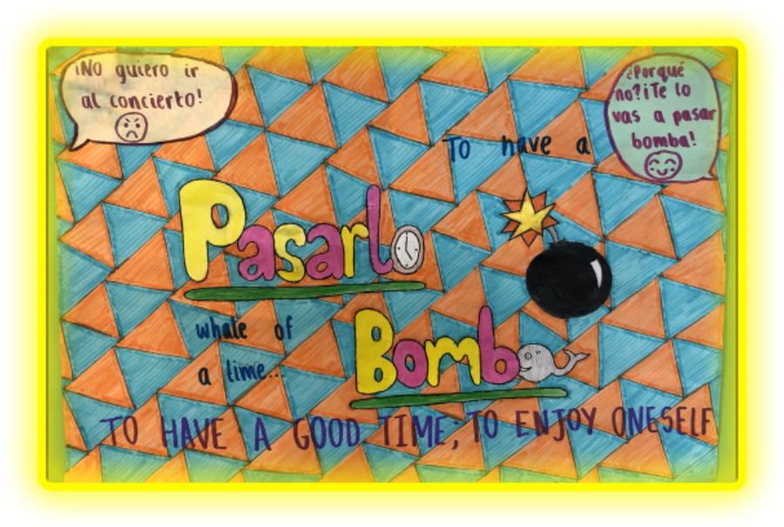
Idiom Calendar Competition 2021

Slide 14
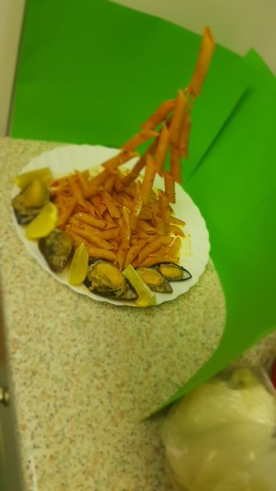
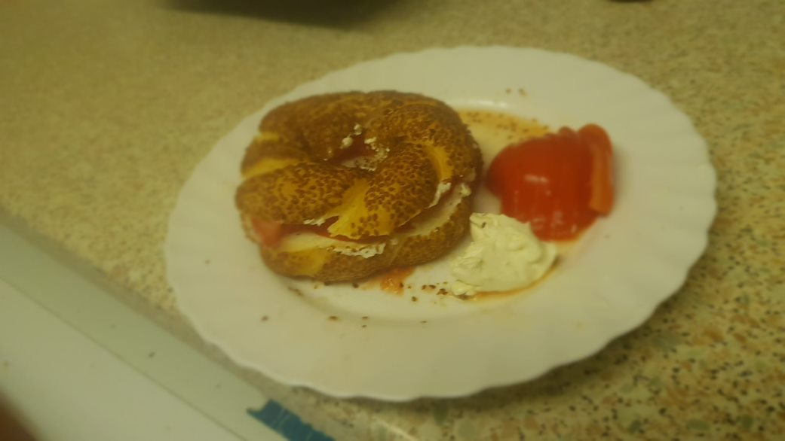
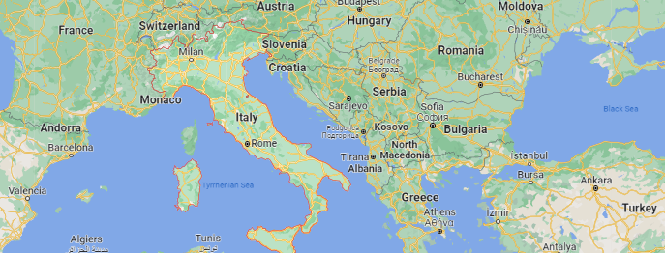
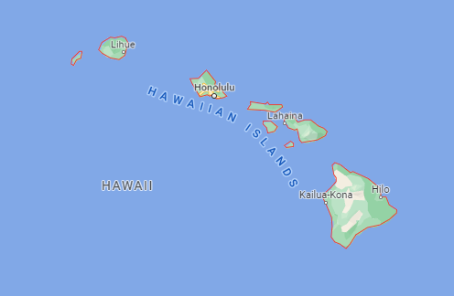
Winners of LinguaChef 2022
Simet ; Mokana; Tanghulu
(Italy; Turkey; Hawaii)
by Yasin
I made 3 dishes. An appetizer is called Simet, it's Turkish and it's like a large bagel with sesame seeds and soft spread and tomatoes.
The main course is called Mokana, it's Turkish but uses Italian pasta with lots of spices, in the shape of an Eiffel Tower because I study French!
For dessert I made Tanghulu fruits - It's a Hawaiian dish of fresh fruit dipped In sugar syrup. Bon appétit!
Notes:
(Y7)

Slide 15
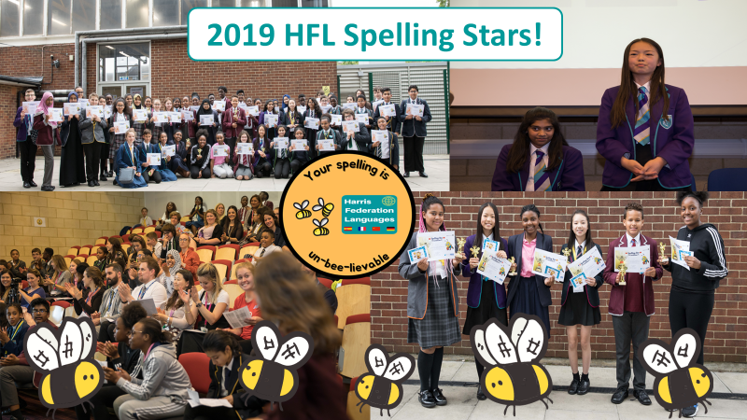
Harris Federation Languages KS3 Spelling Stars 2022
What? Where? When?
Grand prizes
for our
Top 3 Academies!
Harris Spelling Stars!
Revise on www.quizlet.com (search for “Harris_MFL” and join the Spelling Bee class ☺)
#HFLSpellingStars2022 #HarrisFederationLanguages #HarrisBuzzingAbout Spelling #HarrisBeeAStellarSpeller
#DeletreaConNosotros #ÉpelleAvecNous #Hé wǒmen yīqǐ zuò fàn #BuchstabiereMitUns
Notes:
Print in Greyscale or B/W, as needed

Slide 16
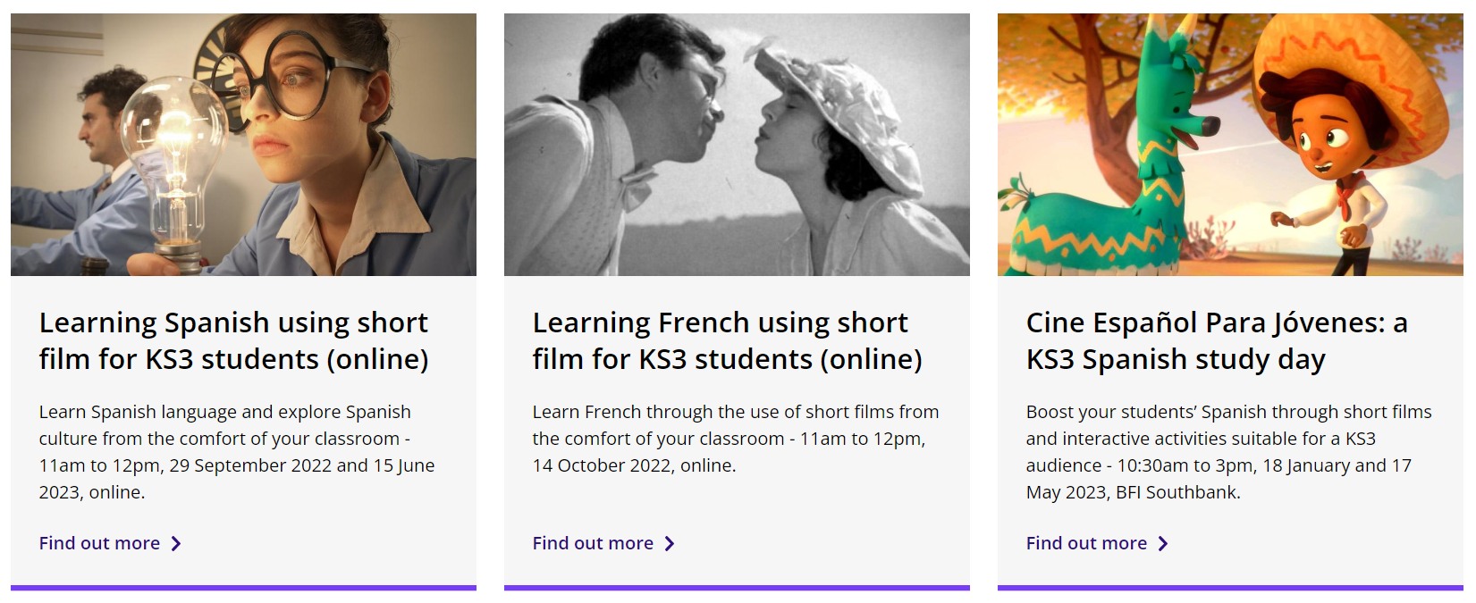
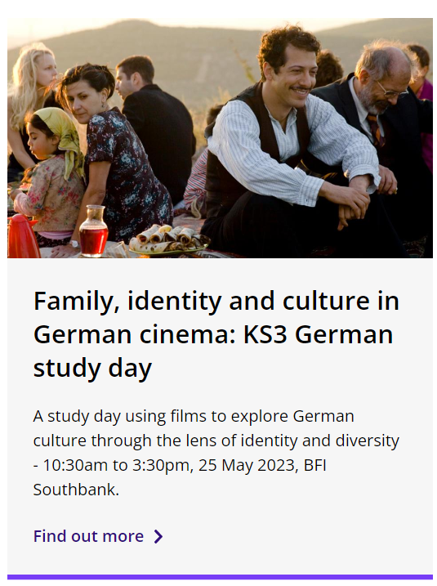
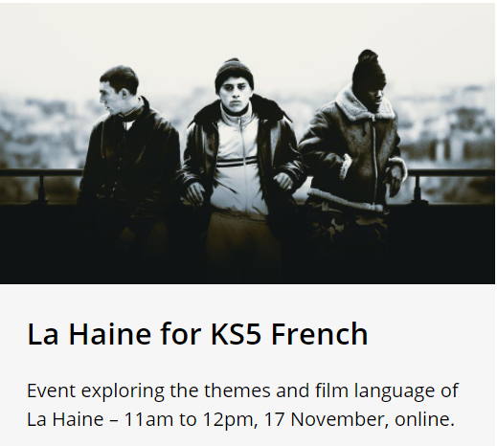
7 Easy trips – British Film Institute
One-day / half-day trip
Usually £10 per student
Online or in-person
Central location
“Well-structured”
“Engaging”
“Memorable”

Slide 17
ALL London Reception for Trainee Teachers 2022
Monday 3rd October 2022, 4:30-6:00pm
6-7 Ideas to Enhance Languages Learning
For questions or resources query, email:
Julien.violette@harrisfederation.org.uk
@HFLanguages / @HFedFrench / @HFedSpanish / @HFedChinese / #MFLTwitterati
Notes:
JVI

